Slide 1
Democratizing Insights: Empowering Business Users with Intuitive Data Modeling in Power BI
Ikechukwu “Ike” Edeagu

Slide 2
Navigating the Analytics Highway

Slide 3
The Analytics Journey
Gather
Clean
Model
Visualize

Slide 4
Data Modeling | Problem
Conceptual Hurdles
“As a Power BI analyst, I find it challenging to understand how to create and manage relationships between different tables in my data model.”
“I struggle with the concept of date tables in Power BI. I don’t know how to create them, how to link them, or why they are essential.”
Good data modeling in Power BI requires expertise that many users do not have.
Resolving Issues
“When I create data models, I struggle to identify inefficiencies that impact report performance. I need better tools or guidance to help me identify and resolve these issues”
Users with “faulty” or “inefficient” data models don’t have any guidance on how to identify issues and resolve them quickly.
“I frequently encounter errors in my data models, and I’m not sure how to diagnose and fix them. These errors disrupt my reporting process and lead to inaccurate insights.”

Slide 5
Data modeling is the vehicle engine. What is the mechanic for the data engine?
Data Modeling | Solution
ASSISTED
MODELING

Slide 6
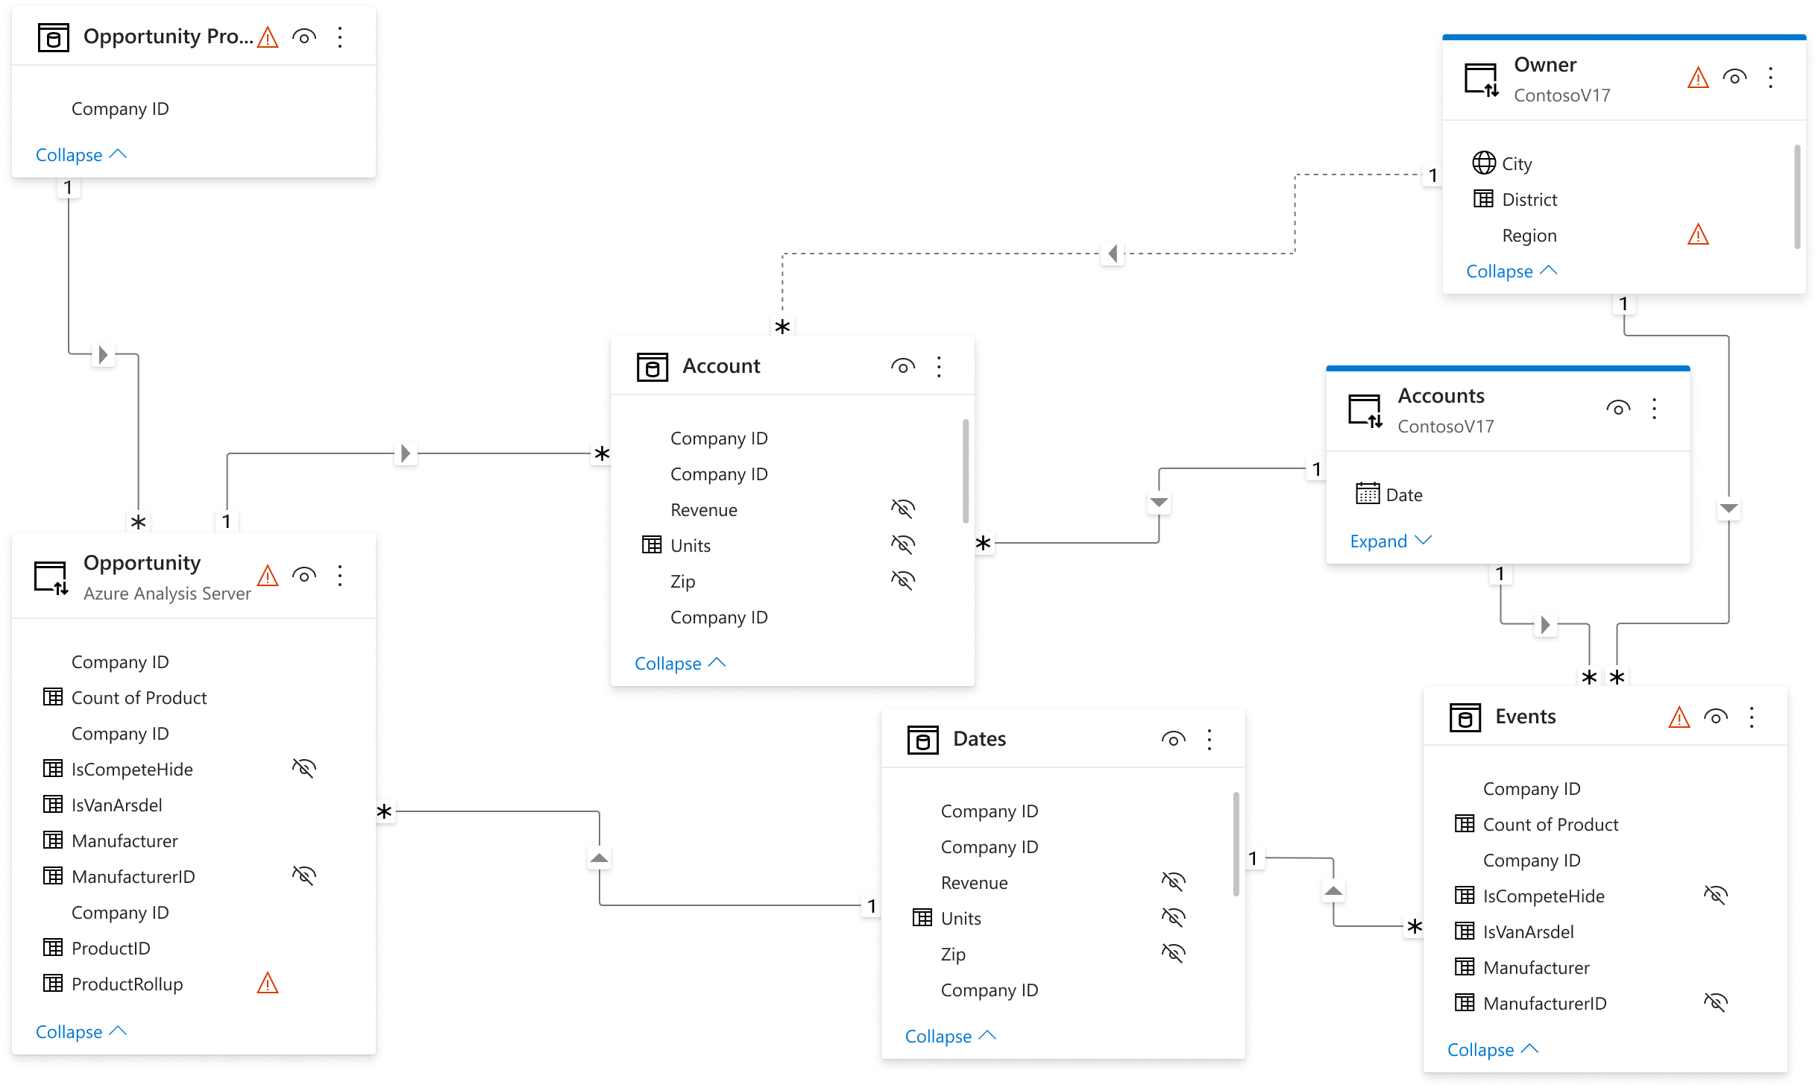
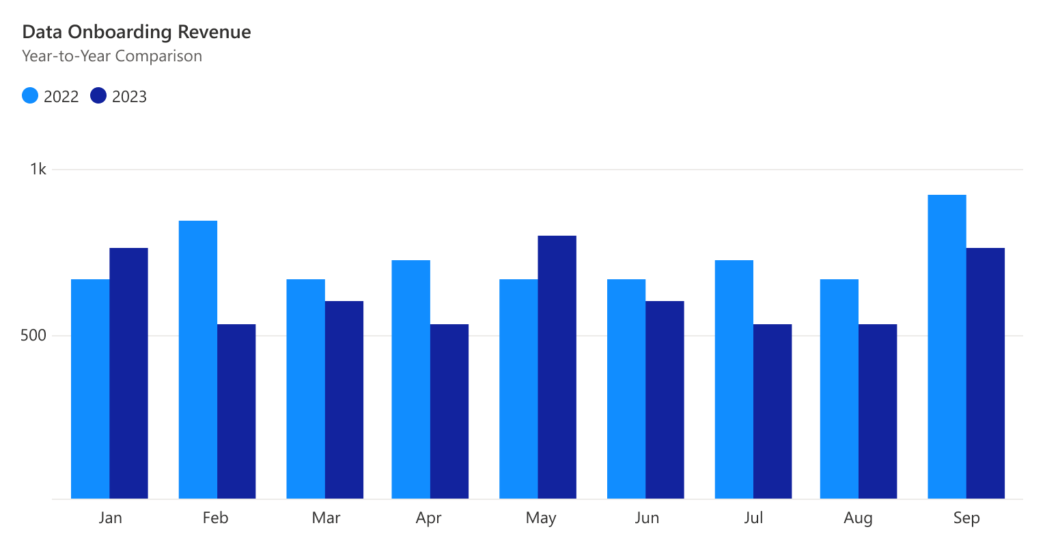
Assisted Modeling | Mission
Enable everyday users to create amazing reports through simplified data modeling experiences
Data
Insights
Assisted Modeling
Model Schema
Date Tables
Data Properties
Table Relationships

Slide 7
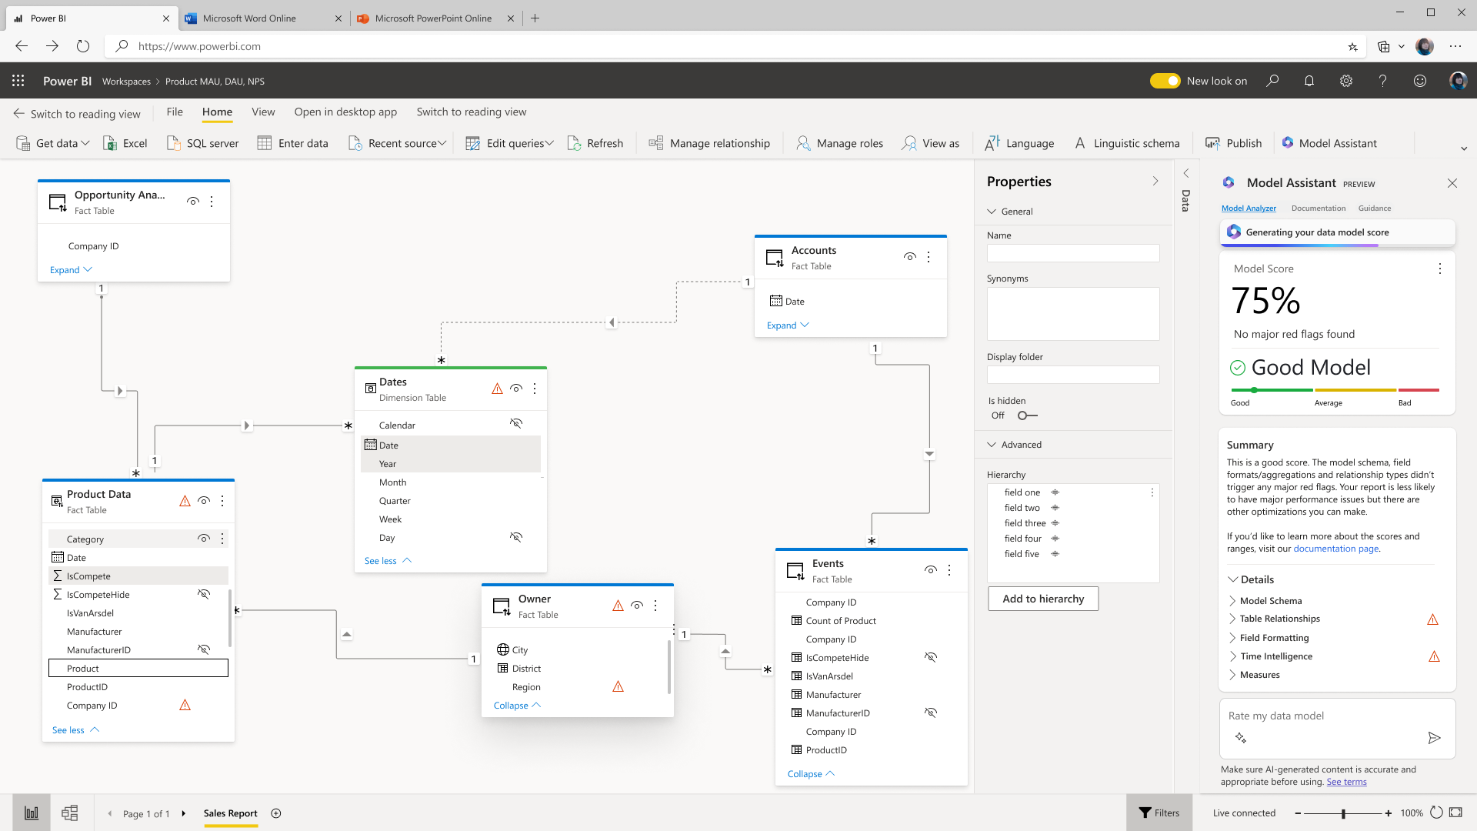
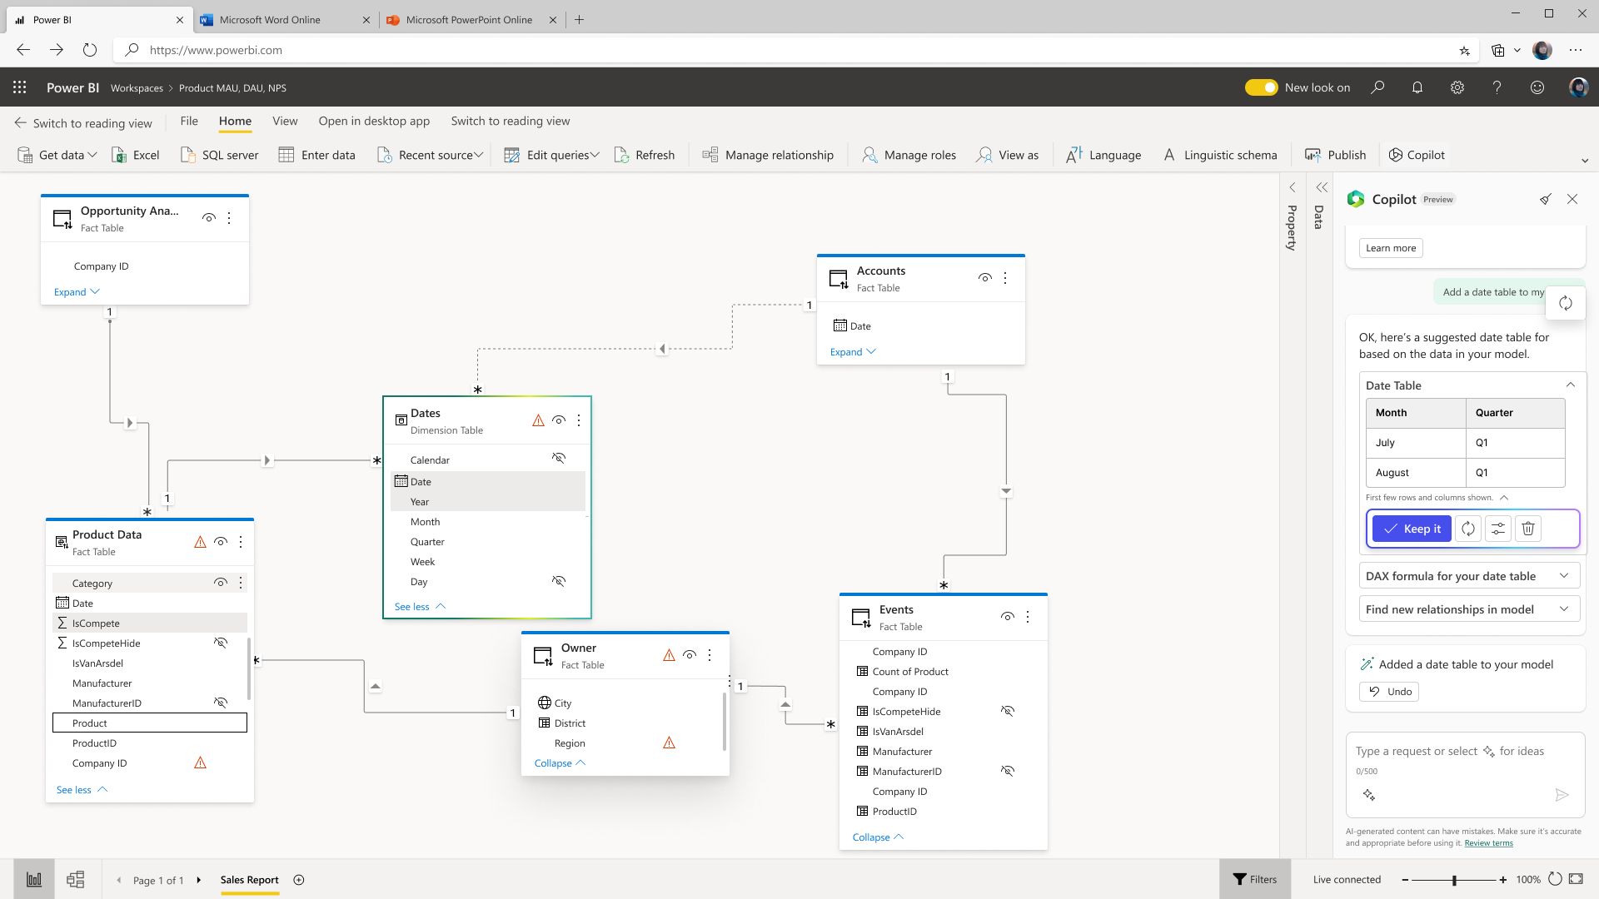
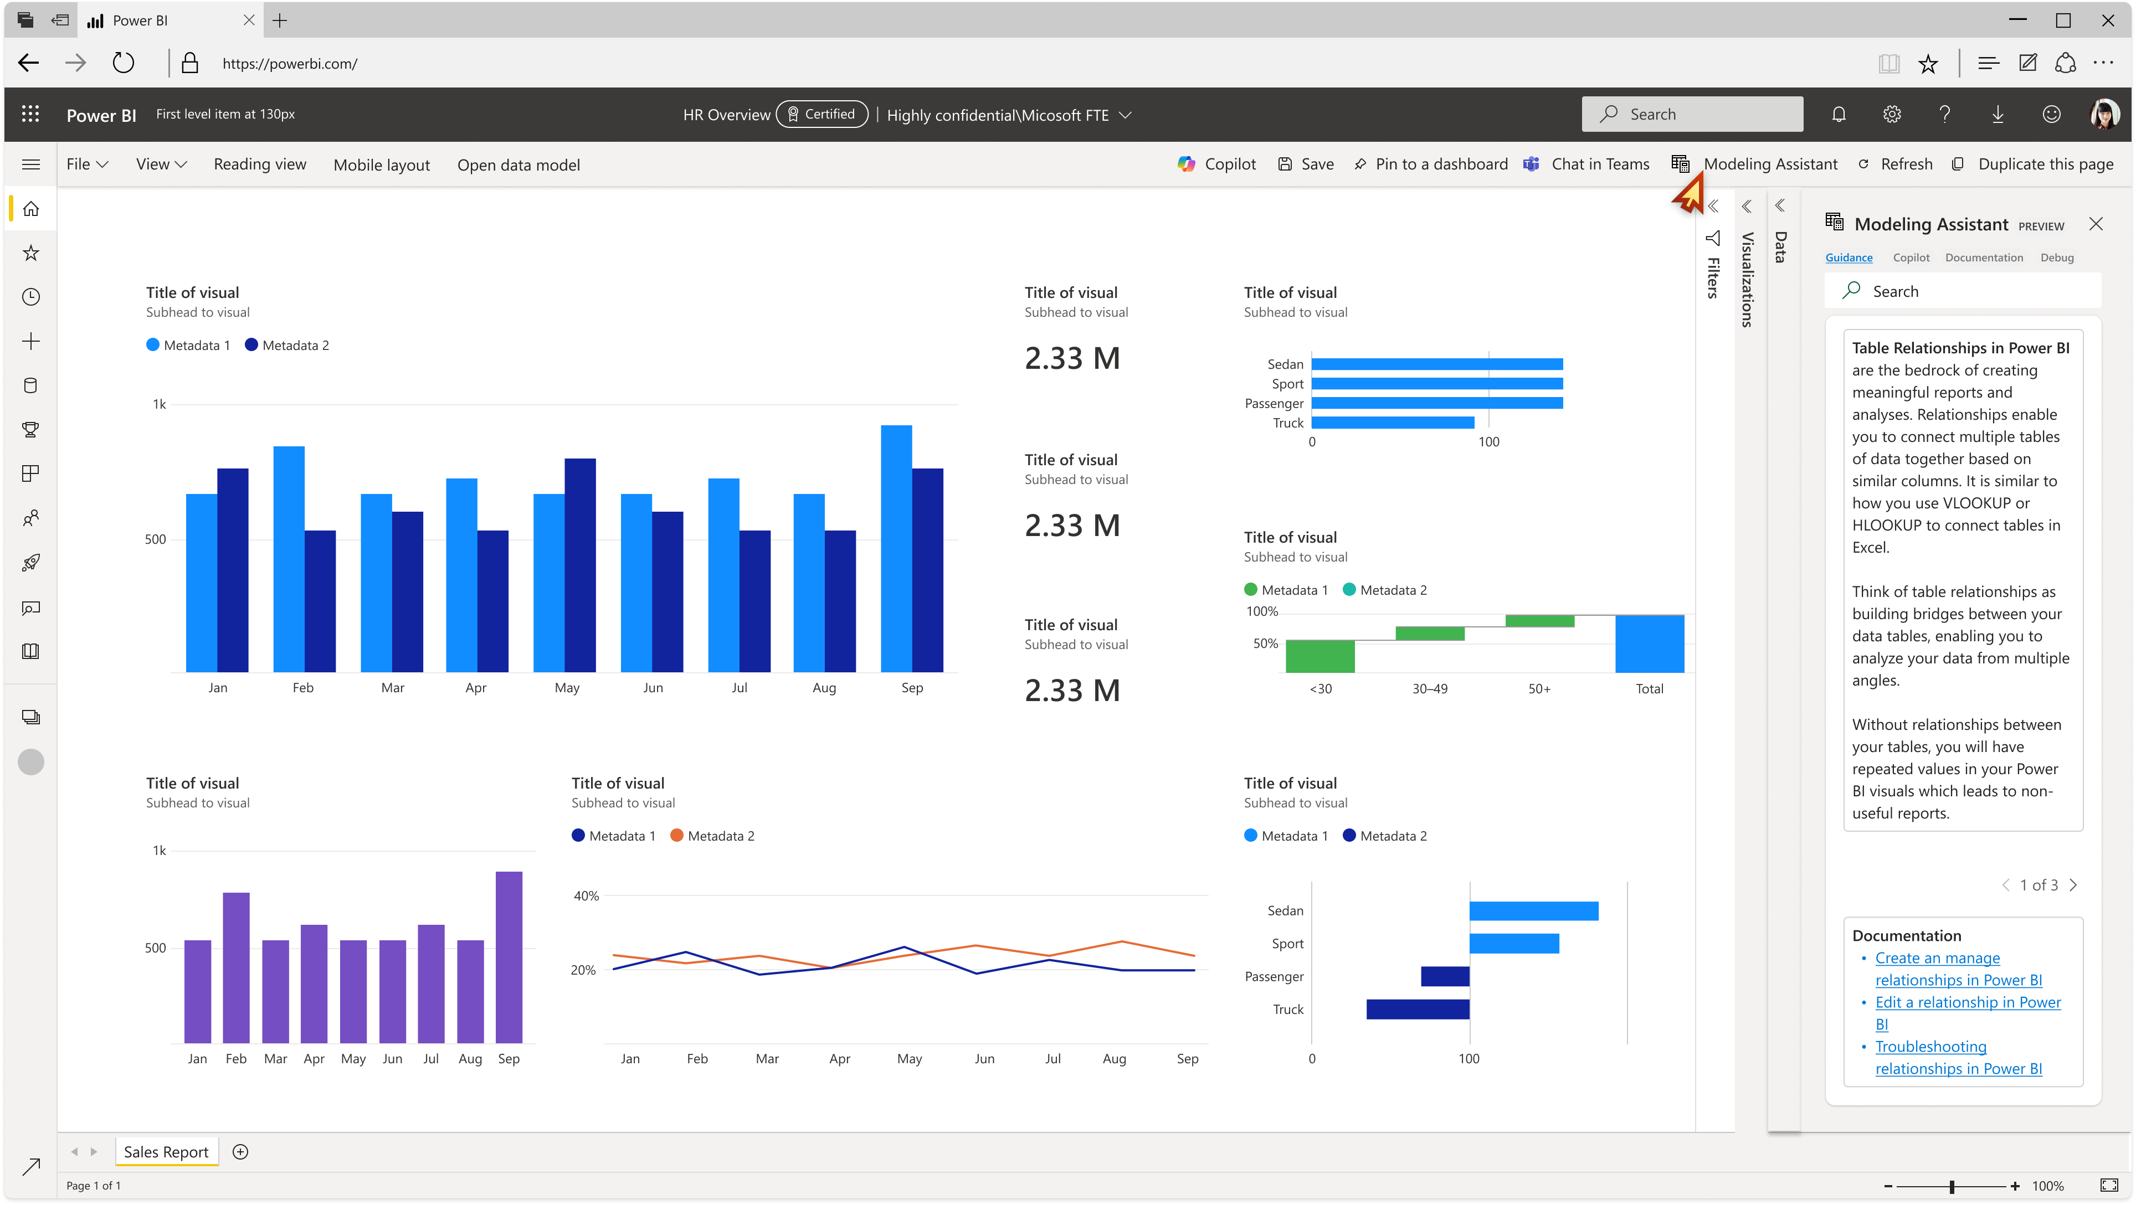
Assisted Modeling | Vision and Strategy
Help millions of information workers to seamlessly navigate complex datasets and transform them into meaningful insights
AI Experiences
Integrated Learning
Guided Modeling

Slide 8
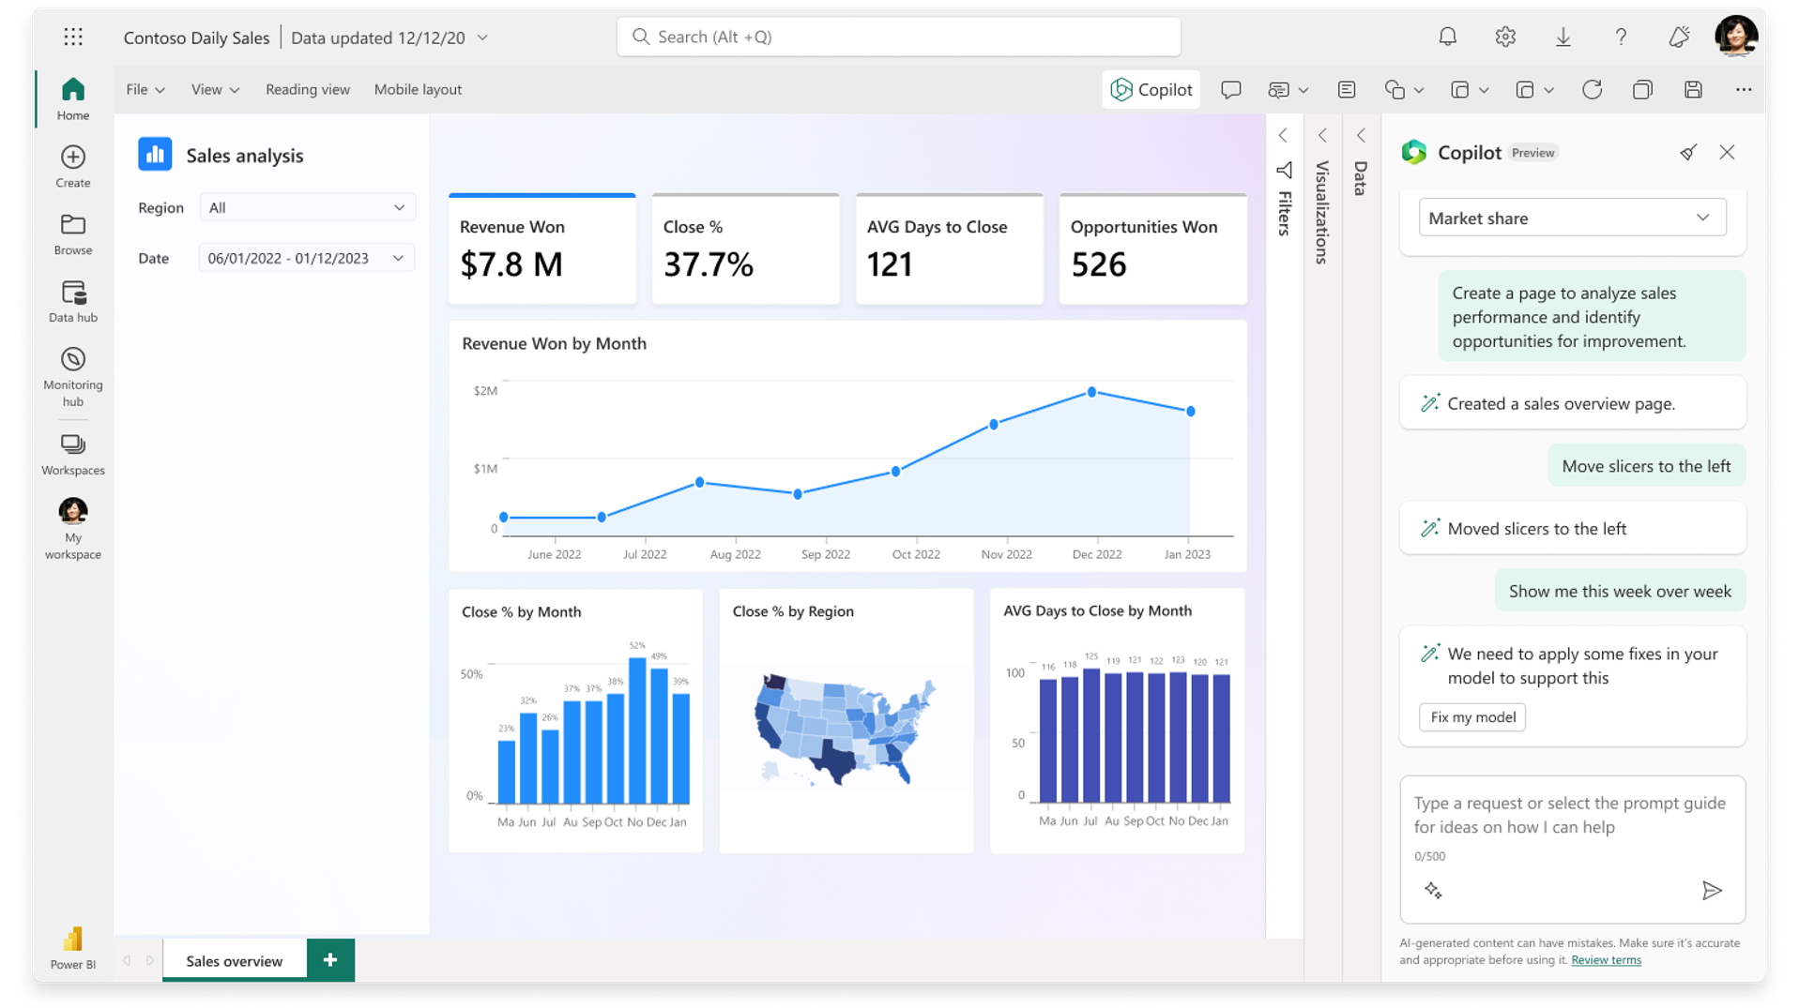
Assisted Modeling | Model Improvements for Copilot

Slide 9
Assisted Modeling | Model Analyzer

Slide 10
Assisted Modeling | Fundamentals
Our first goal is making fundamental modeling features in Power BI work seamlessly
Relationship Detection
Build Date Tables
Web Data Connectors
Improve the relationship detection algorithm to make it easier for users to find connections in their data
Enable users to create and edit custom date tables in Power BI without writing DAX
Ensure users can connect to their favorite data sources in the web to build insightful Power BI reports

Slide 11
Demo
Create a Power BI report in the web from Excel

Slide 13
Demo
Create a Custom Date Table in Power BI Desktop

Slide 14
Questions?
Notes:
10 min

Slide 15
Session evaluation
Event evaluation

Slide 16
Platinum partners
Goud partners
Zilver partners
Brons partners
Community partners

