Slide 1
Share branded & secure:
Distribute Power BI reports within and beyond your organization
Niki de Leeuw & Martijn Giltay | Saturday, March 9, 2024
Notes:
Text Martijn:
Welcome everyone
Who in the audience faces or has faced challenges with sharing reports?
Who has used or uses WDB? If someone has used it, ask why,
Ask who has heard of webdashboard before.
Ok, we are here to inform you about sharing with PowerBI and how to overcome hurdles when using the product: webdashboard.
We will take you through the world of PowerBI focusing on how to share your reports and why it is so important.
Feel free to ask any questions during or after our presentation.

Slide 2
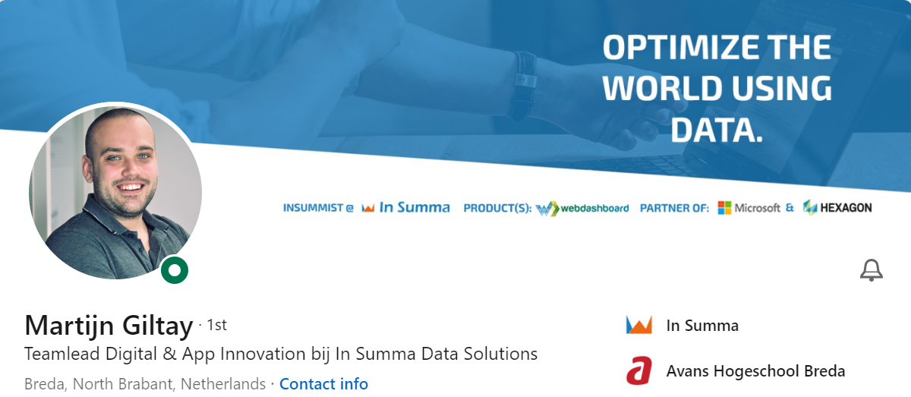
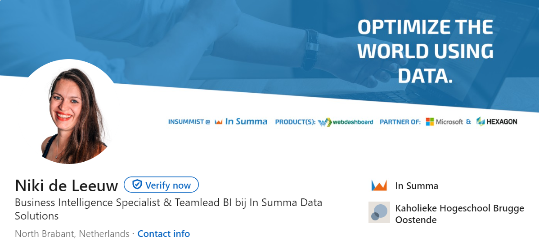
About us
Notes:
Hi Im Martijn Giltay, and i have been working with in summa for over 8 years now, Im a software engineer and did serveral projects over the years inside and outside the company insumma. In 2017 we desided to start a deticated development team to assist our powerbi specialists and build our own products. I have been part of this team since that time.
Hi, I’m Niki de Leeuw and I’ve been working with In summa for 6 years now as a BI specialist.
And that’s also the time I have been working with PowerBI.
Most of my days I spent working with PowerBI, besides that I also furfill the role of operational account manager and projectlead.

Slide 3
Microsoft solution partner since 2003
Business Intelligence
Custom software development
Notes:
Niki
So who or what is In Summa?
In Summa means get everything together.
Get everything together is what we do with data and then we turn it into information.
We build Business intelligence solutions for our customers, which we have been doing since 1998.
In our solutions we rely on Microsoft technology.
We are passionate about Microsoft and are Microsoft solution partner since 2003.
Our solution areas are Data & AI and Digital& App innovation
We work hard to keep our standards high to make sure we stay solution partner for Microsoft.
As soon as PowerBI came to market in 2015 we adopted it into our everyday work.
Like Isaid, we try to work with Microsoft whenever wherever we can.
It does happen though, We receive questions from our customers, we cannot answer with the standard Microsoft software for BI.
Therefore we also have a very skilled Software development team working with us at In Summa.
Everything the BI team can not fix, our software team picks up on, all to make sure we help our customers as good as possible.

Slide 4
Our customers’ struggles (2015-2016)
Share reports with users
Share outside your organisation
Navigation and user friendliness
Branding
Notes:
Martijn
As Niki just told you, every non-standard question gets redirected to the software developers, of which I am one.
So, what did we encounter, when PowerBI came to market in 2015?
We work close with our customers and early adopted PowerBI into our Business Intelligence solutions.
Together with our customers we discovered some challenges.
One of our customers is a very large accountancy & legal advice office.
There wish was to share there reports with over 30.000 users.
Because of the sensitive data, this offcourse needed to be completely safe and customers could not be able to see other custsomers data.
Then there was an internal customer, our own CEO.
A report was created for him to see how the freshly installed solar panels on the roof of our office where doing.
He asked us why he could not simply be on the reports he needed within 2 clicks.
Navigation drove him (even more) crazy.
Another customer talked to us about sharing outside of PowerBI online.
They wanted to share on there internal portal and wanted the reports to totally have look and feel of a website.
Fully branded in their own colors, fonts and logo.

Slide 5
Custom development
Custom software development
Pattern of similar challenges
Can this be done easier, faster and more costefficient?
Notes:
Martijn
For all those questions, custom development was the solution at the time.
A costly event for customers.
More and more of our customers came to us with similar problems.
And our software developers started seeing a pattern in the solutions they were building.
Can this be done easier, faster and more costefficient? We asked ourselves

Slide 6
YES, it can! (2017)
Development on reporting portal
Focus group
Desired features
Sync Azure Entra (AD)
Homepage
Close a report (temporarily)
Branding
Navigation speed
User friendliness
Sharing easily
Sharing outside the organisation
What now?
Notes:
Martijn
Development was started on a standard solution for the struggles our customers encountered.
A focus group of developers and customers was formed.
A monthly meeting with this focus group gave insights on desired features.
**** Talk about the list of features in the slide*****
To continue development on a reporting portal and to be able to create the desired features, we needed to know all about PowerBI licensing and security.
How does licensing work?
What are the options?
And are we allowed to work on a reporting portal on any of those licencing types?
As a Microsoft Gold partner, (at the time, now better known as solution partner) we seeked collaboration with Microsoft to look for solutions on these struggles and answers to our questions.
Ending up in Israel, we found the PO of Microsoft Power BI and learned more about licensing. We will share this knowledge with you later on in the presentation.
Off course we will tell you about your options for licenses now a days, not the ones in 2017.

Slide 7
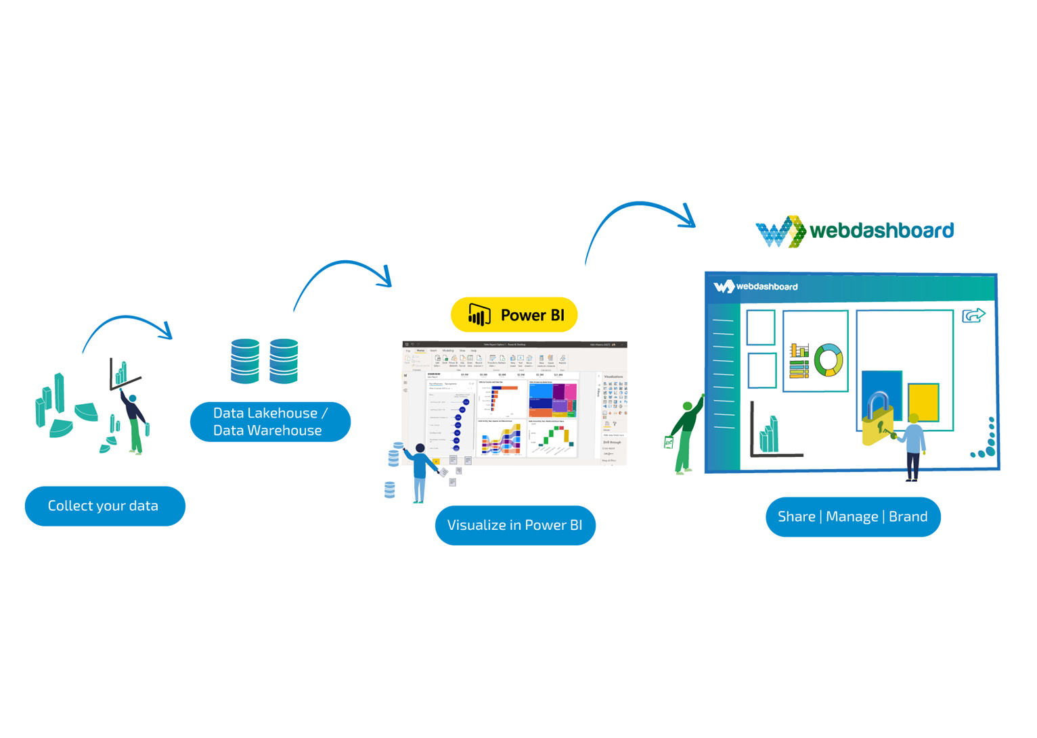
Power BI environment
Share
BI Specialist
Data modeler
Data analyst
BI Specialist
Viewer
BI Specialist
Developer
Data analyst
Ceo
Manager
Customer
Supplier
Report designer
Report manager
Notes:
Niki
When developing a product, it is important to look at the problem the product is solving but also the people you are solving it for.
To do so, we looked at the desired features from the focusgroup and we looked at the PowerBI environment.
When you are creating a report, several steps need to be made by different roles.
Data needs to be collected from datasources
Data needs to be cleaned, you want to combine sources and create a data model.
And then you can create a Power BI Report.
When ready, you want to share the report to the endusers.
The actual people that need the information from the report to do their day-to-day job.
When looking at Microsofts focus area, we found that they create fantastic tools for the first 3 steps in this environment.
All executed by the BI specialist in an organization.
But looking back at the desired features our customers wanted, we saw most of them are related to the last step in the environment: sharing with your viewers.
We decided our reporting tool should be focused on the viewers perspective, as it is not Microsofts focus.

Slide 8
was born (2018)
2017 Started with development
2018 Launch
Our philosophy is simple: Ensure that viewers can always navigate to where they want to be within two clicks.
Share with anyone (with an email address)
Branding (it feels like your own)
White label (app.yourawesomecompany.com)
Notes:
Niki
So these steps were made in 2017.
In 2018 after about a year of development and many feedback sessions with the focus group, the reporting tool was launched and Webdashboard was born.
Our philosophy is simple: Ensure that viewers can always navigate to where they want to be within two clicks.
It should be able to share reports with anyone securely who has an emailadress.
It is easy to locate your reports and, at the same time, personalize them to reflect your own brand identity.
The icing on the cake is that it can also be fully branded under your own company through whitelabeling.

Slide 9
App fabric
BI Specialist
BI Specialist
Viewer
BI Specialist
Notes:
Niki:
Going from 2017 fastforward to 2024
Looking at the PowerBI environment now, we see the similar picture as before, but with new tools.
We welcomed Fabric in the Microsoft PowerBI environment.
In May 2023, Microsoft App Fabric became available for free in preview mode. In November 2023, it was fully released.
Fabric is the all-in-one analytics solution, that covers everything from data movement to data science, Real-Time Analytics, and business intelligence.
It offers the services all in one place.
The orange box here indicates what Microsoft Fabric is within this architecture.
The difference with before is that now you can also build the model outside of your reports in a data lake house. KLIK
Here we see the focus Microsoft has, it is still primarily on the BI specialist role.
Microsofts focus on the BI specialist is probably why it is such a fantastic tool with al of its functionalities.
So we don’t see this as a negative.
But it does confirm what we saw a couple of years ago and why we build Webdashboard: To improve the viewers experience.

Slide 10
Our customers’ struggles
Share with anyone (with an email address)
Branding (it feels like your own)
White label (app.yourawesomecompany.com)
Navigation and user friendliness
Notes:
Martijn
So Webdashboard; Born out of our customers struggles.
Let’s look back at those and zoom in a bit: sharing in the first place and sharing with anyone.
Lets assume i am a BI specialist and finished my PowerBI report I want to share with my marketing collegue.
I want to upload my report to powerbi services online for the first time, but it seems I cannot use the ‘publish’ button

Slide 11
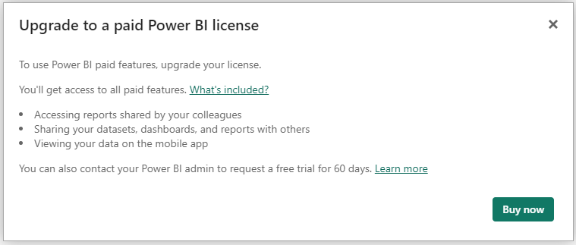
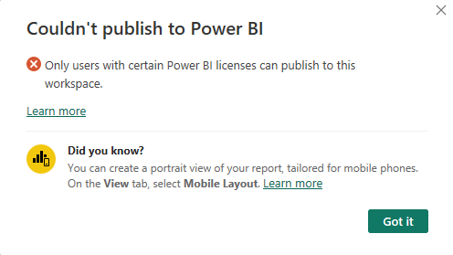
Licensing …
A Question we get a lot ?
Can you please explain the licensing model, the different options and consequences.
Notes:
Martijn:
I will need at least a powerBI pro license to publish the report and I need to be logged in with this account in PowereBIdesktop.
After I purchased the license and logged in, I can look at the report online, it looks good and I copied the link and send it to my collegue in Marketing.
My collegue clicks on the link to view the report.
As a BI specialist, you already know what's in the report yourselves, that’s probably not who you build it for.
You want to share this with your target audience. You want to start collaborating!
TODO MARTIJN, moet hier nog wat bij? verhaaltje over licenties, belangrijk. Blabla
How many of you fully understand all 5 licence types PowereBI has available (excluding the onprem reporting server option)
We found it is one of the most asked questions in our business: Can you please explain the licensing model, the different options and consequences.

Slide 12
Power BI licensing
Per user
Capacity
Pro
Premium per user
Embedded
Premium
€ 9,40 p/u p/m
Data refreshes per day (up to 8)
Maximum storage 10 GB per user
Memory model limit (1 GB)
€ 18,70 p/u p/m
Advanced AI, data streams, data marts, and reading/writing to XMLA endpoints
More compute power than pro
Maximum storage 100 TB
More data refreshes per day (up to 48)
Memory model limit (100 GB)
€ 681 – € 88.372 p/m
Capacity, billed per hour
Can be paused
Memory model limit (3GB to 400 GB)
Needs custom development to share reports
Viewers don’t need a pro license
EM SKU (€ 681 – € 88.372 p/m)
P SKU (€ 4675,60 - € 88.372 p/m)
Capacity, Billed per month
Can not be paused
Memory model limit (3GB to 400 GB)
Access to app.powerbi.com
Viewers don’t need a pro license.
Notes:
Martijn
We want to discuss the various license structures available within Power BI, along with their advantages and disadvantages
Don’t forget to tell them 4 options becomes 5 since there are 2 premium sku options.
Vragen, feedback, commentaar, whatever van Niki:
- bij embedded geef je de vanaf prijs maar wel de model limit tot. misschien hier de range van model limit geven??)
- het premium vakje is nogal vol. de EM SKU is een sort tussenvorm tussen embedded en premium in en heeft minimale verschillen met embedded.
Mijn voorstel is om deze eruit te halen en wel los te benoemen na je uitleg van Embedded, maar het laatste vakje enkel de focus op de ‘echte’ premium te leggen.
Dan kan
Voorstel tekstje: in between embedded and premium is another license type, SKU EM, Pricing is the same as PowerBI embedded, but it is billed per month, so it can not be paused to save on costs. Still you cannot share through PowerBI online, but The advantage of it, compared to de Embedded license, is that you will be able to share your reports through Sharepoint or teams. (factchecken of ik hier niet lieg please….)
Nice to know: SKU = stock keeping unit
EM en P heb ik niet kunnen vinden, mijn aanname zou zijn: embedded en Premium…

Slide 13
We build to share
Pro per user
Premium per user
Embedded
Premium
Requires custom development, which can be costly
Also requires maintenance, incurring additional costs
NO Access to app.powerbi.com
Limited to Microsoft apps SharePoint, teams, powerpoint or custom development (EM SKU)
Very expensive, but a complete solution. (p SKU)
Access to app.powerbi.com
Everyone needs to be in your tenant (guests party)
Everyone needs to be in your tenant (guests party)
Everyone needs a license
Access to app.powerbi.com
Notes:
Niki
We build to share! So here I would like to go through the Possibilities and limitations when sharing with the differtent types of licences.
Within the licensing structures, there are several ways to achieve sharing.
for smaller companies The licensing plans per user are probably the way to go, because you pay per user. Depending on your data needs it can be either one of these.
The downside is that you pay license costs per user, and they also need to be within your own domain, either as members or guests.
In addition to the per-user solution, there are also two capacity-based solutions.
Embedded is the method Microsoft suggests for sharing outside your organization.
However, this requires development and therefore incurs costs, as well as ongoing maintenance.
The premium EM SKU seems limited considering the costs involved, as it only allows sharing through some of the Microsoft apps.
Premium p SKU is primarily for larger organizations, with pricing reflecting this.
As PowerBi Embedded is the solution redommended by Microsoft for sharing outside your organization.
This is the license we build Webdashboard on.
We ‘simply’ did the custom development for you.

Slide 14
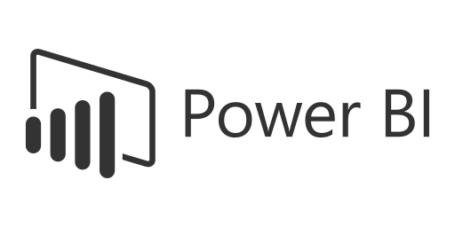
Webdashboard versions
Per user
Capacity
Standard
Enterprise
Shared embedded capacity
Customer embedded capacity
Freelancers, Small and Medium-sized Enterprises (SME)
€ 8,99 pu/pm (including power bi license)
Large Enterprises
From € 1000 p/m (500 users, exclusive embedded license)
Notes:
Niki
Let’d look at the 2 types of licenses are available with this custom development!
We support both mid- and largesize companies
As we saw before, small to medium sized organisations, are more likely to go for a licene per user, as the costs for capacity are to high for their size.
With webdashboard these organisations will share a capacity in the background, monitored for performance off course.
you will not be bothered with powerbi licensing, a Webdashboard license per user is all you need. (prijs benoemen of niet? Staat wel heel klein op de slide??)
Large enterprises, they need to bring there own capacity. Can be for a serveral reasons: Cost wise, Server location, Control about compute power.
Webdashboard capacity solution, called Enterprise licence, is purchased on top of your PowerBI embedded capacity.
(prijs benoemen of niet? Staat wel heel klein op de slide??)

Slide 15
How to share in Power BI
Inside tenant
Outside tenant
1
2
3
4
5
6
7
Make sure the audience is available in your tenant (and they need a Microsoft account)
Make a power bi app and configure the audiences
Internal: Share link, login powerbi.com or power BI app
External: Share the direct app link to your audience
Make sure guests do not lose this link else they will not be able to find the app.
Depending on step 3. Keep in mind licenses are user coupled
Build Your Reports in Power BI & publish them
Make sure all viewers do have a power bi license
BI Specialist
IT Specialist
IT Specialist
BI Specialist
BI Specialist
Viewer
BI Specialist
Viewer
BI Specialist
IT Specialist
Viewer
Notes:
Martijn
Stap 3: Make sure all viewers do have a power bi license OR covered by a capacity license
Martijn
Here we wanna go step by step what is the most elegante way to share reports from a viewers prespective. Note there are more options to share but this one is the most easy for the viewer to find / brand.
Don’t forget to point out that the BI specialist can not go through this process all by himself, he will need the IT specialist.

Slide 16
How to share in Webdashboard
Our philosophy is simple: Ensure that viewers can always navigate to where they want to be within two clicks.
Notes:
Martijn
Let’s look back at the focus role of Webdashboard and it’s philosophy.
It should be made as easy as possible for the viewer to consume information.
Get him to the report within 2 clicks.
Besides that, it would also be nice for the BI specialist to make this happen asap, without dependencies on other departments like IT for licensing.
Let’s see how to do the exact same thing as the previous slide but than with webdashboard.

Slide 17
How to share in Webdashboard
Inside or outside tenant
1
2
3
4
5
Build Your Reports in Power BI
Publish your reports on Webdashboard
Make sure you do have enough Webdashboard licenses
Invite your viewers with just an email address.
Manage your reports and audience
Multiple
Entra or Google workspaces support.
BI Specialist
BI Specialist
BI Specialist
BI Specialist
Viewer
BI Specialist
Viewer
Notes:
Martijn
Tekst bij slide 2,5: manually upgrading the number of licenses can be overruled, so the portal will automatically upgrade your licences when a new person is added in your Entra. We talked to our focusgroup for this and for costefficiency they told us, it would be nice to have the option, but by default this should be done manually. So thats what we build.

Slide 18
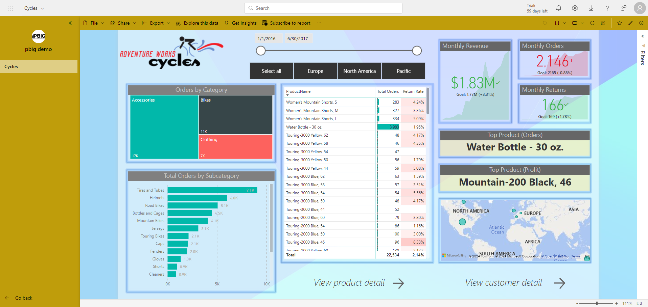
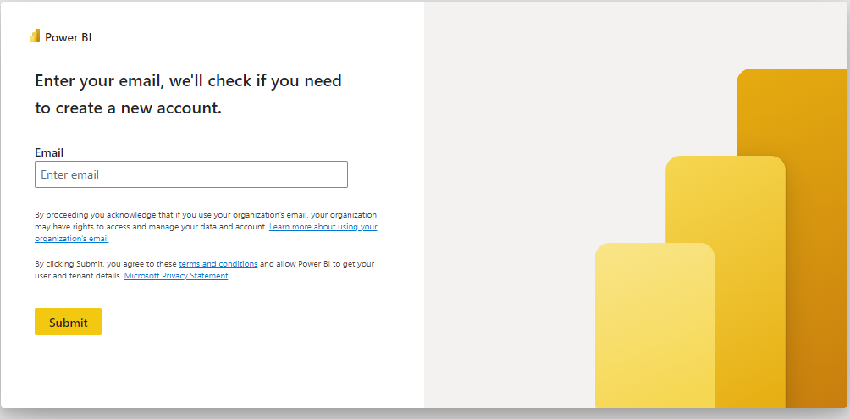
Look & feel Power BI app
https://app.powerbi.com/groups/me/apps/99604f5b-7242-42b5-9f0b-adce03ddc32c/reports/ea4ac788-c293-4857-ac28-6ec8dec9539d/ReportSection?ctid=2996f427-9297-465e-8bf0-f2122c031d1c&experience=power-bi
Notes:
Martijn (LETOP hier focus op het share gedeelte, branding wordt later belicht)
Joke a bit about the very easy to remember link to the powerbi app.
Nice login screen…
Tell you can brand a bit on a powerbi app but the options are limited. Only 1 color for top and nav bar. Just a simple small logo and thats all.
For a lot of companies this might be enough and that’s fine!
For the ones that want more, there are options.

Slide 19
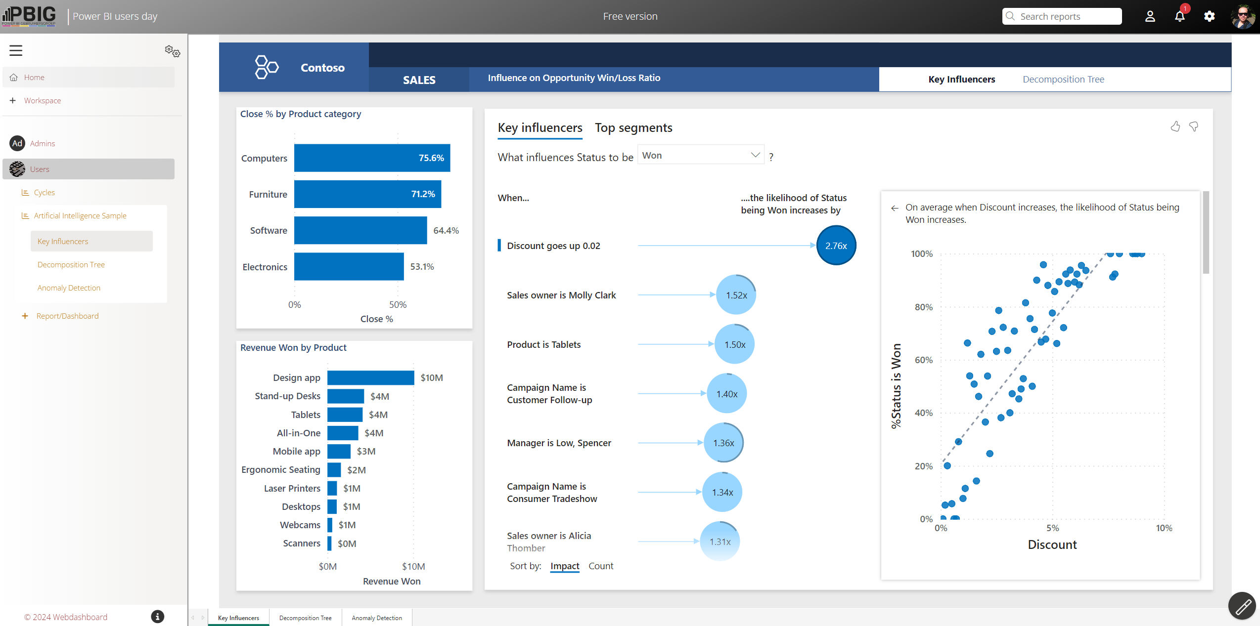
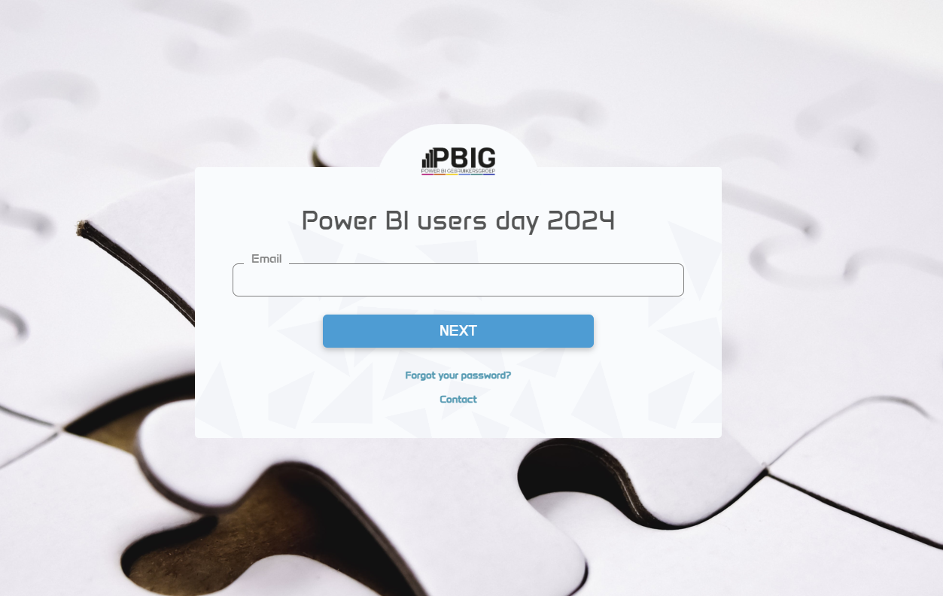
Look & feel Webdashboard
https://pbig.meermetpowerbi.nl/
Notes:
Martijn
Same thing as the previous slide
Nice easy to remember lionk
Note that the login can be custimized
Note that all portal colors / logos / icons / etc can be fully customized by the customer.
Every element shown can be adapted separately.

Slide 20
Our customers’ struggles
Share with anyone (with an email address)
Branding (it feels like your own)
White label (app.yourawesomecompany.com)
Navigation and user friendliness
Notes:
Niki
Back to our our customers struggles.
We talked about sharing and the needed licences.
Next up, branding and whitelabeling

Slide 21
Company's Look and Feel
Recognizability and trust
User acceptance
Efficiency and productivity
app.yourawesomecompany.com
Notes:
Niki
When software looks like a natural extension of the company, users feel familiar and comfortable.
Also users are more likely to accept and use it. An attractive interface can lower the barrier for new users to embrace the software
It can also increase productivity. If users find their info quickly, employees will be able to complete tasks more quickly as well. This leads to time savings and efficiency.
Within Webdashboard you can creatae a custom link and from there on, every element you see, can be customized the way you want it.
Lets look at an example of the coffeecup you see here.

Slide 22
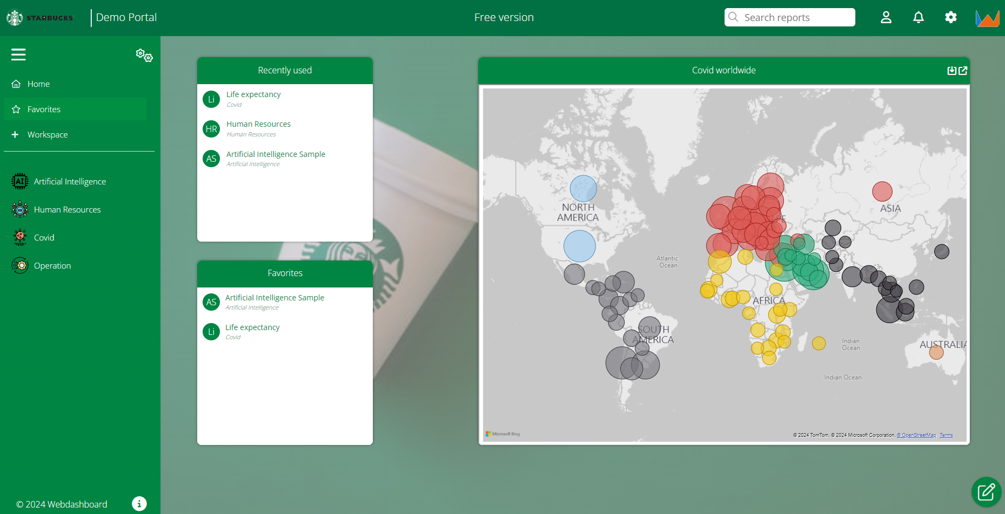
App.yourawesomecoffeecompany.com
Notes:
Here you can see a portal reached with an awesomecoffeecompany link and users land on the homepage of the portal.
Workspace areas can be customized just like this page and you can manage the usergroups and let every group land where you want them to land when they log on.
As you can see every element is customized to the portal owners brand.
On the left you see the navigaton menu, with customized logos, you can show on or more visuals from a report
and here we chose to show the recently used and favorites of the logged on user.

Slide 23
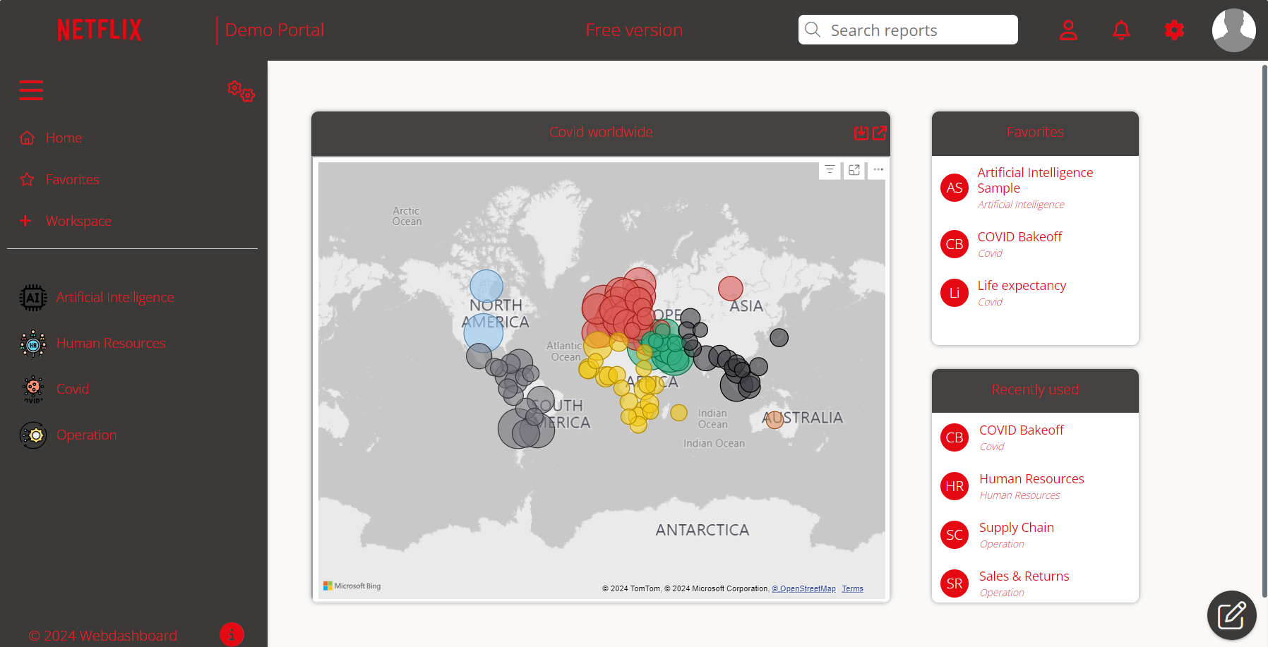
App.yourawesomestreamingservice.com
Notes:
Here a similar example, but this time its from an awesomestreamingservice and colors and logos are adapted to it.

Slide 24
Our customers’ struggles
Share with anyone (with an email address)
Branding (it feels like your own)
White label (app.yourawesomecompany.com)
Navigation and user friendliness
Notes:
Martijn
3rd big struggle we repetedly came across, was navigation and user friendliness.
Not only from our customers, but even from our own Microsftminded CEO.

Slide 25
Time is money
Findability is important
Don’t overcomplicate navigation
Don’t overcomplicate your reports
Insights in insights
Notes:
Martijn → HIER NIET TE UITGEBREID, KORT EN BONDIG EN DOOR
Findability is important since if you cant find the reports you know for sure they will never been seen.
Navigating complex tools like Power BI online can indeed be challenging for occasional users.
Think about your audiance when making a report. Some might need only a few kpis (like CEO’s) while others need much more detail, like collegues woring in operation. But always think from the viewer, because that’s who you are making the report for. What doe he need to know, what does he need to take action on.
Insights in insights are your reports watched? By who? How often? And maybe more important, who should be watching te report, but isn’t???
When viewere numbers popping up, are not as high as you would expect. Its a signal for you to find out, why reports aren’t viewed a much and it gives you the opportunity to improve one of the 3 points above.

Slide 26
Some features
Tell your data story easy
Shortcut to a report with filter
Slideshows
Customize fonts
Implement RLS on a report level (with tabular or shared dataset).
Temporary close reports for your viewers.
Analyse your reports on model level
Notes:
Niki
Let’s talk about some features WDB has to offer.
WDB offers you the possibility to tell a data story. Design the landing page with focus points for the viewers.
Show the key visuals ffom different report on the workspace page (like dadhboard functionality in PowerBIervice) and combine it with supporting texts, relevant twitterfeeds or whatever you need to tell the story.

Slide 27
Some features
Tell your data story easy
Shortcut to a report with filter
Slideshows
Customize fonts
Implement RLS on a report level (with tabular or shared dataset).
Temporary close reports for your viewers.
Analyse your reports on model level
Notes:
With WDB you are able to create a shortcut to a report with a predefined filter. Not only when coming from another report, but from any place you can put a link. This can be very helpfull to use on your WDBworkspace to help your storytelling.

Slide 28
Some features
Tell your data story easy
Shortcut to a report with filter
Slideshows
Customize fonts
Implement RLS on a report level (with tabular or shared dataset).
Temporary close reports for your viewers.
Analyse your reports on model level
Notes:
One of the functionilities is to create a fullscreen slideshow. This can be needed to show up to date information on a big screen within your office or warehouse for example

Slide 29
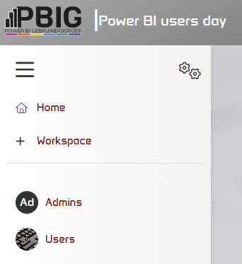
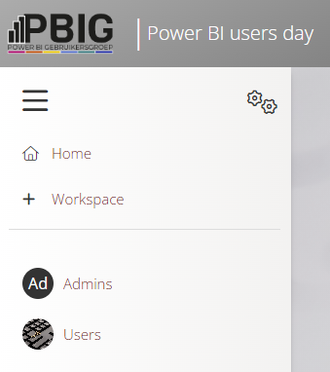
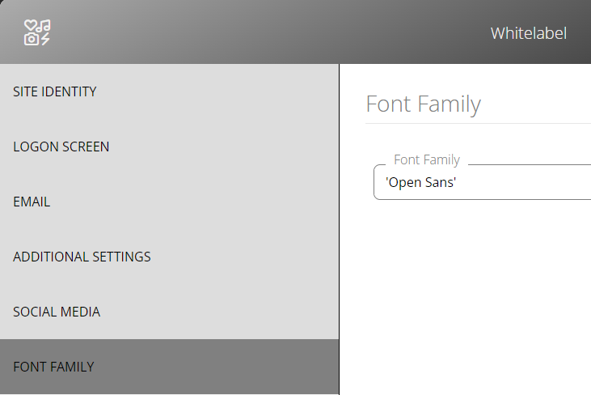
Some features
Tell your data story easy
Shortcut to a report with filter
Slideshows
Customize fonts
Implement RLS on a report level (with tabular or shared dataset).
Temporary close reports for your viewers.
Analyse your reports on model level
Notes:
the latest feature allowing you to utilize custom fonts, including the option to seamlessly integrate your own custom font during white labeling.
Released last week.

Slide 30
Some features
Tell your data story easy
Shortcut to a report with filter
Slideshows
Customize fonts
Implement RLS on a report level (with tabular or shared dataset).
Temporary close reports for your viewers.
Analyse your reports on model level
Notes:
One of the main challenges I encountered in my work as BI specialist, was implementing RLS on different reports in a different way, when working with a centralized dataset.
I find this feature somewhat difficult to explain, as you kind of need to have to problem, to understand it. But I will give it a try.
More and more it is recommended to work with a centralized dataset, where you create your data model once and implement your business logic into measures, calculation groups and field parameters only once.
On this model you build several reports for different users. This model can be created in Analysis Service (tabular) or a shared dataset in PowerBI. (semantic model)
Row Level Security is build on the dataset and also appointed on a dataset level in PowerBI service.
I found that depending on the details in the report, You want to have different RLS on a reportlevel, although it has the same dataset.
For example a report on sickleave. Int he detailed report with data on coworker level, you want coworkers to only see their on data and managers to only see their teams data. But in a dashboard,(build on the same dataseT) where you would only show KPI’s on an organisation level, you do want everyone to see the full companies-score.
This is not possible without workaround and adding columns with totals on a rowlevel or even adding tables with totals.
But in WDB it is simple to implement RLS, different roles on different reports, or even different RLS on the same report when in different WDB workspaces. (so for different users)

Slide 31
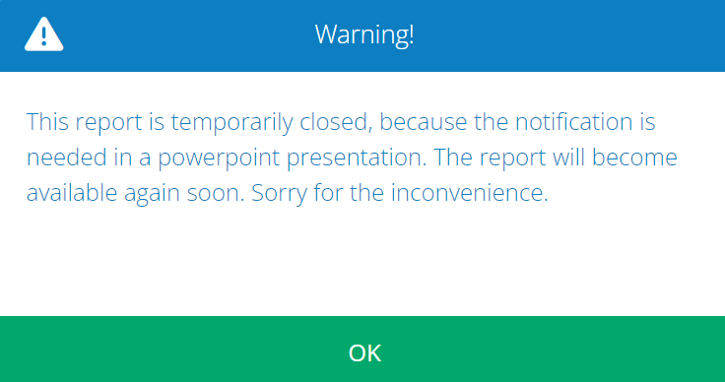
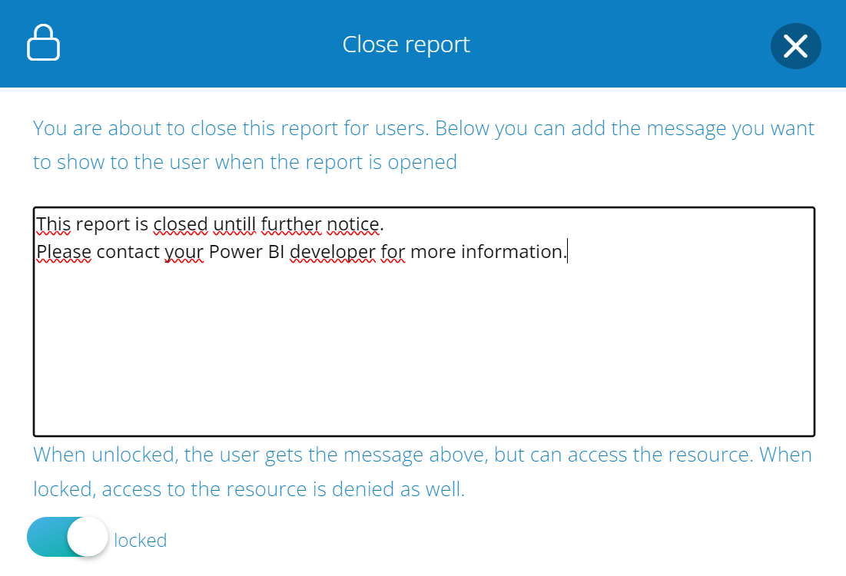
Some features
Tell your data story easy
Shortcut to a report with filter
Slideshows
Customize fonts
Implement RLS on a report level (with tabular or shared dataset).
Temporary close reports for your viewers.
Analyse your reports on model level
Notes:
It has been made easy to temporarily close a report, for instance when a bug in the report is found. The report can be made invisible to endusers, without deleting the report and needing to imlement all settings (like refreshes, security, etc) again when the bug is fixed.
Portal admin who closes the report can write a personlized message to the enduser, when trying to open the report.
He can also choose to not really close the report but still keep it available after the message is showed.

Slide 32
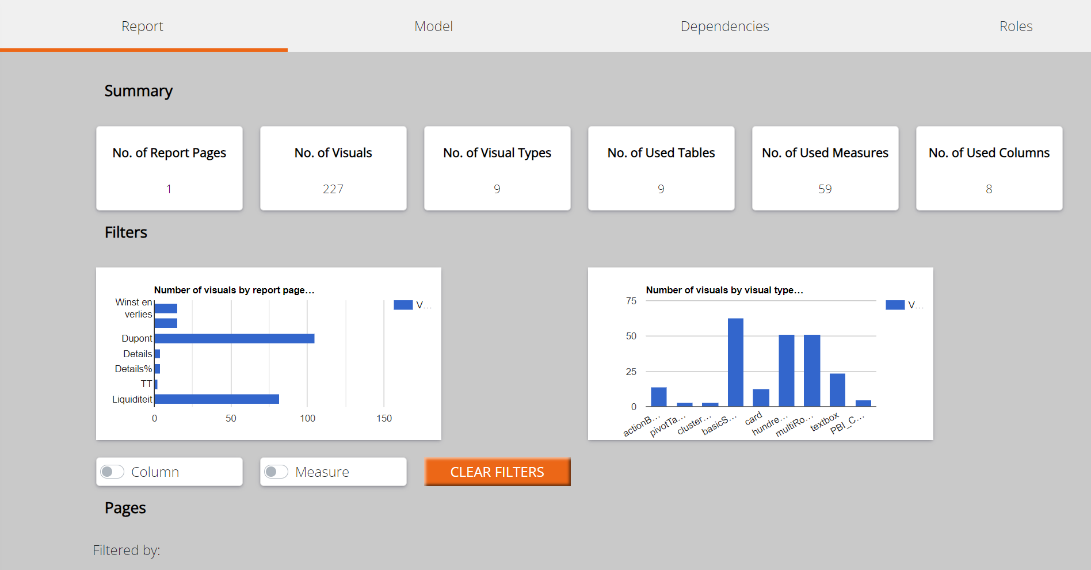
Some features
Tell your data story easy
Shortcut to a report with filter
Slideshows
Customize fonts
Implement RLS on a report level (with tabular or shared dataset).
Temporary close reports for your viewers.
Analyse your reports on model level
Notes:
WDB offers a dataset analyser, showing the BI specialist all datamodel related information, providing great insight.
Insights are provided on a report and model level and dependencies and roles are shown.
It gives you for example information about measures or tables that are not used in the report, which can help you throw out unused items and keep your model clean

Slide 33
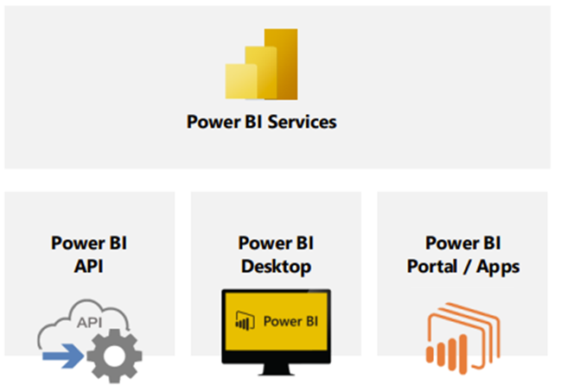
Collaboration with Microsoft
Available on:
www.webdashboard.com or:
Used in
20+
countries
BI Specialist
Security tested by:
Partner of:
Viewer
Notes:
Niki
So how does WDB work?
WDB does not replace PowerBI, it is complementing Microsoft and PowerBI to get the most out of your BI landscape.
As seen earlier, Microsoft focuses on the BI role, everything data related, but has less focus on the enduser.
WDB comes in at the end of your data environment. So the BI specialist is still creating DWH or datalakehouse the way he does this now and he still uses PowerBI desktop to create the reports.
When ready to share reports, WDB is the place to go. When a portal is created, powerbi services is still behind it. But the viewer/enduser only sees your own branded webdashboard portal.
Therefore we collaborate with Microsoft and our product is also available in Microsoft stores.
Although Webdashboard is using PowerBI Service in the background, as a Webdashboard standard customer, you only need to purchase Webdashboard licenses and no PowerBI licenses on top.
WDB standard licensing is the model Martijn showed earlier, for small to midsize companies, where licenses are bought per user.

Slide 34
Go to webdashboard.com and:
Start your free trial
or
Get in touch for a demo!
Webdashboard is also available via:
In Summa is a Microsoft Solution Partner Data & AI | Digital & App Innovation
Thank you,
And don’t forget to visit or stand!
Notes:
Feedback:
Benoemen dat we een stand hebben.
ipv quote, weer aangeven waar je WDB kan halen (appstores) en dat je een gratis demo portaal kunt aanmaken op onze site.
Evt de pricing slide nog een keer samenvatten op deze slide
Solutionpartner logo
Mooie afsluiting.
Note van Natasja -> Zoiets?

Slide 35
Demo

Slide 36
Go to webdashboard.com and:
Start your free trial
or
Get in touch for a demo!
Webdashboard is also available via:
In Summa is a Microsoft Solution Partner Data & AI | Digital & App Innovation
Notes:
Feedback:
Benoemen dat we een stand hebben.
ipv quote, weer aangeven waar je WDB kan halen (appstores) en dat je een gratis demo portaal kunt aanmaken op onze site.
Evt de pricing slide nog een keer samenvatten op deze slide
Solutionpartner logo
Mooie afsluiting.
Note van Natasja -> Zoiets?

