Slide 2
Best practices for developing Power BI reports
9th March 2024
Power BI Gebruikersdag

Slide 3
Best practices for developing Power BI reports What to expect? -Why should I care? -Power Query -Data modeling & DAX -Visualization -Demo (if there is time)
9th March 2024
Power BI Gebruikersdag

Slide 4
Best practices for developing Power BI reports What this session is not about: -Providing a list of all best practices -Telling you exactly what to do -One fit all approach
9th March 2024
Power BI Gebruikersdag

Slide 5
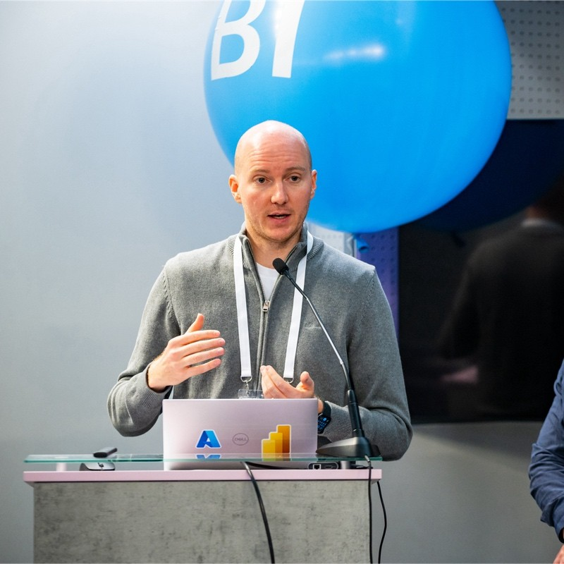
Gregor Brunner
Founder @ brunner.bi
8+ years of experience in Power BI
Mainly in the DACH area
Development and consulting
Power BI external tool “Measure Killer”
E-Mail: gregor@brunner.bi

Slide 6
Why should I care? -Clean, performant, long lasting report -Who are best practices actually for? -Reusability, documentation -Community standard (subjective, no 10 commandments) -Constantly evolving and improving -Goal vs. reality
9th March 2024
Power BI Gebruikersdag
Notes:
-My reports are fine, I dont need best practices...
-Ask audience who best practices are for?
-Even if you open a report 6 months later, you will appreciate having followed best practices because you will understand quickly what is going on
-Best practices are not a fixed set of rules but rather constantly evolving like a language – also everyone has different best practices, you will not find 2 people having exactly the same best practices
-Over time best practices will change, if I look at my reports from 2-3 years ago I did things differently, I dont even want to look at my reports from 5 or 6y ago
-Best practices are an ideal, something we strive for. We do not need to fullfil them 100% - it might just take too much time. But the more we can fulfill, the better.

Slide 7
Three areas we will focus on -Power Query -Data modeling & DAX -Visualization
9th March 2024
Power BI Gebruikersdag

Slide 8
Power Query 1) Only load what you really need (theory & practice) 2) Query folding 3) Set data types correctly (avoid variants / ABC123) 4) Name your queries and use query groups 5) Name transformation steps and comment intent 6) Reduce number of steps - use functions and parameters 7) Use RemoveOtherColumns instead of RemoveColumns
9th March 2024
Power BI Gebruikersdag
Notes:
1) (use MK) - you can always add stuff later (true for columns and rows)
2) query folding (if not then reduce the size of your query as early as possible - first columns then rows)
3) set data types correctly (avoid variant ABC123)
4) name your queries properly and create groups (still adapting to this – maybe data sources are a good idea? – currently only for fact tables etc.)
5) naming steps and commenting intent (START - END of more complex transformations can help)
6) reduce number of steps or create multiple queries or use functions if you have so many transformations that you need to apply – use functions for reused transformations – use parameters for reused connections (snowflake user warehouse etc.)
7) It has at least 2 benefits – 1 is you don’t automatically get new columns from the data source – 2 if columns from the source are removed later and you removed them actively before, no error will be thrown with RemoveOtherColumns

Slide 9
Data modeling & DAX 1) Deactivate Auto Date/Time 2) Star schema (theory & practice) 3) Avoid M:N relationships and bi-directional filters 4) Avoid calculated columns and costly virtual tables 5) Be careful with iterator functions in DAX 6) No expensive calculations on high cardinality columns 7) Create a custom measure table (_Measures) 8) Use field parameters and calculation groups More: Organize model in tabs, hide keys and other columns, format your DAX and comment out your measures
9th March 2024
Power BI Gebruikersdag
Notes:
One of the most annoying default settings in Power BI – beware of hundreds of localdatetables if you DO NOT turn it off – it can easily be the biggest part of your model
This is of huge importance – if you can achieve a star schema it will greatly improve performance – in practice it is pretty hard a lot of times
These type of relationships are troublemakers- slow everything down and can create huge problems with calculations
Calculated columns are a hot topic, but the community pretty much agrees on avoiding them as much as possible – virtual tables especially in iterator functions are a bad idea
These functions are marked with an X at the end like SUMX or COUNTX and they will execute a command on every row of the table. They consume a lot of resources
Like the prev. point one calculation can destroy your whole model – especially if the column you are executing it on has a high cardinality (explain)
This is a very nice way of organizing your measures in folders and subfolders in THEIR OWN TABLE – not part of the data tables – my measures always start with _
These advanced features will help with interactivity and avoids redundancy of calculations – calc groups for YTD measures – field parameters for dynamic axis

Slide 10
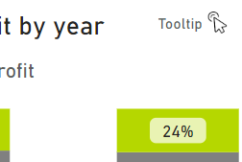
Visualization 1) Limit number of visuals 2) I hate pie & donut charts 3) Find nice color patterns and dont use too many colors 4) Use custom visuals with care 5) Do not always turn on all visual headers 6) Set a clear standard for where your filters are 7) Show users where tooltips are used More: Organize visuals in groups, TopN for tables
9th March 2024
Power BI Gebruikersdag
Notes:
I have seen reports with more than 100 visuals on one page - there are smart ways to do this to add multi-card visuals or a background image (every visuals costs!!!!!)
Pie or donut charts are only allowed in some very very rare cases
There are some good articles on which colors go together well – dont use more than 3 or 4 colors on one page
Custom Visuals can be great but can also create lots of problems (security because they can send out data if they are not certified, bugs, performance)
In my opinion they can be really ugly and remember the export feature that they can bring
Some people prefer to have filters, I think on the side is also fine – I do not like to use the native filter pane because it is not very user friendly – use button to hide/unhide custom filter pane
This is a best practice for us in-house – we always put these little icons in the corner of the visuals to show if a simple tooltip or tooltip page is there

Slide 11
It‘s demo time
9th March 2024
Power BI Gebruikersdag
Notes:
I have seen reports with more than 100 visuals on one page - there are smart ways to do this to add multi-card visuals or a background image (every visuals costs!!!!!)
Pie or donut charts are only allowed in some very very rare cases
There are some good articles on which colors go together well – dont use more than 3 or 4 colors on one page
Why does a table visual have to show all 100k rows? Use TOPN unless you really need a sum, but even then…
Custom Visuals can be great but can also create lots of problems (security, bugs, performance)
In my opinion they can be really ugly and remember the export feature that they can bring
Some people prefer to have filters, I think on the side is also fine – I do not like to use the native filter pane because it is not very user friendly
This is a best practice for us in-house – we always put these little icons in the corner of the visuals to show if a simple tooltip or tooltip page is there

Slide 12
Session evaluation
Event evaluation

Slide 13
Platinum partners
Goud partners
Zilver partners
Brons partners
Community partners

Slide 14
Thank you for your attention
Reach out
www.brunner.bi
gregor@brunner.bi
LinkedIn
Website
21. November 2023
Budapest BI Conference

Slide 15
Best practices -Build a star schema -Try to avoid bi-directional filters and many to many relationships -Use tricks like “IsAvailableInMdx” setting in the tabular model -Organize your measures well -Only load columns you need – I know it is hard…
21. November 2023
Budapest BI Conference

