Slide 1
Automate data ingestion with custom Power Query functions
Grzegorz (Greg) Strzymiński

Slide 2
Platinum partners
Goud partners
Zilver partners
Brons partners
Community partners

Slide 3
Grzegorz (Greg) Strzymiński
Senior BI Developer at Kearney in Warsaw, Poland
Developing end-to-end reporting and analysis solutions
Designing data models and pipelines
DAX fan

Slide 4
Agenda
Custom functions in Power Query in a nutshell
Use-cases for Power Query custom functions
Live demos
Limitations and considerations

Slide 5
After this session you will be:
Equipped with knowledge on how to recognize use-cases for automation using Power Query custom functions
Able to create custom functions to handle various scenarios
Familiar with methods to debug and optimize custom functions

Slide 6
A function
Y = F(X)
Outcome Function Input

Slide 7
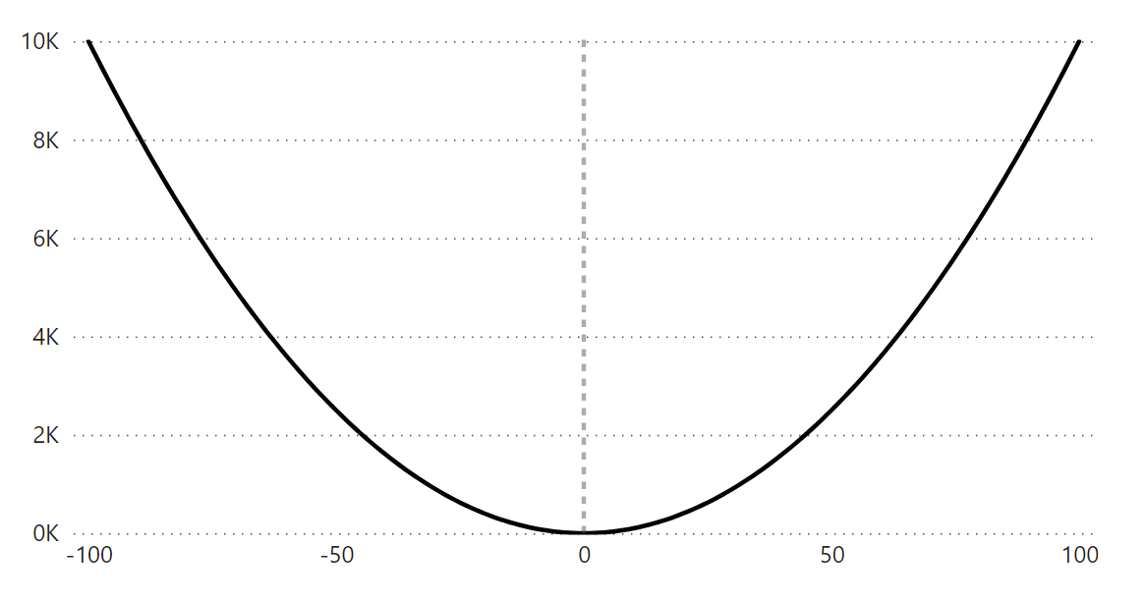
A function
Y = $x^{2}$
Once we define what a function does we can apply it over a number of inputs

Slide 8
A custom function in Power Query
Y = F(X)
Result Transformation Parameter

Slide 9
General use-case for custom functions in Power Query
Use custom functions when you need to transform multiple files in the same format at once in the same way and consolidate them

Slide 10
Rule of thumb – when to leverage custom functions
Files are in a consistent format and are available for Power BI to ingest
It’s not possible to get access to the actual datasource
You need the insights quickly
There are manual steps included in data transformation after extracting from the datasource

Slide 11
Frequent use cases for custom functions in Power Query
Monthly extracts from a source system stored as Excels in Sharepoint and used for analyses
Transactional data sent in manually from another team / division / vendor / client and stored as flat files
Tracking some data in the same Excel and format but each worksheet represents different entity

Slide 12
Live demos
Let’s see some live examples in Power BI

Slide 13
Function with sample file transformation or without
Function and sample transformation
Only the function
Easier to debug
Faster to update
Need to maintain the sample file
Its’ inputs need to be Power Query parameters
More troublesome to debug
Slower to update
Doesn’t need the sample transformation file
Its’ inputs can be unrelated to Power Query parameters

Slide 14
Considerations
Extracts are stored and available for Power BI to ingest -> they come from somewhere too
You need the insights quickly –> there’s no time for developing a more forward-looking solution
There are manual steps included in data transformation after extracting from the datasource –> it’s not possible to connect to the datasource and pull all data at once

Slide 15
When custom functions might not be the go-to choice
Large data volume from flat files and incremental addition of new
Input format is not always consistent
Data transformations required are very compute-heavy

Slide 16
Alternatives to custom functions
Consolidating inputs, favourably with migration to another file type
Direct or indirect connection to a data source
API

Slide 17
Once you ingest the data …
It’s time to think about data modelling!

Slide 18
To use custom functions or not to?
You need to prepare an analysis due in a few days based on marketing campaigns effectiveness data. Data is stored in a network drive of your company and comes in every week by an automated email from a marketing agency that drives campaigns for your firm. The marketing agency generates and sends the Excel files in an automated way.

Slide 19
To use custom functions or not to?
You want to create a sales report from your company’s transactional data. Data is extracted using a SQL script by a Data Analyst once per month and stored as .csv files in a Sharepoint Folder, for Excel analyses of your team. So far there are are 300 million rows corresponding to 2 years of data.

Slide 20
Q&A

Slide 21
Thank you!
Grzegorz Strzymiński
https://www.linkedin.com/in/grzegorz-strzyminski/
grzegorz.strzyminski@kearney.com

Slide 22
Session evaluation
Event evaluation

