Slide 1

Power BI + Fabric Dataflows introductie
Arthur Graus
Download slides + demo code
https://tinyurl.com/pbig-dataflows

Slide 2
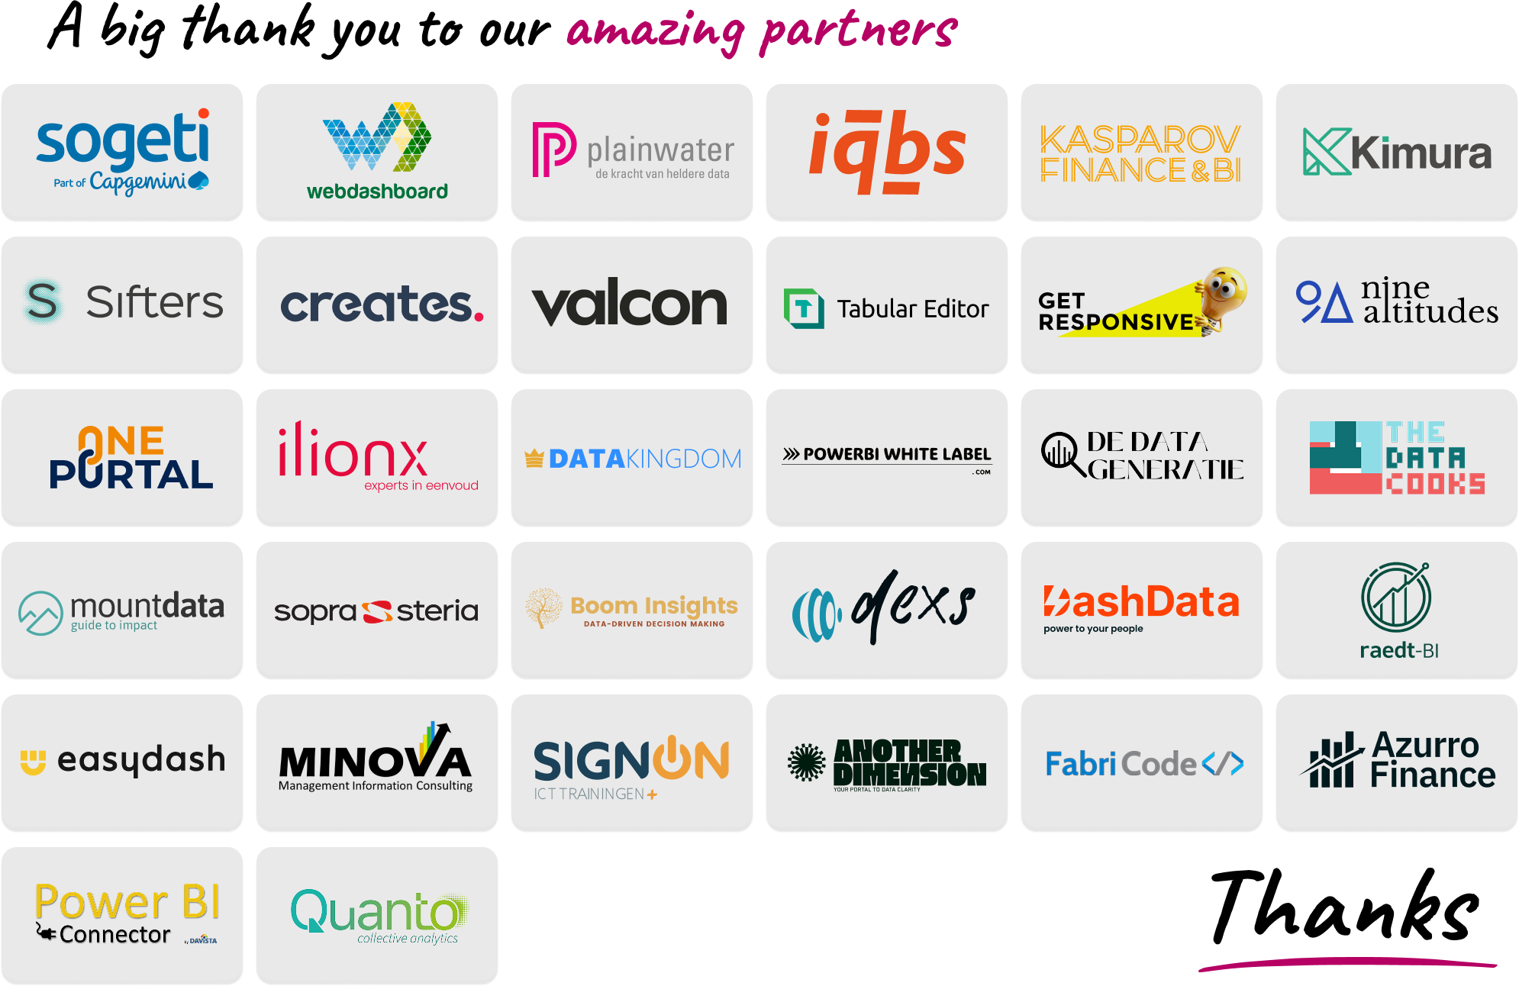

Slide 3


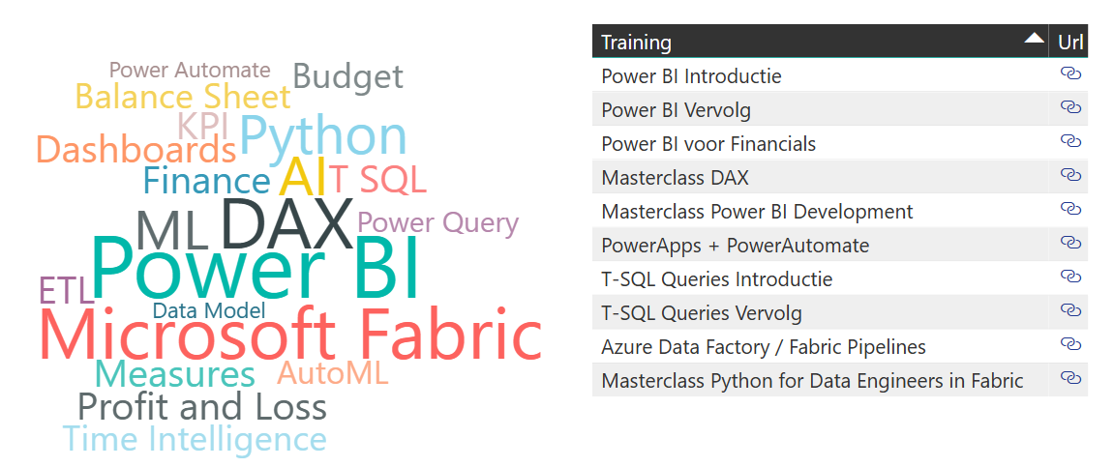



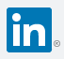
Bio: Arthur Graus
Power BI + MS Fabric Trainer | Developer / ML Enthusiast
Questions, re
info@arthurgraus.nl
https://www.linkedin.com/in/arthurgraus
.com
Get started coding in Fabric!

Slide 4
Agenda
  Power Query
  Power BI Dataflows (Gen 1)
    Common Data Model
    Power Query Online
    Demo
    Use cases
  Fabric Dataflows (Gen 2)
    Fabric Lakehouse
    Features
    Demo
    Use cases
    Alternatives

Slide 5
Power Query
In 2013 First released as an Excel add-in
Self Service ETL Engine inside of Power BI Desktop (2015)
Uses M Language to transform data
Storage: Semantic Model

Slide 6
Power BI Dataflows (Gen1)

Slide 7
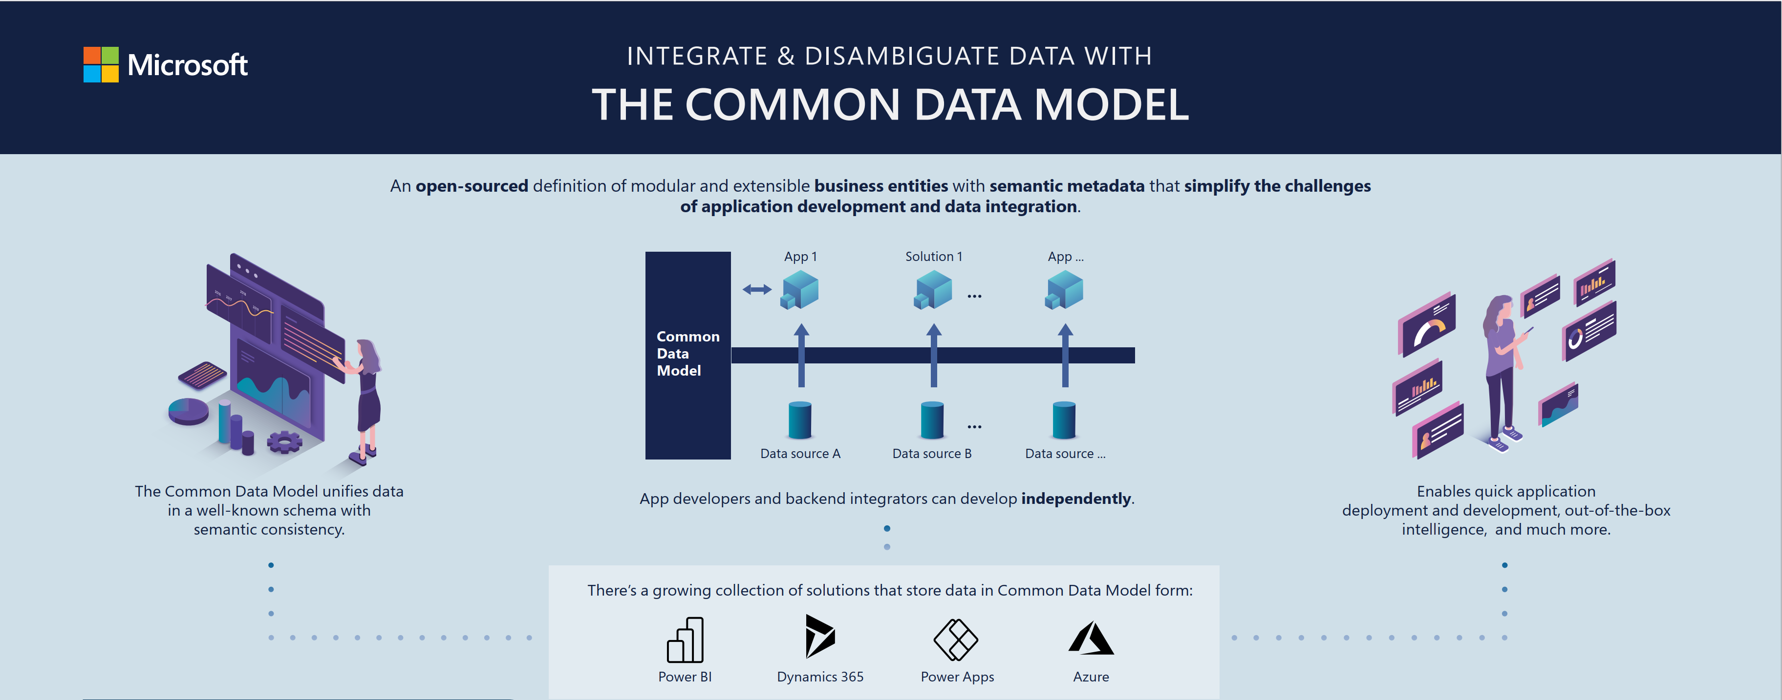
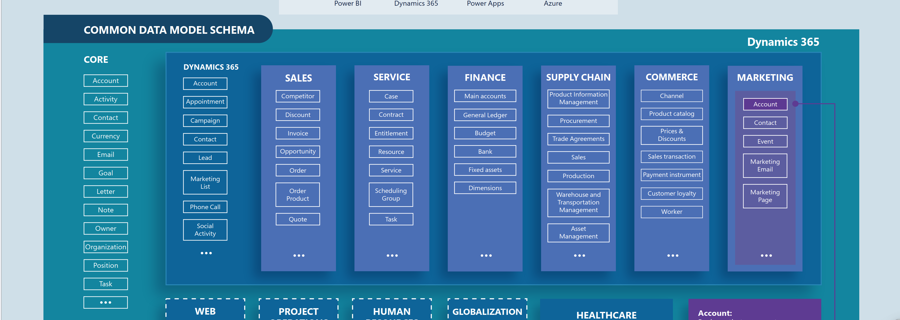
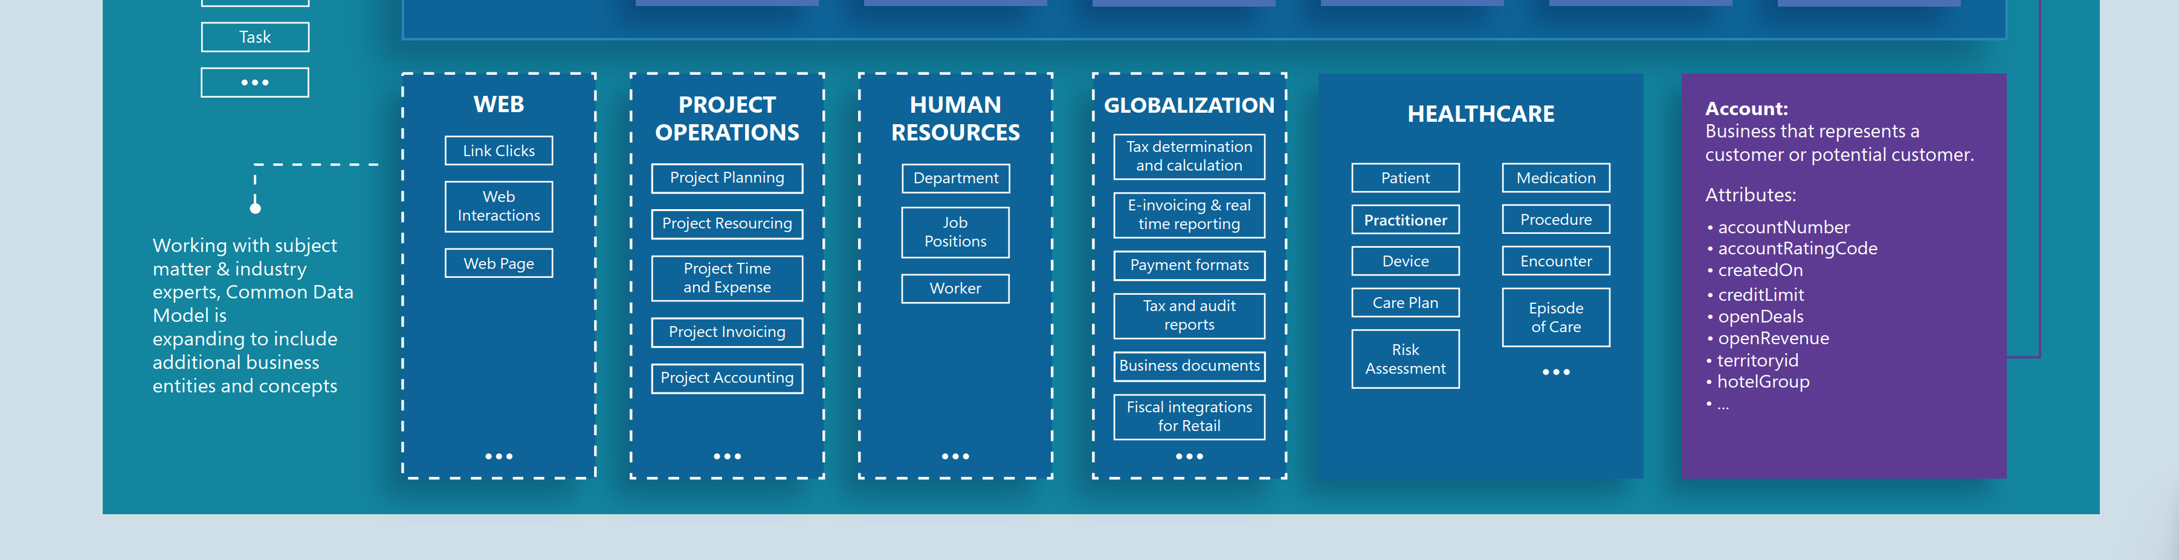
Common Data Model (CDM)
Common Data Model - Common Data Model | Microsoft Learn

Slide 8
Common Data Model - Common Data Model | Microsoft Learn

Slide 9
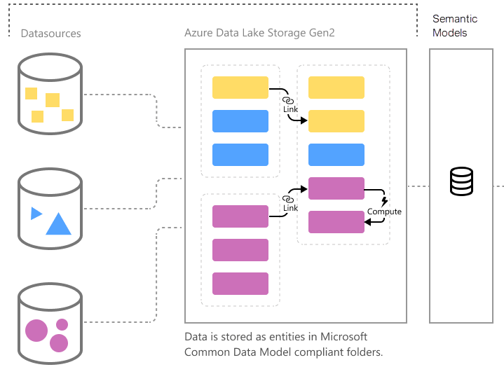
Dataflows Gen1
2018 released as Self Service ETL engine to load data into Common Data Model compliant applications:
  Dataverse (Common Data Service) / Model Driven Apps / Dynamics 365
  Azure Synapse
  Power BI Model
Online editor: Power Query Online
Storage:
  CDM folders (model.json + CSV / Parquet files)
  Azure Data Lake Storage Gen 2 (ADLS).
2 types:
  Power BI Dataflows
  Power Apps Dataflows
Introduction to dataflows and self-service data prep - Power BI | Microsoft Learn

Slide 10
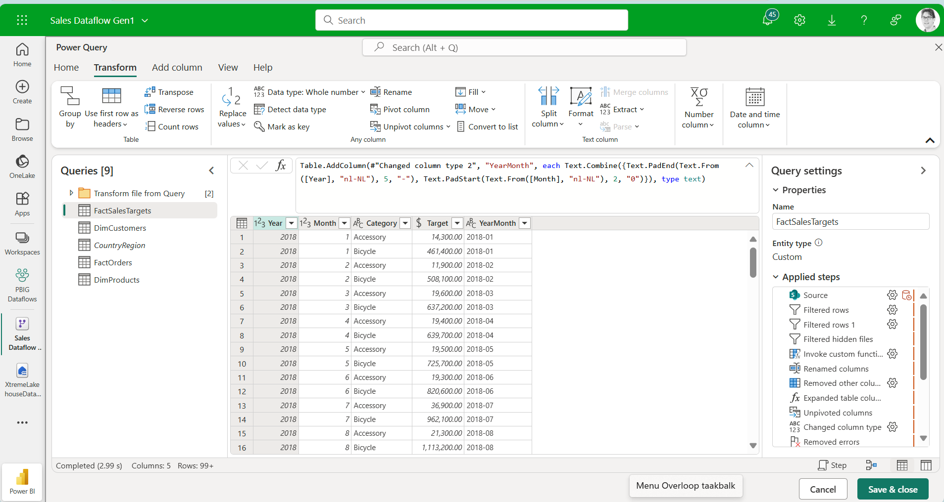
Power Query Online: editor in the browser

Slide 11
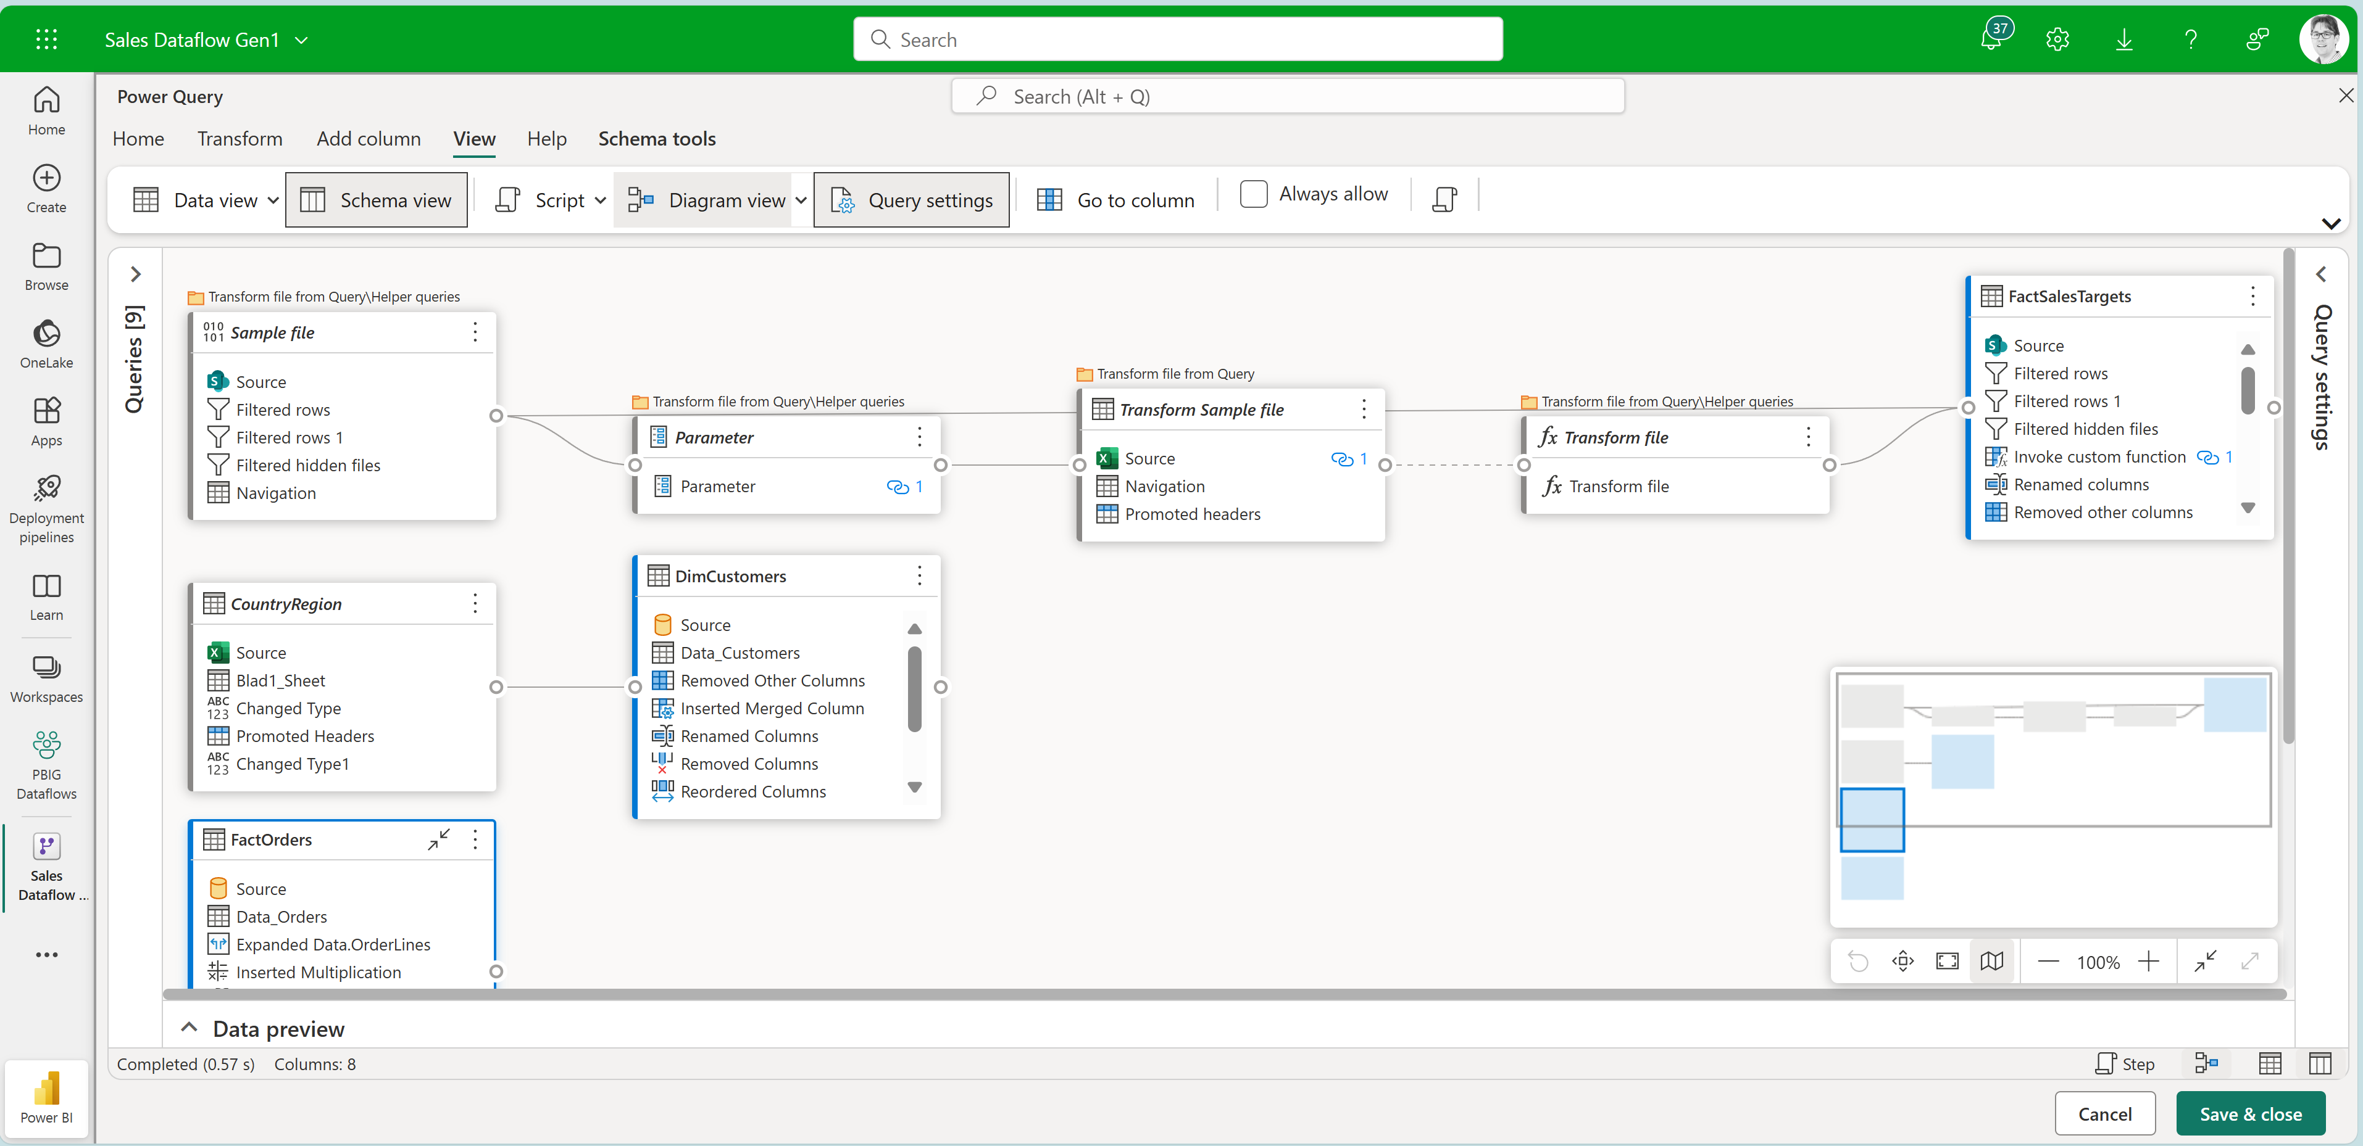
Power Query Online: Diagram view

Slide 12
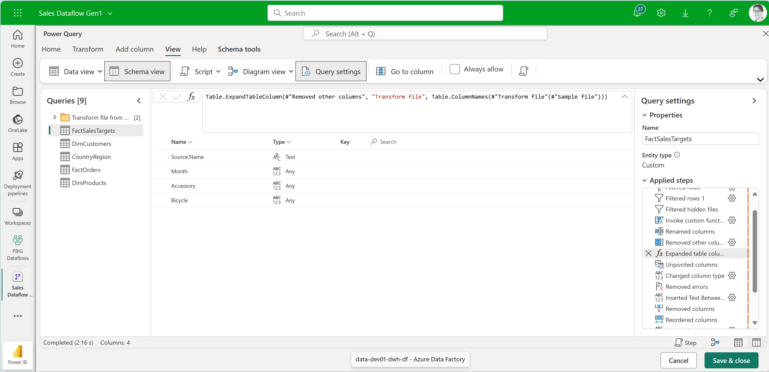
Power Query Online: Schema view
Do schema operations without having to wait for the preview to update.

Slide 13
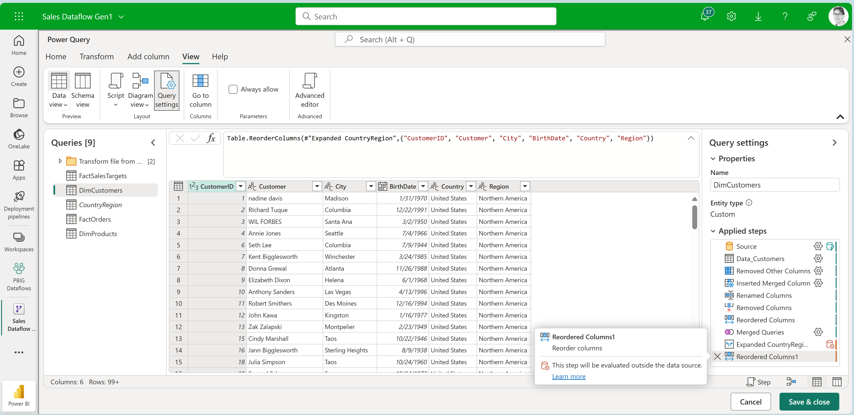
Power Query Online: Query Folding indicator
Indicator turns red if M code cannot be translated into native language:
T-SQL, PL/SQL, Snowflake SQL etc.

Slide 14
Power BI Dataflows (Gen1): usage scenario's

Slide 15
Demo Power Query Online / Dataflows Gen1

Slide 16
Fabric Dataflows (Gen2)

Slide 17
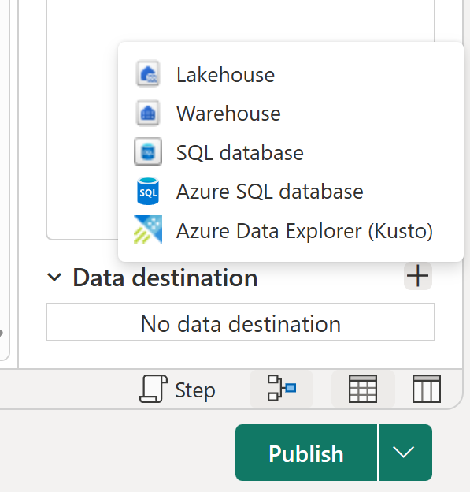
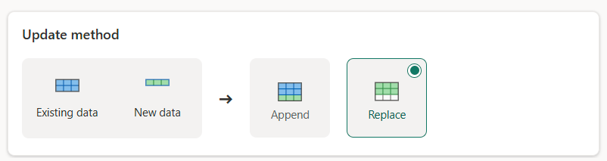
Fabric Dataflow Gen2
2023 introduced as part of Microsoft Fabric
Storage Destinations:
  SQL Server database (Azure + OnPremises)
  Fabric Lakehouse
  Fabric Warehouse
Better performance for large datasets
Uses a Staging Lakehouse
  better performance for complex operations like Merge
  M code is Query Folded into SQL
Support for Replace or Append

Slide 18
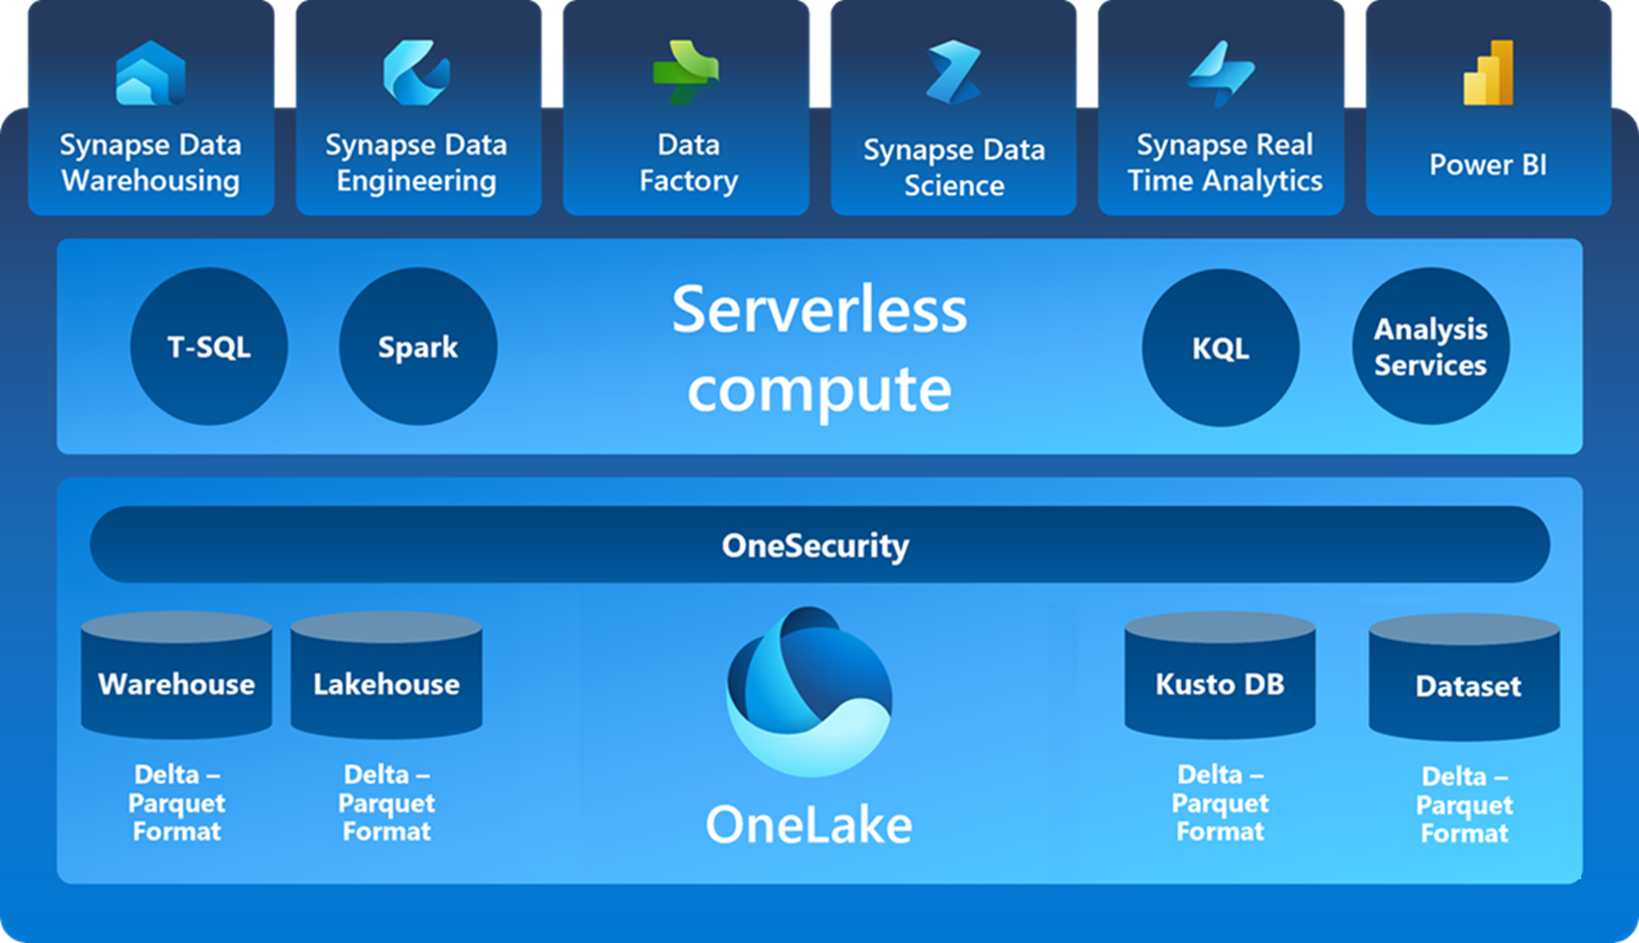
Microsoft Fabric + Dataflows
Dataflows Gen2
Dataflows Gen1

Slide 19
Traditional Data Warehouse / Data Mart
Pros
  Well known architecture
  Works well for structured enterprise data like Sales, Finance, HR, Production
Cons
  scale-out extension is poor.
  Expensive for large data volumes
  Only structured data
  Not suitable for data science and ML scenarios.

Slide 20

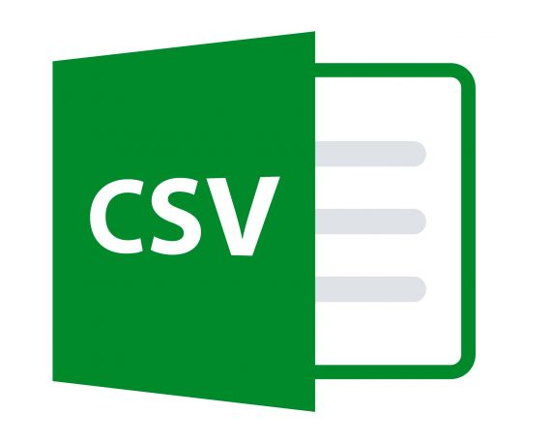
Big Data: Data Lake
Pros
  Good for storing (semi) unstructured data, highly scalable
  Low-cost storage
  Query lots of files using SQL language (Serverless)
  Suitable for data science and ML scenarios
Cons
  Data redundancy brings greater storage overhead
  More complex ETL, extra layers

Slide 21
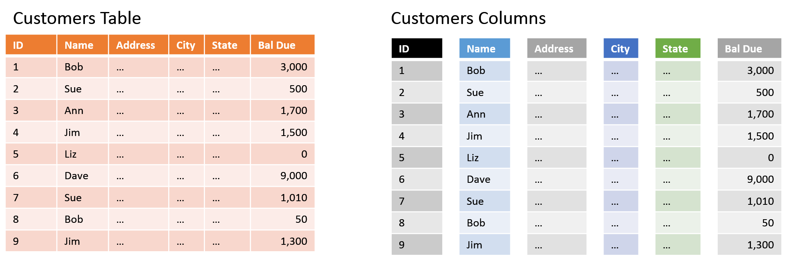
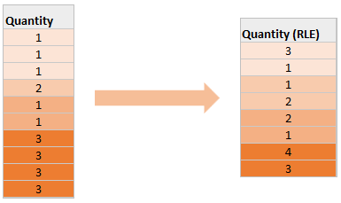
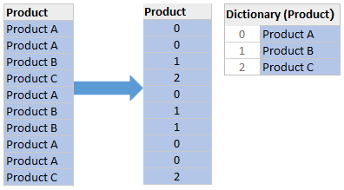
Parquet files: Columnar Storage (like Power BI Vertipaq)
Dictionary Encoding
Run Length Encoding

Slide 22
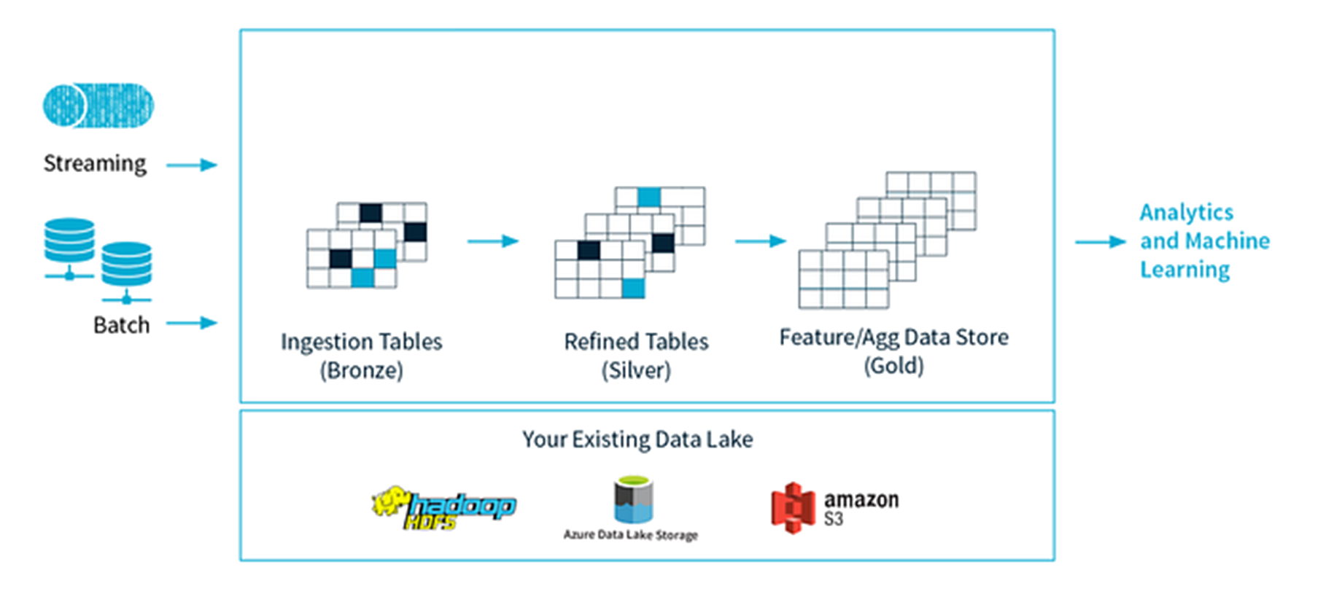
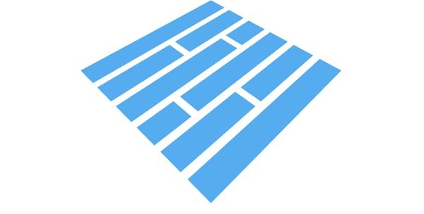




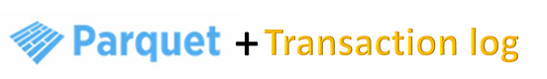
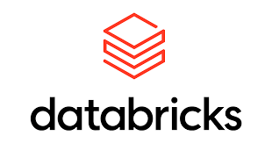
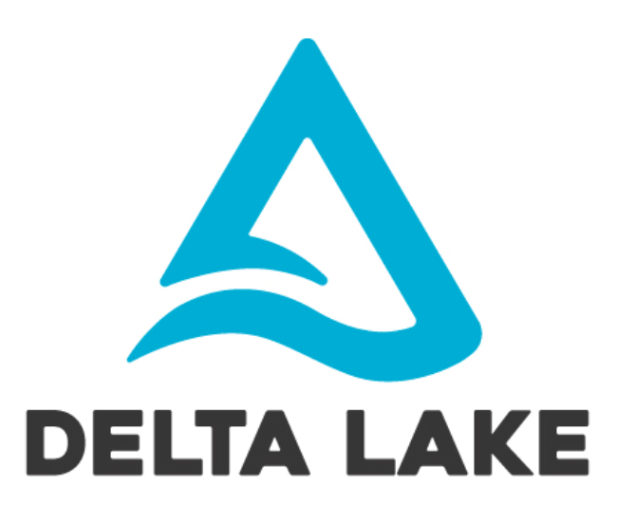
Lakehouse = Delta Lake + Medallion Architecture
Developed by Databricks in 2017, Delta Lake 2.0 open sourced in 2022
Uses Delta Tables to store data with update + transaction support.
Lakehouse
Staging
Data Warehouse
Data Mart
=
Delta Lake Cheatsheet (databricks.com)

Slide 23
Lakehouse in Fabric + Power BI
ETL options in Fabric:
Pipelines:
Azure Data Factory
Notebooks:
Spark / Python / SQL
Dataflows Gen 2:
Power Query Online

Slide 24
"Self-Service" Lakehouse using Dataflows Gen 2

Slide 25
Demo Dataflows Gen 2

Slide 26
Use cases Power Query v.s. Dataflows Gen 1 v.s. Gen 2
Power Query
  Self-service no-code ETL in Power BI Desktop + Excel: small files
  Database queries: SQL Server
Power BI Dataflows Gen 1
  Reusable unrelated Entities accross multiple Reports/Models like reference tables:
  Customers, Products, Business Units, Costcenters
  Different refresh schedules:
    f.e. refresh DWH data once a day and operational data every hour
  Slow ETL processes:
    Webservices / REST API calls
    SharePoint Folders + Files: XLSX, CSV, JSON + XML
Fabric Dataflows Gen 2
  Enterprise like level ETL but still easy to use (no-code)
  Self-Service Lakehouse setup in Workspace
  Big Data? No!

Slide 27
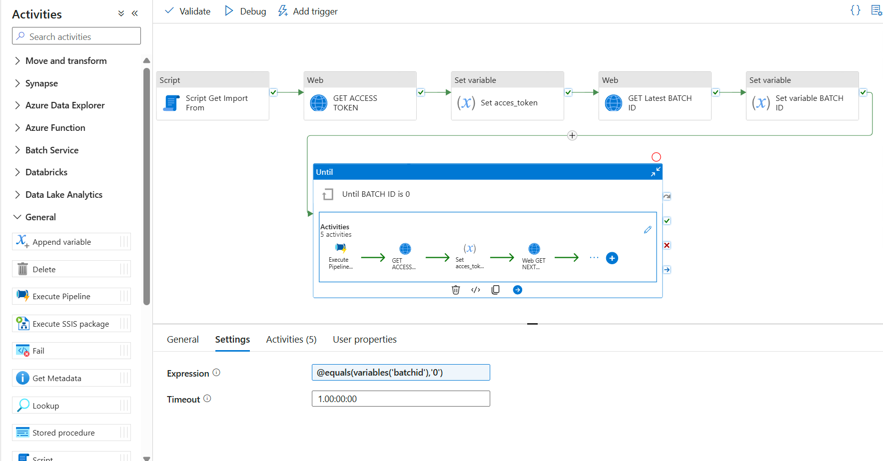
Alternatives in Fabric
Fabric Pipelines
  Low code ETL engine built on Azure Data Factory (ADF)
  100+ data sources and destinations
  Supports for each iterators: f.e. loop through all tables in database
  Very fast and scalable
  More expensive for large-scale orchestration (charges per run)
  Best for Enterprise Data Engineering
Fabric Notebooks
  Code-based ETL for large-scale processing (Big Data, AI) using Python or Spark SQL
  Runs on Spark clusters (Apache PySpark)
  Best for massive data processing (parallel execution on Spark)
  Big data? Yes!

Slide 28
Summary
Feature | Power Query | Dataflows Gen1 | Dataflows Gen2 | Pipelines | Notebooks
Ease of Use | ★★★★★ | ★★★★☆ | ★★★★☆ | ★★★☆☆ | ★☆☆☆☆
Flexibility / reuseability | ★★☆☆☆ | ★★★☆☆ | ★★★☆☆ | ★★★★★ | ★★★★★
For Business Users | ★★★★★ | ★★★★☆ | ★★★★☆ | ★★☆☆☆ | ★☆☆☆☆
For Data Engineers | ★★☆☆☆ | ★★★☆☆ | ★★★☆☆ | ★★★★★ | ★★★★★
Performance / Scalability | ★☆☆☆☆ | ★★☆☆☆ | ★★★☆☆ | ★★★★★ | ★★★★★
Cost | ★★★★★ | ★★★★☆ | ★★★☆☆ | ★★☆☆☆ | ★★★☆☆

Slide 29






Thank you!
Download slides, code samples + video:
https://tinyurl.com/pbig-dataflows
Usefull links:
Differences between Dataflow Gen1 and Dataflow Gen2 - Microsoft Fabric | Microsoft Learn
Questions, reach out to me:
info@arthurgraus.nl
https://www.linkedin.com/in/arthurgraus

