Slide 1
Semantic Modeling in Microsoft Fabric
Emily Lisa

Slide 2
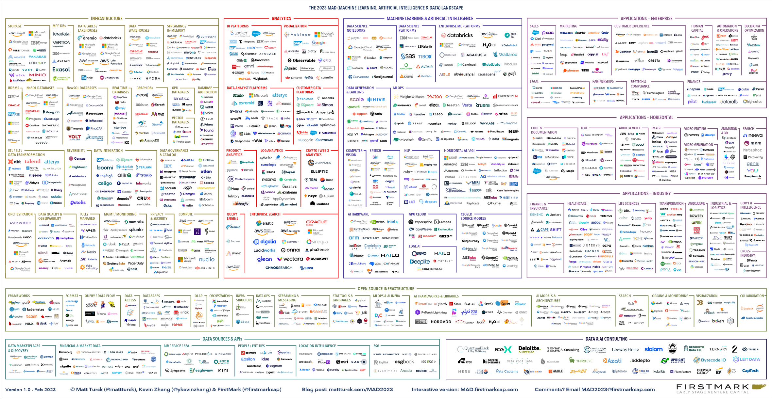
The 2023 ML, AI, and Data Landscape
Notes:
Imagine you are a chief data officer, what do you pick across the data landscape stack. How do they work together? How do they integrate?

Slide 3
“
Simplify, I am the Chief Data Officer and don’t want to be the Chief Integration Officer.”
Every CDO, Every Enterprise
Notes:
Give freedom for choice and have an integrated experience

Slide 4
Microsoft Fabric
Data analytics for the era of AI
Complete Analytics Platform
Lake Centric and Open
Empower Every Business User
AI Powered
Everything, unified
OneLake
Familiar and intuitive
Copilot accelerated
SaaS-ified
One copy
Built into Microsoft 365
GPT on your data
Secured and governed
Open at every tier
Insight to action
AI-driven insights
Notes:
Microsoft Fabric is not just an analytics platform; it's a complete ecosystem designed for the age of AI with best of breed capabilities across every analytics workload. It's open, avoiding proprietary lock-ins and promoting flexibility at every layer. By integrating with familiar tools like Microsoft 365, Fabric empowers users with intuitive experiences and seamless collaboration. And with AI copilots, it's pushing productivity to new heights, offering tailored insights and the ability to harness ChatGPT's capabilities using your own data. This makes Fabric a powerful ally in turning data into action.

Slide 5
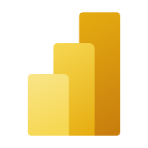
Microsoft Fabric
Data analytics for the era of AI
Data
Factory
Synapse Data
Engineering
Synapse Data
Science
Synapse Data Warehouse
Synapse Real Time Analytics
Power BI
Data Activator
OneLake
Notes:
OneLake revolutionizes data management by providing a single, unified data lake for the entire organization, much like how OneDrive operates for individual files. It's automatically provisioned with every Microsoft Fabric tenant, streamlining setup and management. This unified approach allows that there's only one copy of data across the organization, which can be used by multiple analytical engines, promoting efficiency and reducing redundancy.
With OneLake, data governance is embedded by default, and distributed ownership is enabled to foster collaboration while maintaining control within the tenant's boundaries. Workspaces within OneLake allow different parts of the organization to manage their own data access policies, yet all data remains within the governance framework set by the tenant admin.
The open nature of OneLake, built on Azure Data Lake Storage Gen2, supports both structured and unstructured data. It facilitates the storage of data in the Delta Parquet format, compatible with various analytics engines like T-SQL and Spark, allowing for flexible data operations without the need for duplication.
OneLake also enhances user accessibility, offering an intuitive file explorer for Windows that enables users to navigate their data with ease. This simplifies interactions with data lakes, allowing even non-technical users to upload, download, or modify files in a familiar environment.
By eliminating unnecessary data movement and duplication through features like shortcuts, OneLake allows organizations to share data effortlessly between users and applications. It provides a single, streamlined location for all tabular data, stored in a format optimized for use across different applications, thus enabling a seamless, integrated analytics experience across the entire data estate

Slide 6
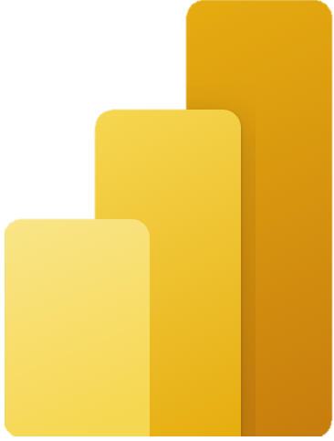
How does this relate to Power BI?
Gather
Clean
Model
Visualize

Slide 7
How does this relate to Power BI?
Gather

Slide 8
Demo
Build a Lakehouse in minutes
Notes:
Create a new lakehouse with a dataflows gen 2 connected to Adventure works SQL DB
Server: bhartmantestserver.database.windows.net
Database: bhartmantestdb

Slide 9
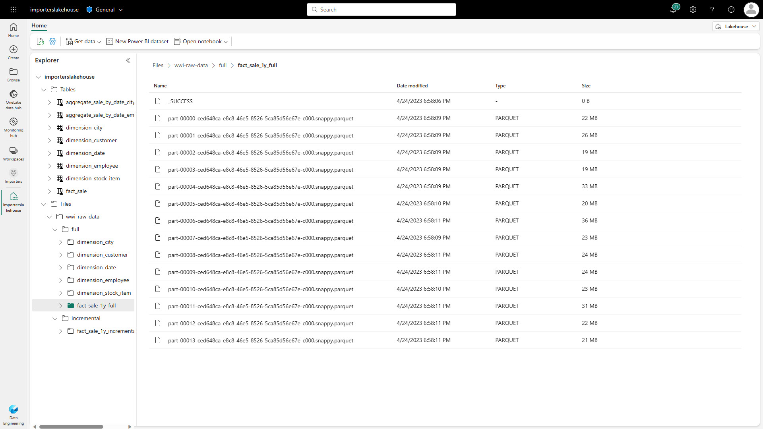
Lakehouse Overview
Store, manage, and analyze all your data in a single location and easily share across the entire enterprise.
Quickly and easily create a Lakehouse without having to provision and configure compute, storage, and networking.
Key Capabilities:
Flexible and scalable solution that enables organizations to handle large data volumes of all types and sizes
Built-in SQL endpoint unlocks data warehouse capabilities on top of your Lakehouse with no data movement
Use ‘direct lake’ mode to build reports in seconds directly on top of the data lake with blazing fast performance
Easily ingest data into the Lakehouse through a variety of methods
Share your Lakehouse as a data product with consumers
Notes:
Microsoft Fabric Lakehouse is a data architecture platform for storing, managing, and analyzing structured and unstructured data in a single location. It's a flexible and scalable solution that allows organizations to handle large volumes of data using various tools and frameworks to process and analyze that data. It integrates with other data management and analytics tools to provide a comprehensive solution for data engineering and analytics.
The Lakehouse incorporates a SQL analytics endpoint, automating the generation of a default semantic model upon creation. This feature provides a direct, performant experience from data ingestion to reporting, although it is read-only and doesn’t support the full T-SQL surface area of a transactional data warehouse​​.
It features automatic table discovery and registration for Delta format tables, streamlining file-to-table management for data engineers and scientists by automatically registering files into the metastore with the necessary metadata​​.
Users can interact with the Lakehouse using the Lakehouse explorer for data management, notebooks for code-based manipulation, pipelines for data integration, and Apache Spark for developing robust applications

Slide 10
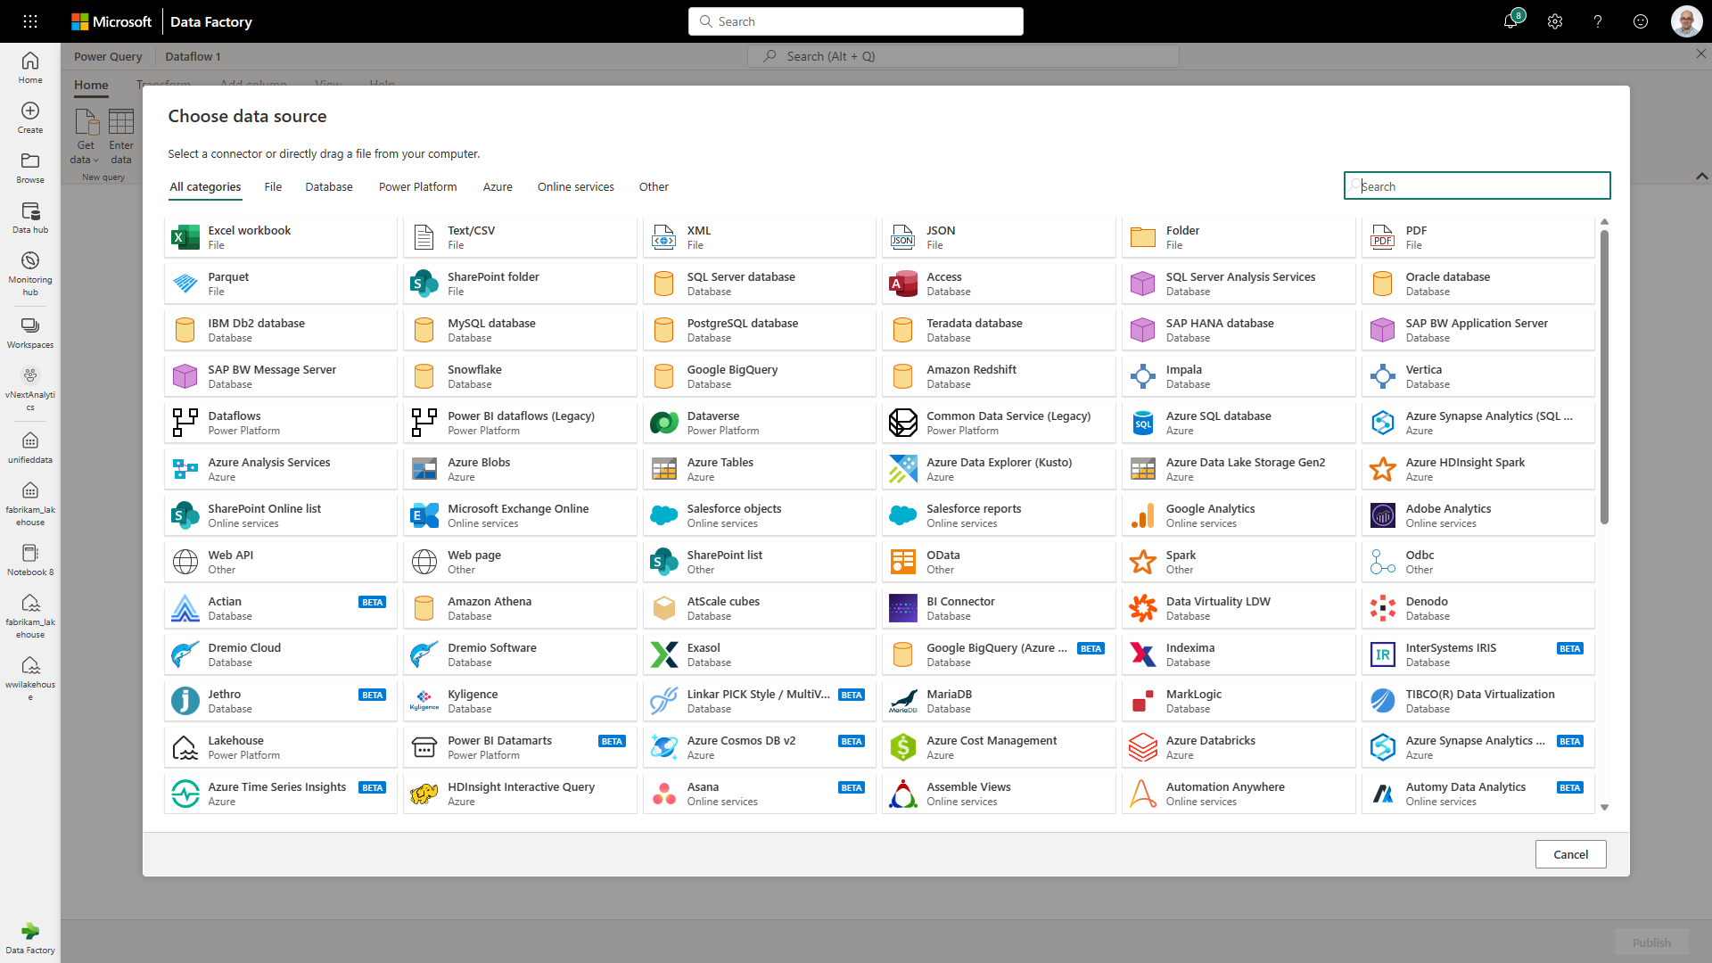
Dataflow Gen 2
Dataflow provides a low-code interface for ingesting data from hundreds of data sources.
Dataflow quickly and easily unifies disparate data sources, establishes a more collaborative analytics approach, and promotes more informed, agile decision making.
Key Capabilities:
Accelerate data transformation with code-free data flows
Standardize dataflows in Power Apps support for loading data
Load results of data transformations into multiple destinations (Azure SQL Databases, Lakehouse, etc.)
Notes:
A dataflow is a collection of tables that are created and managed in workspaces in the Power BI service. A table is a set of columns that are used to store data, much like a table within a database. These tables are created as a result of Power Query transformations.
The new generation of dataflows resides alongside the Power BI Dataflow (Gen1) and brings new features and improved experiences.
Similar to Dataflow Gen1, Dataflow Gen2 allows you to transform your data into dataflow's internal/staging storage where it can be accessed using the Dataflow connector. Dataflow Gen2 also allows you to specify a data destination for your data. Using this feature, you can now separate your ETL logic and destination storage. This feature benefits you in many ways. For example, you can now use a dataflow to load data into a lakehouse and then use a notebook to analyze the data. Or you can use a dataflow to load data into an Azure SQL database and then use a data pipeline to load the data into a data warehouse.
In Dataflow Gen2, we added support for the following destinations and many more are coming soon:
Fabric Lakehouse
Azure Data Explorer (Kusto)
Azure Synapse Analytics (SQL DW)
Azure SQL Database

Slide 11
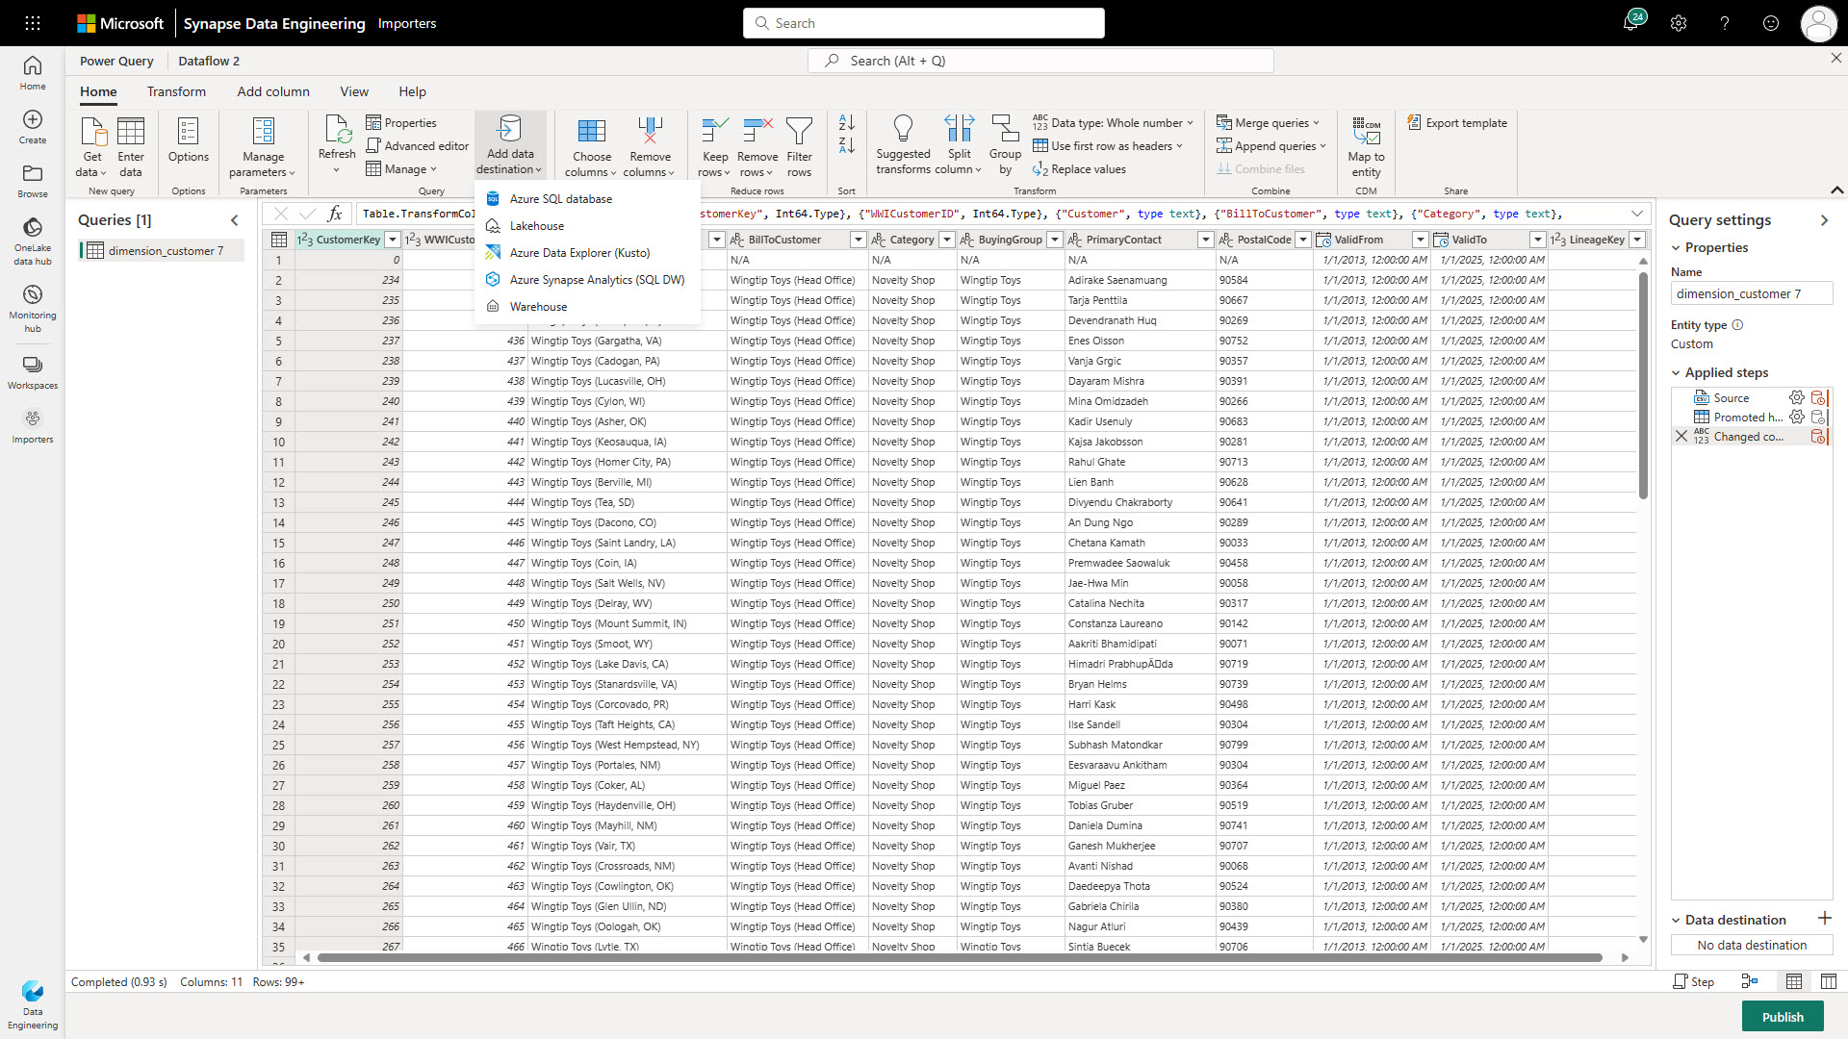
Dataflow Output to Lakehouse
Simply write into a Lakehouse from a Dataflow.
Users select the Lakehouse output destination from the list and configure the connection.
This requires the Lakehouse connector to be installed as a custom connector into your data gateway when loading data from on-premise.
Notes:
A dataflow is a collection of tables that are created and managed in workspaces in the Power BI service. A table is a set of columns that are used to store data, much like a table within a database. These tables are created as a result of Power Query transformations.
The new generation of dataflows resides alongside the Power BI Dataflow (Gen1) and brings new features and improved experiences.
Similar to Dataflow Gen1, Dataflow Gen2 allows you to transform your data into dataflow's internal/staging storage where it can be accessed using the Dataflow connector. Dataflow Gen2 also allows you to specify a data destination for your data. Using this feature, you can now separate your ETL logic and destination storage. This feature benefits you in many ways. For example, you can now use a dataflow to load data into a lakehouse and then use a notebook to analyze the data. Or you can use a dataflow to load data into an Azure SQL database and then use a data pipeline to load the data into a data warehouse.
In Dataflow Gen2, we added support for the following destinations and many more are coming soon:
Fabric Lakehouse
Azure Data Explorer (Kusto)
Azure Synapse Analytics (SQL DW)
Azure SQL Database

Slide 12
How does this relate to Power BI?
Gather
Clean

Slide 13
Demo
Perform ETL using Dataflows Gen2
Notes:
Open the SQL endpoint and query top on SalesOrderDetails
Change date/time to date
Query the SQL endpoint again to show the transformation go through

Slide 14
How does this relate to Power BI?
Gather
Clean
Model

Slide 15
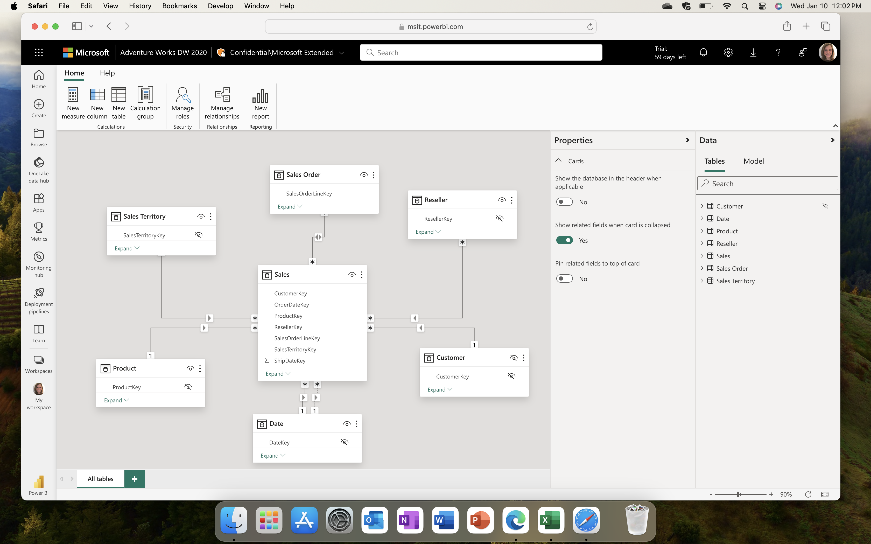
Semantic Model Editing in the Service
North Star: parity with Desktop
Autosave changes
Basic multi-author support
Supported Scenarios:
Manage relationships
Edit properties
Write DAX
Row-level security
Create new reports

Slide 16
Power BI Direct Lake Mode
Direct Lake is a fast-path to load the data from the lake straight into the Power BI engine, ready for analysis.
Direct Lake is based on loading parquet-formatted files directly from a data lake without having to query a Lakehouse endpoint, and without having to import or duplicate data into a Power BI semantic model.
Direct Query Mode. Slow, but real time
Storage
Database files
Data
Warehouse /
Lakehouse
SQL
Queries
Power BI
Analysis
Services
DAX
Queries
Tables
Scan
Reports
Storage
Database files
Data
Warehouse /
Lakehouse
Power BI
Analysis
Services
DAX
Queries
Tables
Scan
Import
Reports
Copy of
Tables
Direct Lake Mode. Fast and real time
OneLake
Parquet/Delta Lake
Data
Warehouse /
Lakehouse
Power BI
Analysis
Services
DAX
Queries
Tables
Scan
Reports
Notes:
Direct Lake is a semantic model capability in Power BI for analyzing large data volumes, loading parquet-formatted files directly from a data lake like OneLake. This mode enhances performance by avoiding data duplication and query translation, providing real-time data analysis​​.
Prerequisites for Direct Lake include Power BI Premium P or Microsoft Fabric F SKUs, and the provisioning of a Lakehouse with delta tables on supported Power BI or Microsoft Fabric capacities​​​​.
Direct Lake models support write operations through the XMLA endpoint, enabling customization, version control, and automation with tools like SQL Server Management Studio and Power BI Desktop​​​​​​.
The models feature unique metadata properties, supporting Direct Lake partitions and shared expressions for data sources, with capabilities for fallback to DirectQuery mode under certain conditions​​.
Data changes in OneLake are automatically reflected in Direct Lake models, but this can be disabled for manual refresh, offering flexibility in data management. However, Direct Lake has limitations, including support for single Lakehouse or Data Warehouse sources and some restrictions in model types and data types​

Slide 17
Demo
Create a Direct Lake semantic model
Notes:
Show:
New manage relationships dialog and create one relationship (SalesOrderDetail to Product by productid many to 1 single and active)
Custom RLS (SalesLT_Address table where StateProvince Equals Washington)
Sort by – just show it don’t change
Simple DAX example - Total Orders = DISTINCTCOUNT(SalesLT_SalesOrderHeader[SalesOrderID])
Model explorer - I can see all tables and relationships with a full view of all semantic objects in model pivot. I can see all roles, relationshionships, perspectives, and measures even in different tables. Even calc groups are listed.
Calc group – just speak to it

Slide 18
How does this relate to Power BI?
Gather
Clean
Model
Visualize

Slide 19
Demo
Create a new Power BI report using Copilot
Notes:
Adventureworks 2 custom model
Create a page that shows customers by date

Slide 20
Coming soon to Fabric semantic modeling

Slide 21
Demo
Version History

Slide 23
Demo
DAX Query View

Slide 24
Notes:
Focusing on DAX – not Copilot features
Open dax query view
Here you can run DAX queries you write such as this sample one where I will get the top 100 rows of my fact table
I also can do this another way in the context menu of my fact table by selecting quick queries
Another useful quick query is to show column statistics. This can help me get a quick sense of my model by seeing helpful information like the count, max, and min for each of the columns in my table.
Not only can I run these quick queries for my tables but I also can do it for my columns as well to see the top rows and column statistics.
This is also really helpful with allowing me to understand all the measures in my model. I can select to see all measure definitions in my model to get a quick and easy view of all my measure in one single location.
I can also evaluate individual measures from this view. I can see how these measures are defined, test out new definitions, and apply these changes to my measures back to the model.
For my more complex measures I can also define all the measures it references in a simple view to help me understand how this complex measure is constructed. I can run the result right here to test it to make sure it behaves as expected.

Slide 25
Demo
Measure descriptions with copilot
Notes:
Show measure description example for the measure I created earlier

Slide 26
Questions?
Notes:
10 min

Slide 27
Session evaluation
Event evaluation

Slide 28
Platinum partners
Goud partners
Zilver partners
Brons partners
Community partners

