Slide 1

Elevate the art of possible with the new card and slicer visuals
Grzegorz (Greg) Strzymiński

Slide 2




























Platinum partners
Goud partners
Zilver partners
Brons partners
Community partners

Slide 3






Grzegorz (Greg) Strzymiński
Power BI Consultant and Trainer
Kearney, Warsaw, Poland
Developing end-to-end reporting and analysis solutions
Designing data models and pipelines
DAX fan

Slide 4
Agenda
New (button) slicer visual
New card visual
Live demos

Slide 5
After this session you will be:
Familiar with the current capabilities of the new card and slicer visuals.
Able to identify scenarios in which using these functionalities will result in tangible benefits.
Equipped with the technical knowledge needed to implement the new card and slicer visuals in your reports literally the next day.

Slide 6


New (button) slicer visual
Old
New

Slide 7
New slicer visual timeline
Currently only button slicer is released
There are plans to release next slicers. Microsoft roadmap:
  Button slicer - released
  List and dropdown slicer – date tbd
  Slider – date tbd
  Calendar slicer - date tbd
  Relative slicer – date tbd

Slide 8
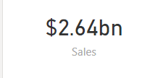
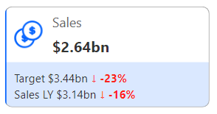
New card visual
Old
New

Slide 9
New card visual timeline
Currently multi cards and reference labels are released
There are plans to continue the development. Microsoft roadmap:
  Multi card - released
  Reference labels – released
  Small multiples – date tbd
  Actions - date tbd
  Trends – date tbd

Slide 10
Live demos
Let’s see some live examples in Power BI

Slide 11
Key takeaways
New card and button slicer visuals offer a great degree of customizability and a number of interesting features.
You should choose the new visuals over the older ones whenever you need a more fancy design over the basic one.
Definitely go for the new card visual if you can consolidate some visual elements using it. The performance of your report will be better.
New card and slicer visuals are fully reusable of course. Use copy & paste and you can reuse them with another dimension.
Both the new slicer and card visuals are in preview – some bugs are just expected.

Slide 12
Q&A

Slide 13
Thank you!
Grzegorz Strzymiński
https://www.linkedin.com/in/grzegorz-strzyminski/
  grzegorz.strzyminski@kearney.com

Slide 14


Session evaluation
Event evaluation

