Slide 1
AI/ML + Fabric + Power BI = Insights²
✗ ChatGPT / Open AI
✗ Co-pilot
✗ Sentiment Analysis
✗ Cognitive Services
✓ Custom ML Models
✓ Low-code (Python + DAX)
Arthur Graus
Power BI trainer / consultant / developer / ML enthusiast

Slide 2
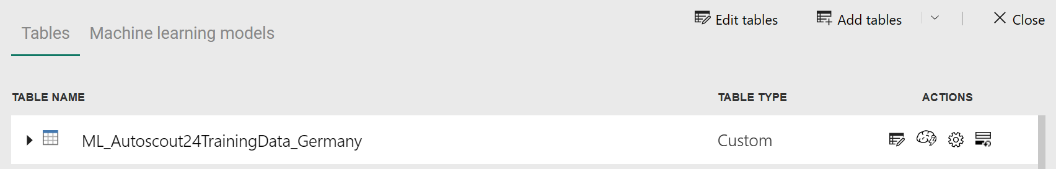
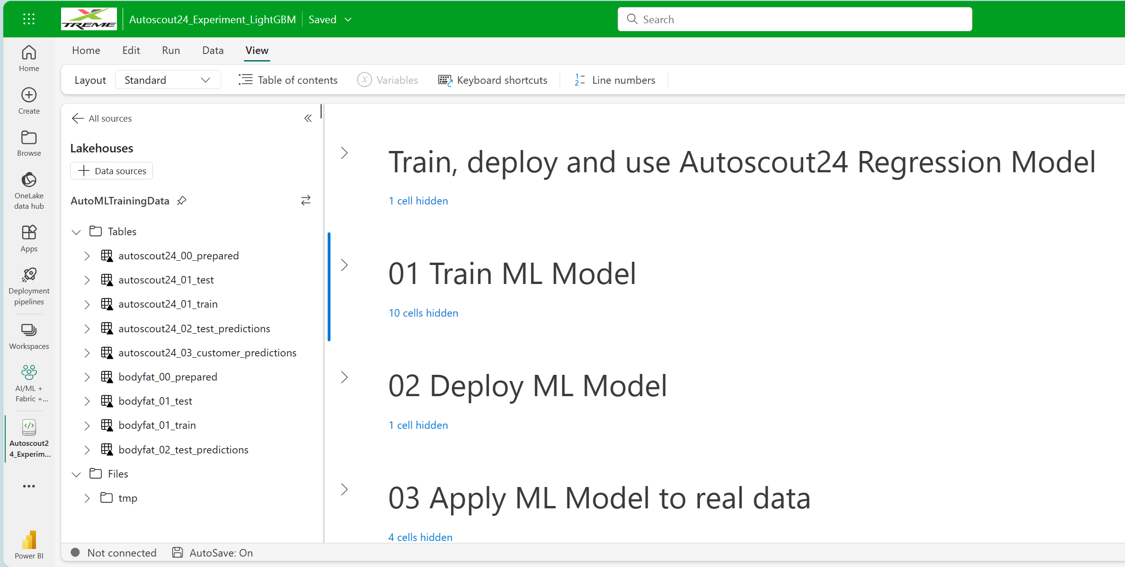
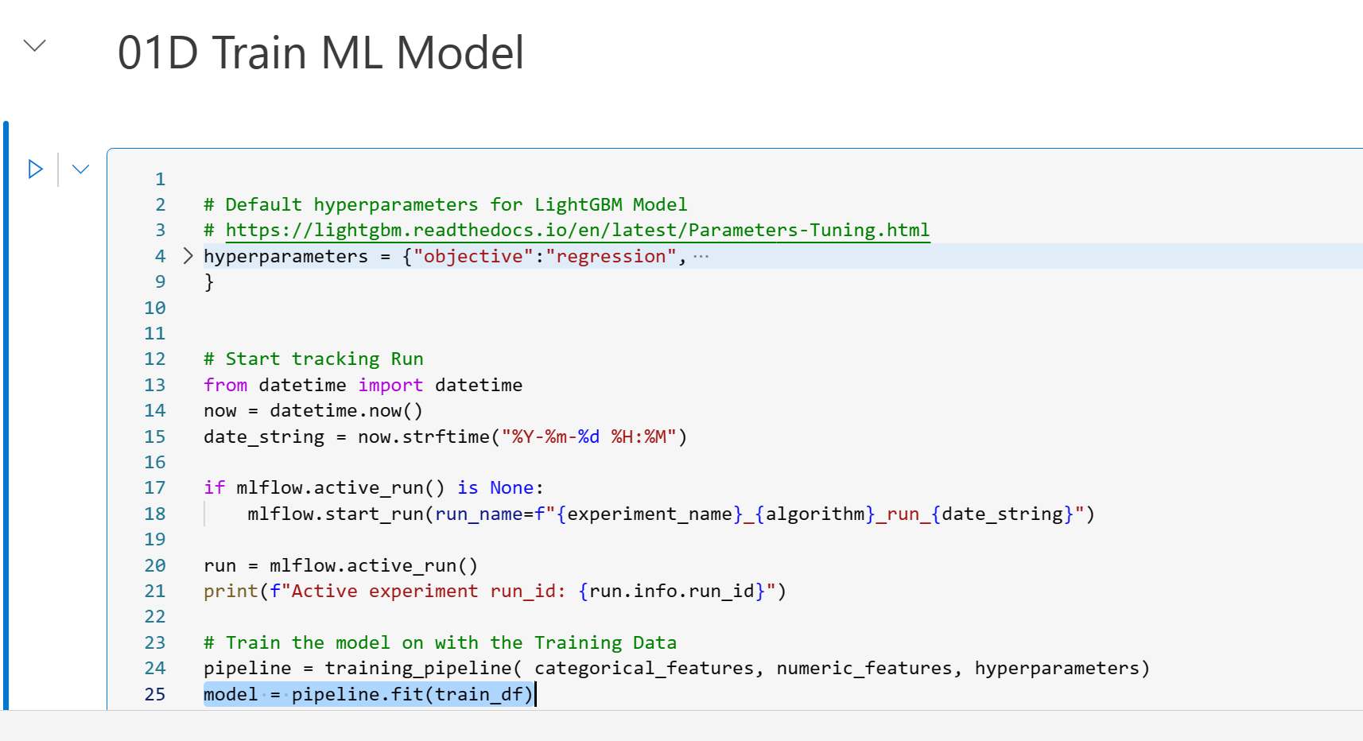
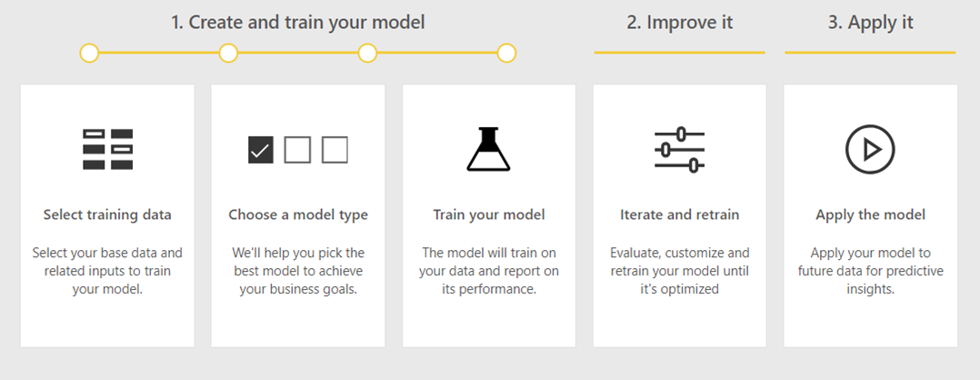
AI/ML + Fabric + Power BI = Insights²
✗ ChatGPT / Open AI
✗ Co-pilot
✗ Sentiment Analysis
✗ Cognitive Services
✓ Custom ML Models
✓ Low-code (Python + DAX)
Arthur Graus
Power BI trainer / consultant / developer / ML enthusiast

Slide 3

























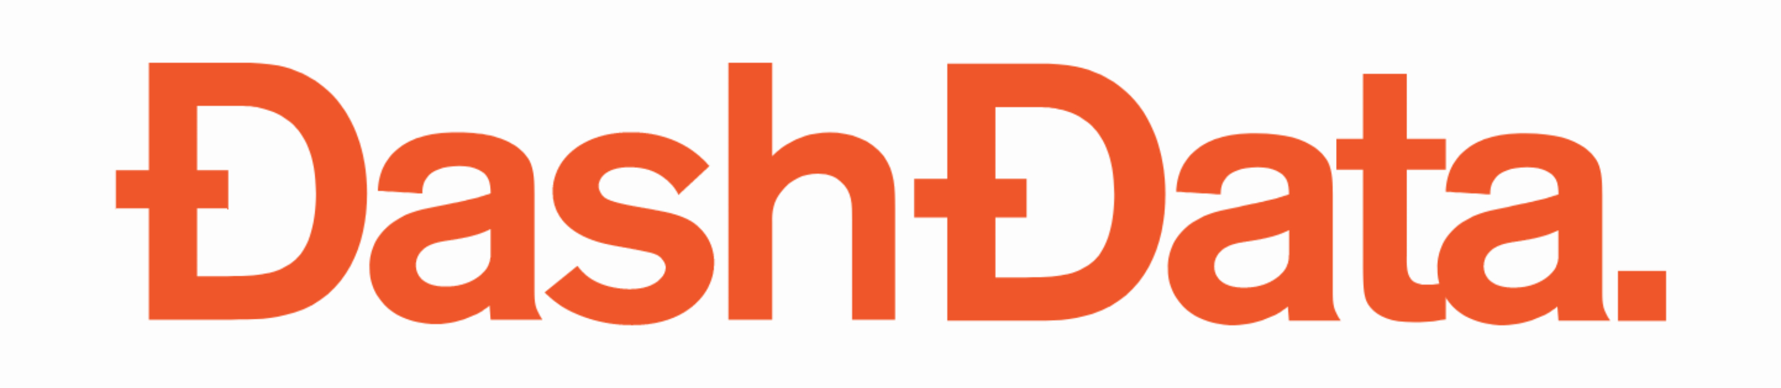


Platinum partners
Goud partners
Zilver partners
Brons partners
Community partners

Slide 4


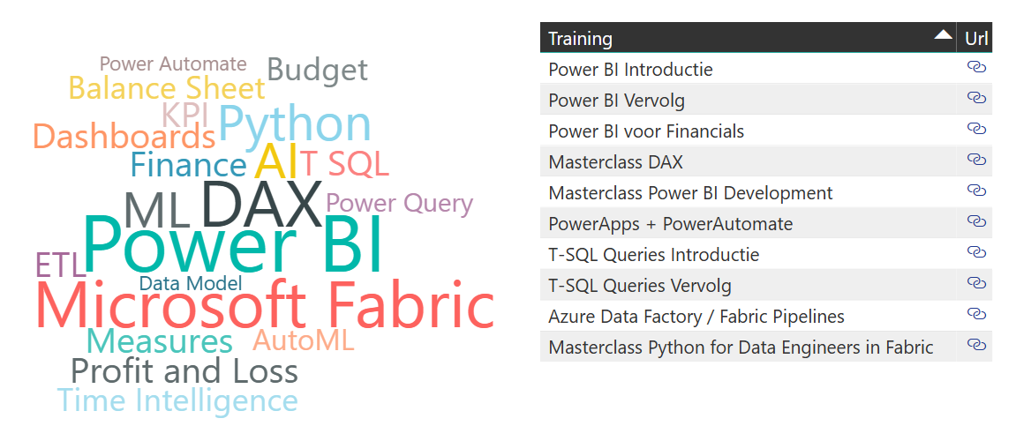


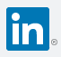
Bio: Arthur Graus
Power BI + MS Fabric Trainer | Developer / ML Enthusiast
info@arthurgraus.nl
https://www.linkedin.com/in/arthurgraus

Slide 5
Agenda
AI / Machine Learning introduction
ML Supervised Learning: Classification v.s. Regression
Exploratory Data Analysis with Power BI:
Statistics, Scatter diagram, Histograms, Correlation Matrix, Pair Plot + Key Influencers Visual
Fabric Introduction: Lakehouse, Data Engineering + Data Science
ML Regression with Fabric + MLFlow + Power BI:
Train, evaluate performance and apply Regression Model
ML Classification with Fabric + MLFlow + Power BI :
Train, evaluate performance and apply Classification Model
Lessons learned ML + Fabric + Power BI

Slide 6
AI – ML history
1956
Artificial Intelligence
  the field of computer science that seeks to create intelligent machines that can replicate or exceed human intelligence
Artificial Intelligence
Machine Learning
1997
Machine Learning
  subset of AI that enables machines to learn from existing data and improve upon that data to make decisions or predictions
Deep Learning
2017
Deep Learning
  a machine learning technique in which layers of neural networks are used to process data and make decisions
Generative AI
2021
Generative AI
  create new written, visual, and auditory content given prompts or existing data. Chat-GPT

Slide 7
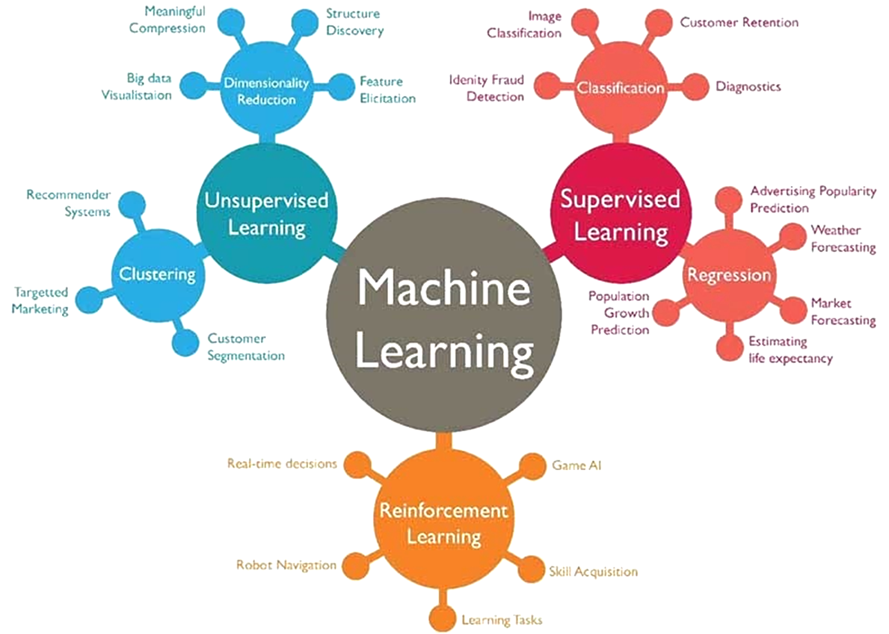
BI / Big Data
Introduction to Machine Learning for Beginners | by Ayush Pant | Towards Data Science

Slide 8
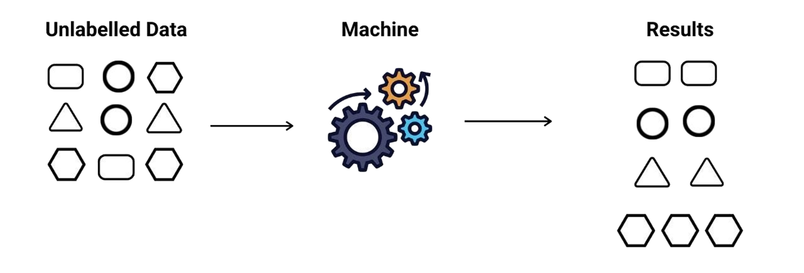
Machine Learning: Unsupervised - Clustering
Complicated stuff /
not in ML for Dataflows
Group data
Use cases: Customer Segmentation, Anomaly Detection, Market Research, Images Segmentation, Basketcase Analysis

Slide 9
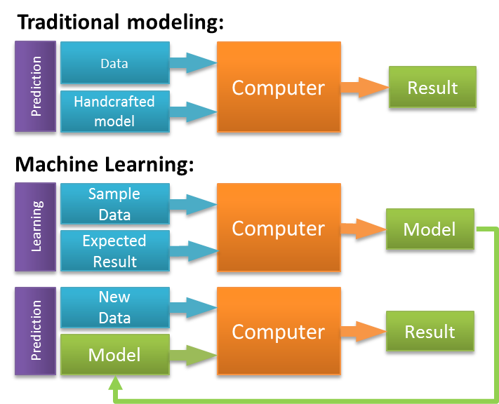
Machine Learning: Supervised Learning

Slide 10
Machine Learning Model components
Input Features:
Dataset Columns
Output:
Predicted value or label/class
Algorithm(s):
Linear Regression, Decision Tree, Random forest, SVM, Logistic Regression, Neural Network, XGBoost, Light-GBM etc.
Hyperparameters:
Algorithm specific settings like: Maximum depth of the tree for Random Forest
Azure Machine Learning:
Service used for training and hosting ML Model

Slide 11
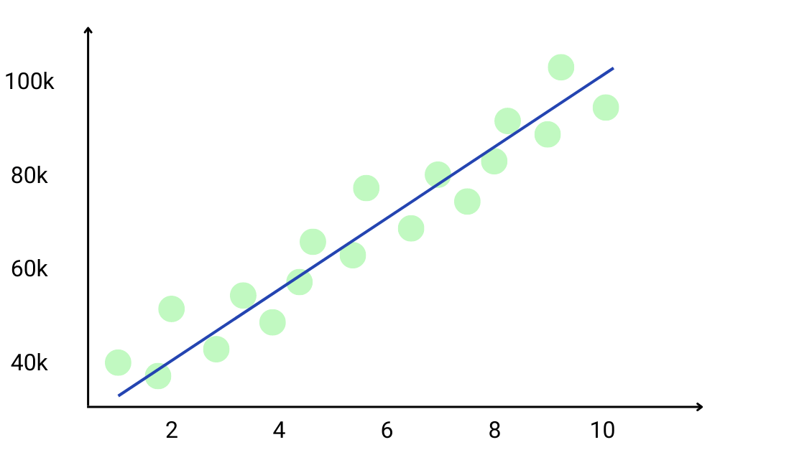
Machine Learning - Supervised – Regression
Predict a value:

Slide 12
Machine Learning - Supervised – Regression
Use Cases:
Real Estate:
Predicting house prices based on features like size, location, number of bedrooms, etc.
Finance:
Credit score prediction based on a user's financial history.
Healthcare:
Estimation of medical costs for patients with specific conditions.
Energy:
Forecasting energy demand based on historical consumption, weather data etc.
Retail and E-commerce:
Predicting sales based on historical data, promotional activities, etc.
Forecasting inventory demand to optimize stock levels.

Slide 13
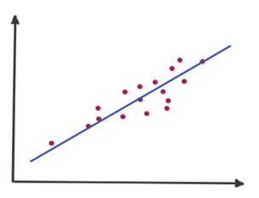
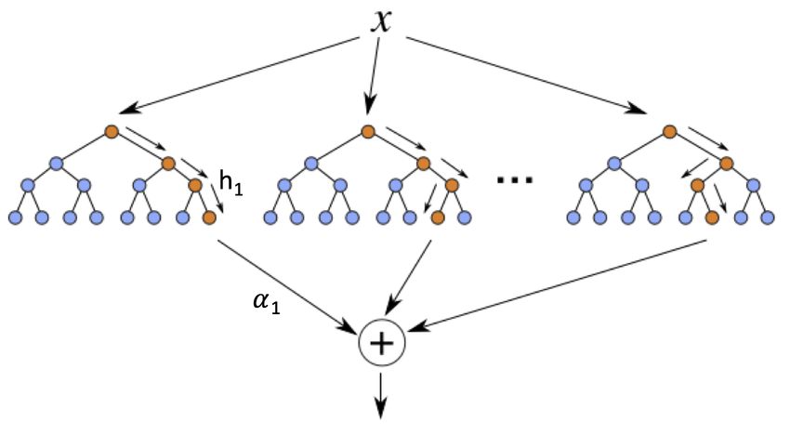
Machine Learning - Supervised – Regression – Algorithms:
No need to know all of them!!!
Linear models
Linear Regression
Ridge Regression
Lasso Regression
Bayesian Ridge
Linear Regression
Non-linear models
Support Vector Machine Regression (SVR)
Decision Tree Regression
Random Forest Tree
XG-Boost Regressor
Gradient Boosting Regression
Light-GBM Regressor
XGBoost Regressor
Notes:
Not necessarily a straight line predictions. Y variable has curvature still make predictions
Don’t be discouraged by the name.
Fast especially linear regression
Also interpretable
Explain linear independent/ linear combination
Interpretable, give example
Non linear longer to train more complicated but more adaptable
Also not interpretable (but is)

Slide 14
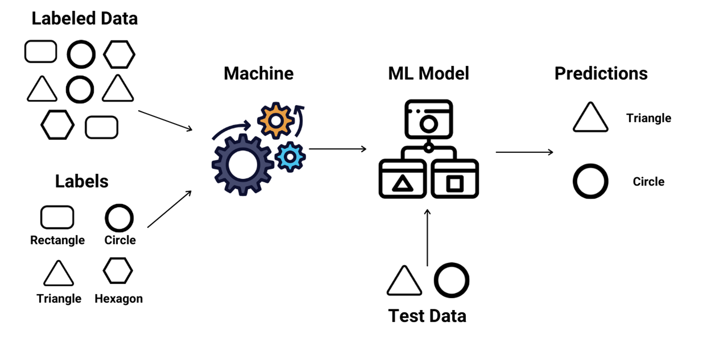
Machine Learning - Supervised - Classification
Predict a Label: 1, 0 (Binary) or A,B,C, D (Multi-class)

Slide 15
Machine Learning - Supervised - Classification
Use Cases:
Email Filtering:
Classifying emails as either spam or not spam.
Sentiment Analysis:
Determining whether a given piece of text expresses positive, negative, or neutral sentiment.
Customer Churn Prediction:
Predicting if a customer will leave a service or product in the near future.
Fraud Detection:
Identifying fraudulent transactions based
Loan Approval Systems:
Predicting whether a loan applicant is high-risk or low-risk.
Medical Diagnoses:
Classifying diseases based on medical imaging data.

Slide 16

Exercise – Machine Learning with your data
What could be your Use Cases?
Regression:
Real Estate Pricing
Finance Credit Score
Healthcare Medical Costs
Energy Consumption
Retail and E-commerce Sales
Other
Classification:
Email Filtering
Sentiment Analysis
Customer Churn Prediction
Fraud Detection
Loan Approval Systems
Medical Diagnoses
Other

Slide 17


Case I: Car Prices Regression
Background:
Xtreme Car Insurance Corp. wants to analyze the distribution of Total Current Value of all insured cars across Europe.
Objective:
Estimate the current value of an insured car based on generic Autoscout24 data.
Actions:
  Explore data Autoscout 24 to find correlations (Exploratory Data Analysis)
  Train Regression Model with ML in Fabric
  Evaluate performance of the model using Fabric + Power BI
  Apply Model to Customers car data
  Visualize Total Current Value in Power BI Map

Slide 18
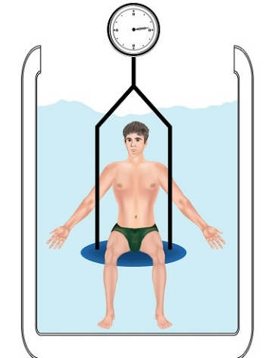
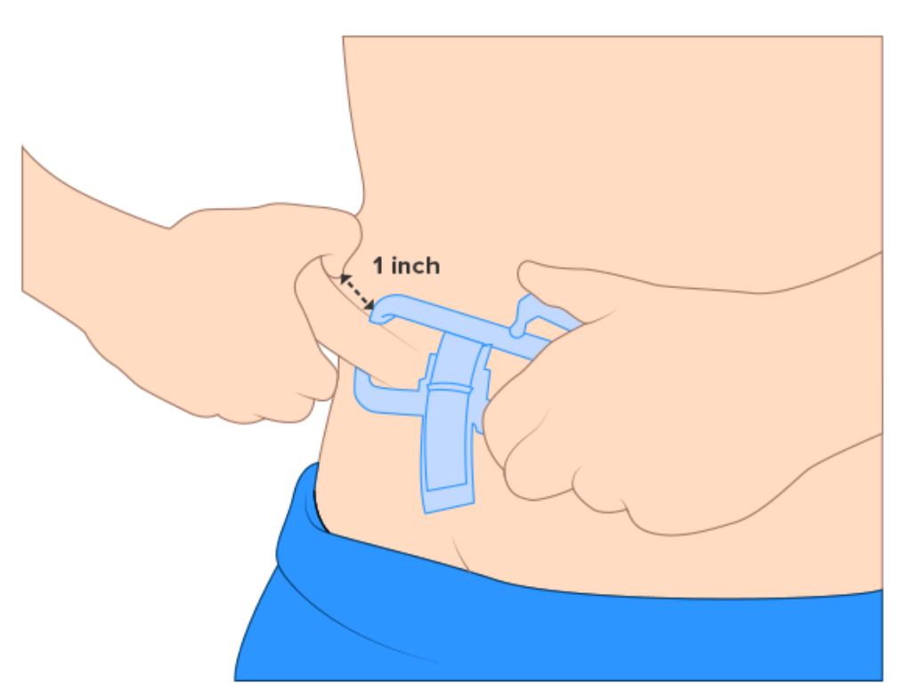
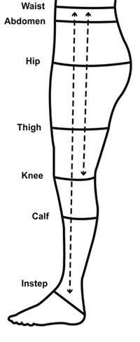

Case II: Bodyfat % / overweight
Background:
Heathinsurance Corp. wants to give healthy customers a discount based upon metrics like Bodyfat %.
Objective:
Determine overweight status using body fat percentage from simple home measurements: height, weight, abdomen, hip, thigh etc.
Actions:
  Explore Bodyfat data to find correlations between simple measurements
  Train ML Regression / Classification Model in Fabric
  Evaluate model performance
  Apply Model to Customer Measurements data
  Visualize Overweight % in different Age Categories in Power BI

Slide 19
Exploratory Data Analysis (EDA)
Goal:
Understand the data you are working with and find correlations between Features
Statistics:
Min, max, average, median, and standard deviation
Data Visualization:
  Histograms: To see the distribution of the data.
  Scatter Plots: To find relationships between variables.
  Pair Plots: To visualize pairwise relationships in a dataset.
  Correlation Matrices: To understand the linear relationship (Correlation Coefficient) between variables.
  Key Infuencers Visual

Slide 20
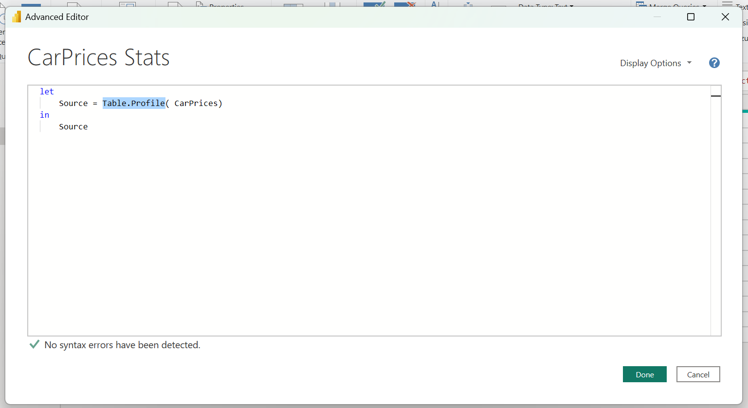
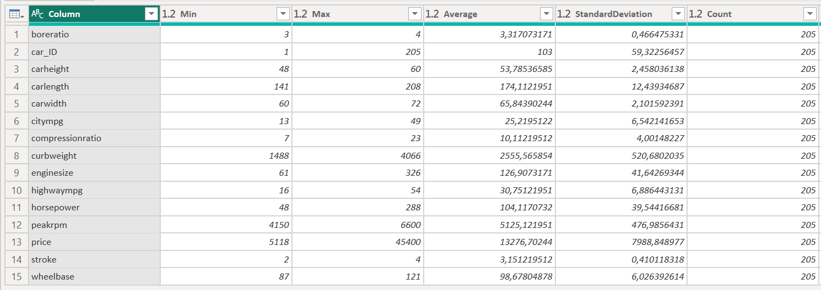
Summary Statistics in Power BI – Power Query

Slide 21
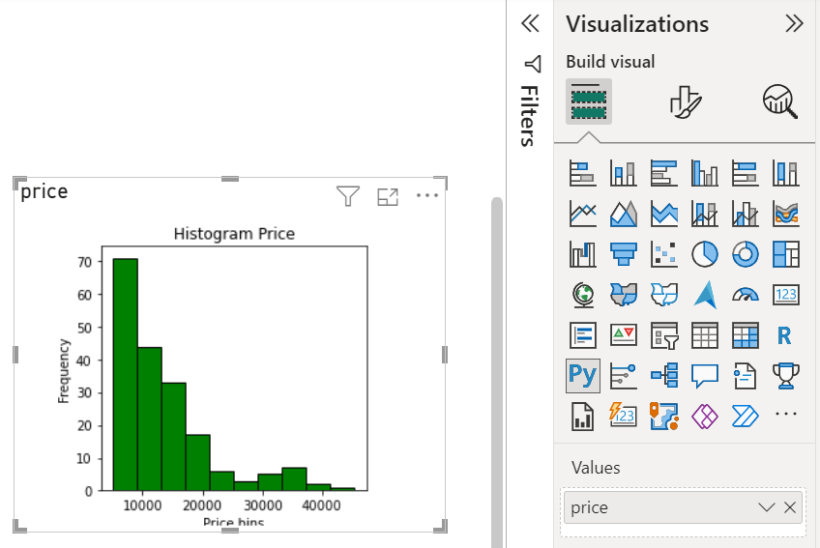
Histogram in Power BI with Python Visual
import matplotlib.pyplot as plt
plt.hist(dataset['price'],bins=10, color='green', edgecolor='black')
plt.xlabel('Price bins')
plt.ylabel('Frequency')
plt.title('Histogram Price')
plt.show()

Slide 22
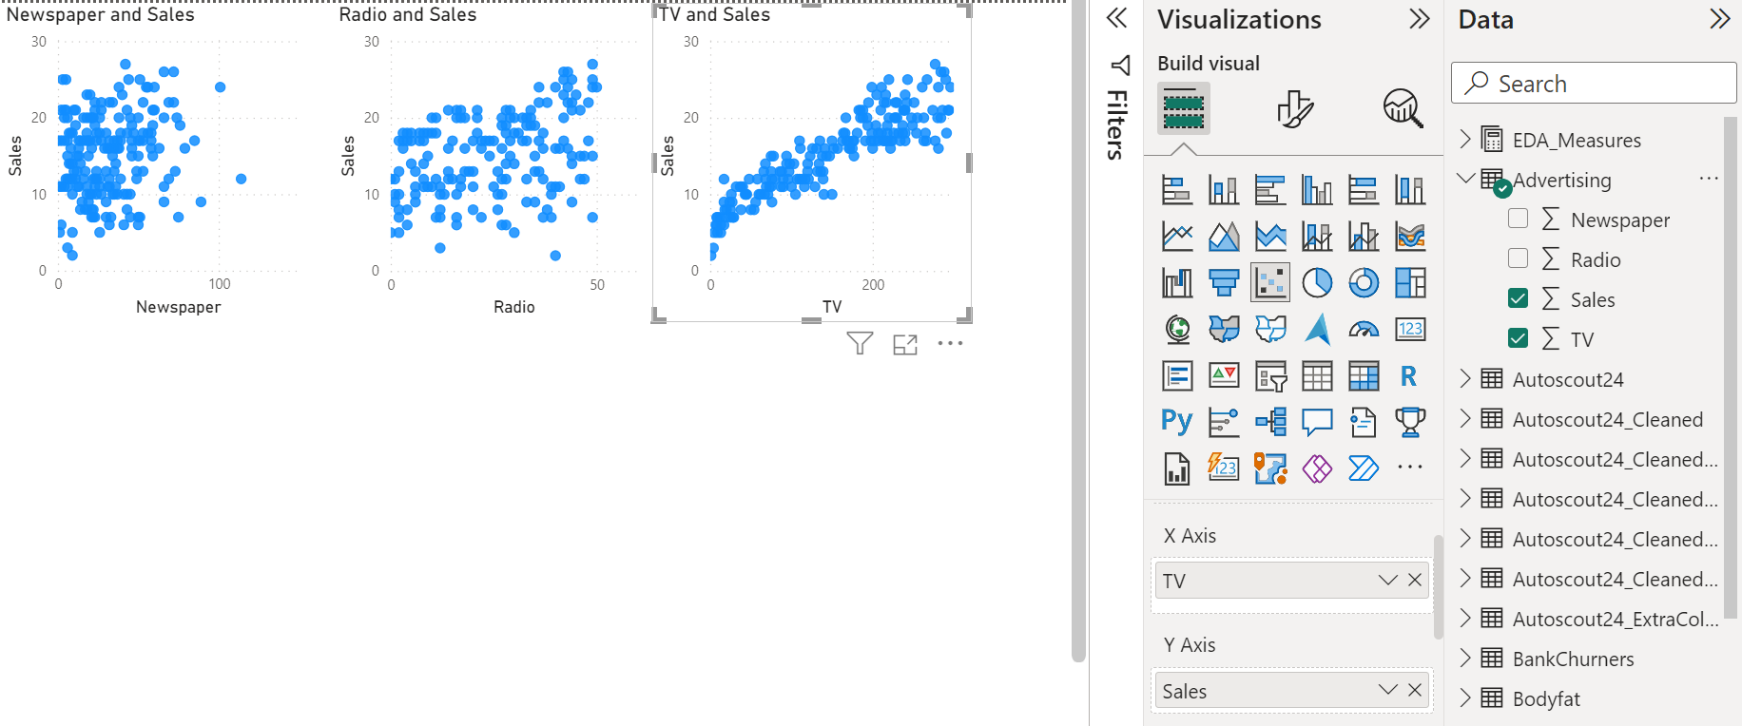
Scatter Chart
Visualize the correlation between two columns: X and Y
Set summarization to None

Slide 23
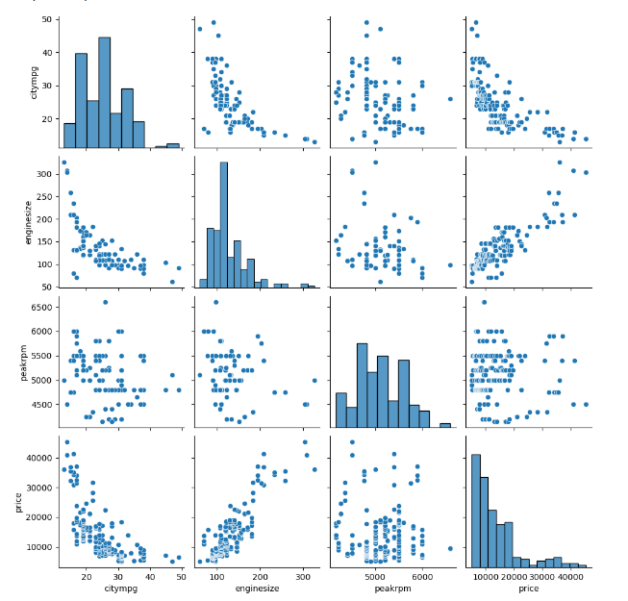
Pair Plot
import numpy as np
import pandas as pd
import matplotlib.pyplot as plt
import seaborn as sns
sns.pairplot(dataset)
plt.show()

Slide 24
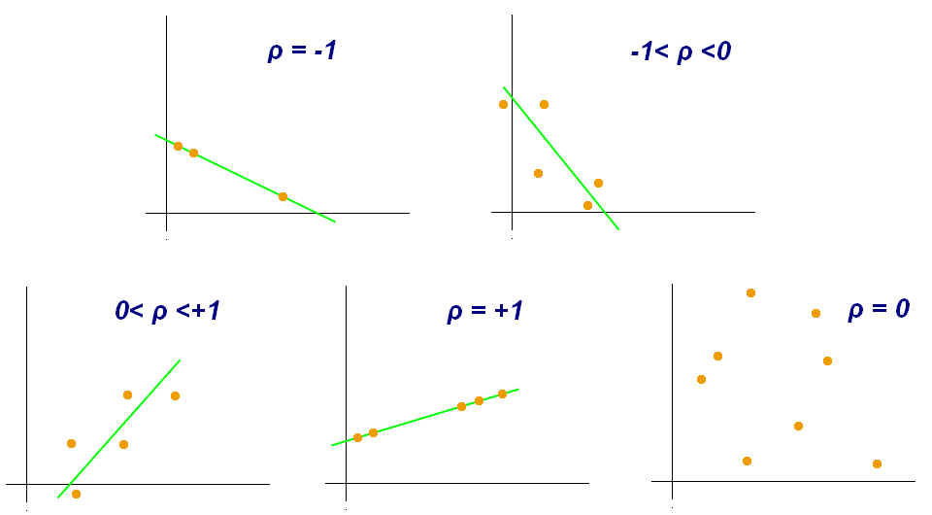
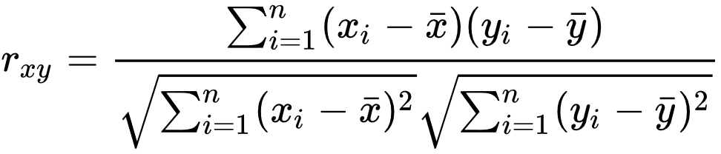
(Pearson) Correlation Coefficient
between 0.1 and 0.3 (or -0.1 and -0.3): weak correlation
between 0.3 and 0.7 (or -0.3 and -0.7): moderate correlation
between 0.7 and 1.0 (or -0.7 and -1.0): strong correlation
Pearson correlation coefficient - Wikipedia

Slide 25
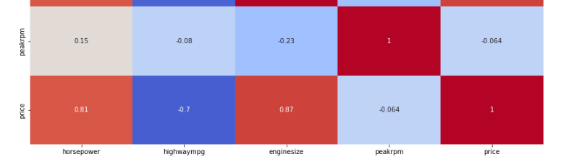
Correlation Matrix
import pandas as pd
import seaborn as sns
import matplotlib.pyplot as plt
correlation_matrix = dataset.corr()
sns.heatmap(correlation_matrix, annot=True, cmap='coolwarm')
plt.show()

Slide 26
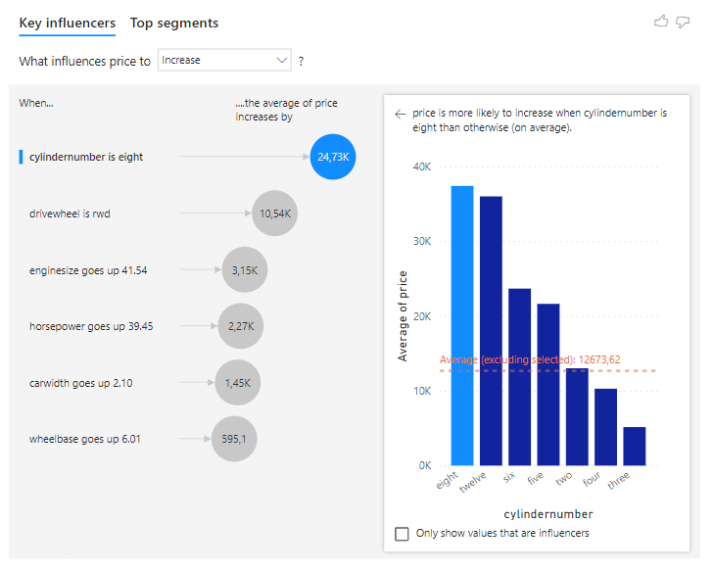
Key Influencers Visual
One stop EDA tool for finding relevant features and correlations

Slide 27
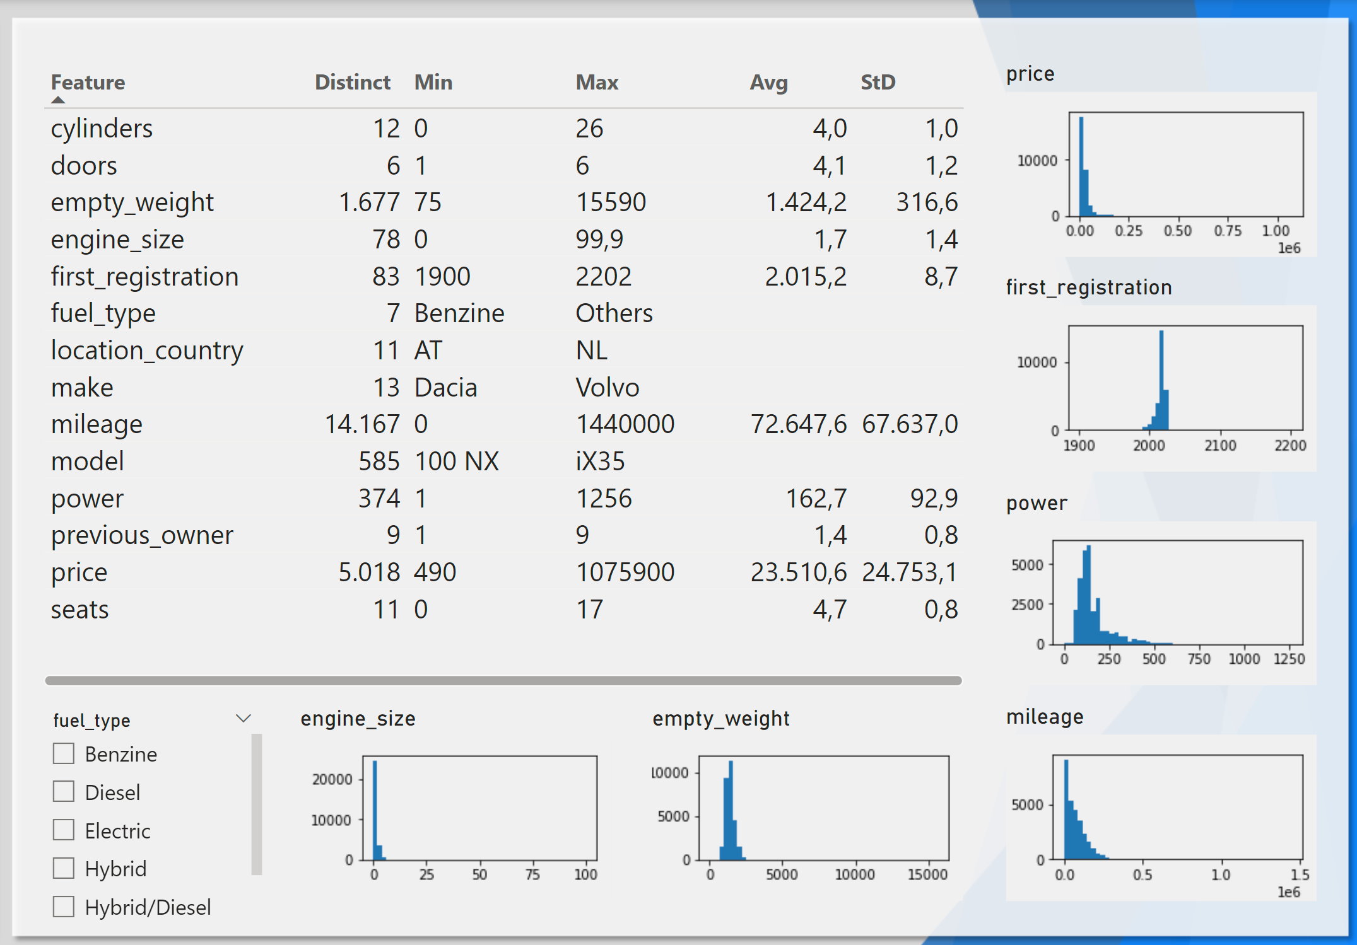
Exercise - EDA Autoscout 24 - Statistics
Which Calculated Columns to add?
Which filters to apply?
Which Columns to remove?

Slide 28
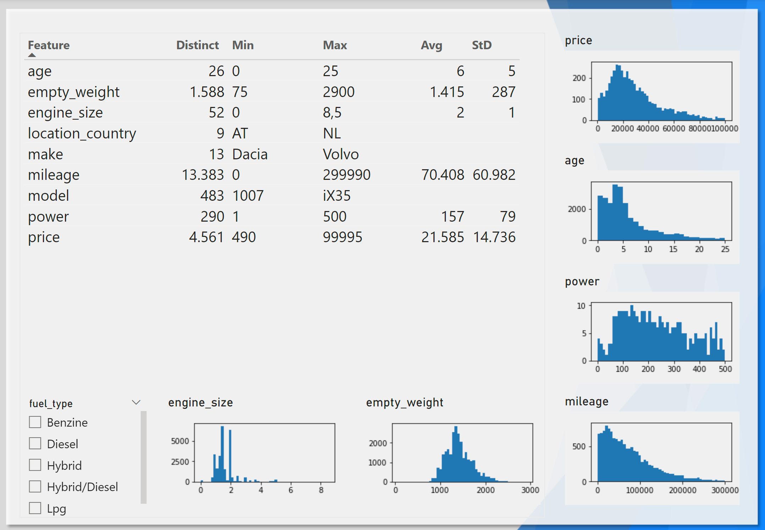
Exercise - EDA Autoscout 24 – Statistics - Solution
Added Columns:
[age] =
2022 – [first_registration]
Applied Filters:
[age] >= 0 And <= 25
[price] < 100.000
[power] <= 500
[mileage] < 300.000
[empty_weight] < 3.000
Removed Columns:
[doors]
[cylinders]
[first_registration]
[seats]

Slide 29
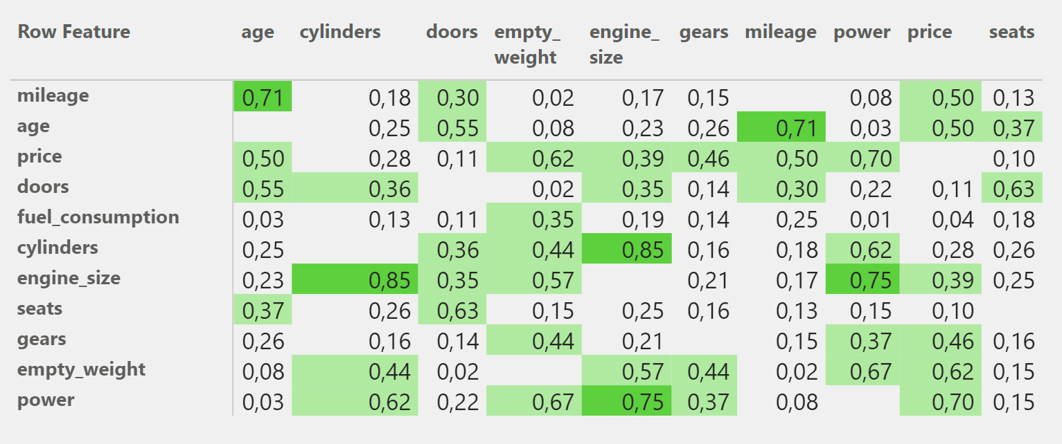
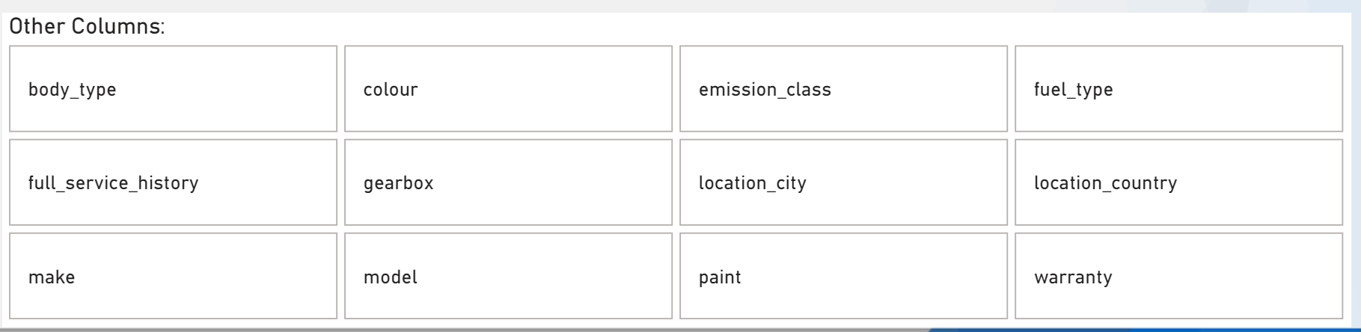
Exercise - EDA Autoscout 24 – Feature Selection
Which columns are Feature candidates based on the Correlation Matrix?
Which other columns would you add based on domain knowledge?

Slide 30
Exercise - EDA Autoscout 24 – Feature Selection - Solution
Which columns are Feature candidates based on the Correlation Matrix and/or on domain knowledge?

Slide 31
Train AutoML Model in Power Query

Slide 32
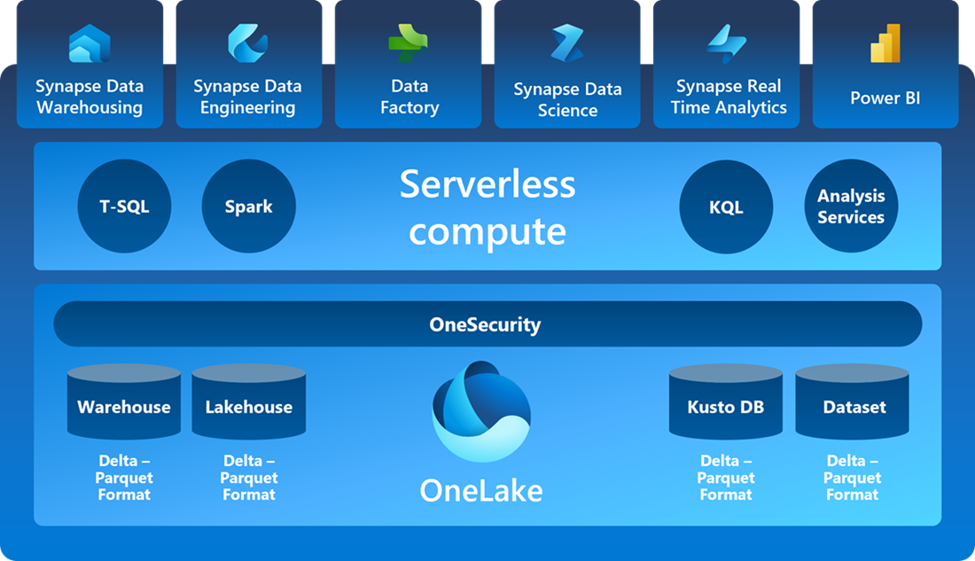

Microsoft Fabric 2023+

Slide 33
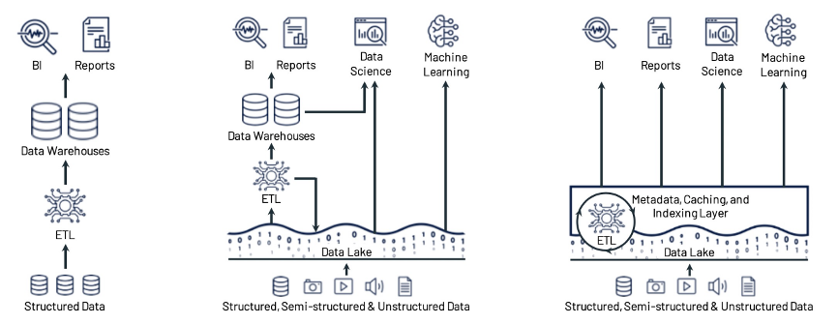
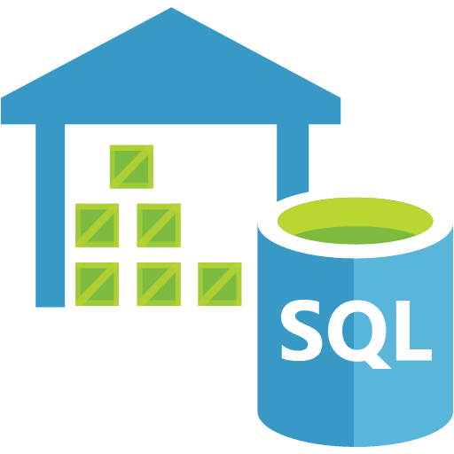
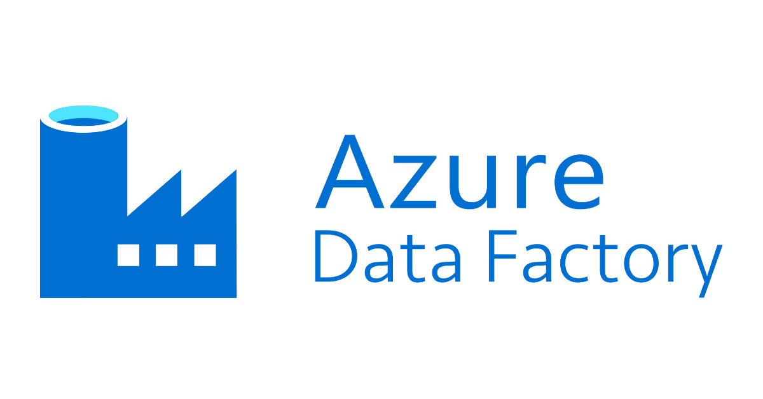
Big Data Architecture: Data Warehouse
Traditional BI Architecture
Pro's
  Well known architecture
  Works good for structured enterprese data like Sales, Financen, HR, Production
Con's
  The scale-out extension capability is poor.
  Expensive for large data volumes
  Not suitable for high-level and complex query and analysis scenarios, such as data science and ML scenarios.
Use Case
  BI
  Reporting
Technologies
  Azure SQL Parallel DW
  Azure Synapse Dedicated SQL

Slide 34



Big Data Architecture: Data Lake
Modern file and folder based architecture
Data is stored in CSV or Parquet format
Pro's
  Good for storing (semi) unstructured data, highly scalable
  Query lots of files using SQL language (Serverless)
  Low-cost storage
Con's
  Data redundancy brings greater storage overhead
  More complex ETL, extra layers
Use cases
  Machine Learning
  Data Science
Technologies
  Azure Synapse SQL Serverless Pools
  Azure Synapse Spark Clusters
  Azure Data Lake Storage Gen 2

Slide 35

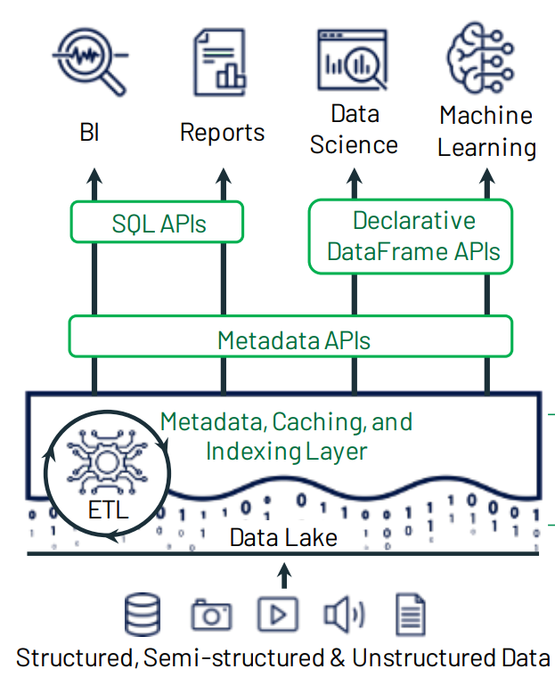
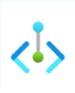


Big Data Architecture: Lakehouse
Lakehouse:
Adds intermediate metadata management layer provides reliable atomicity, consistency, isolation, and durability (ACID) transactions while providing performance optimization for database operations.
Supports data types of all structures and various analysis scenarios.
Technologies:
  Microsoft Fabric
    SQL End Point
    Apache Spark
    Delta Lake
    Delta Parquet
    OneLake
  Databricks
    Delta Lake
Lakehouse: A New Generation of Open Platforms that Unify Data Warehousing and Advanced Analytics

Slide 36
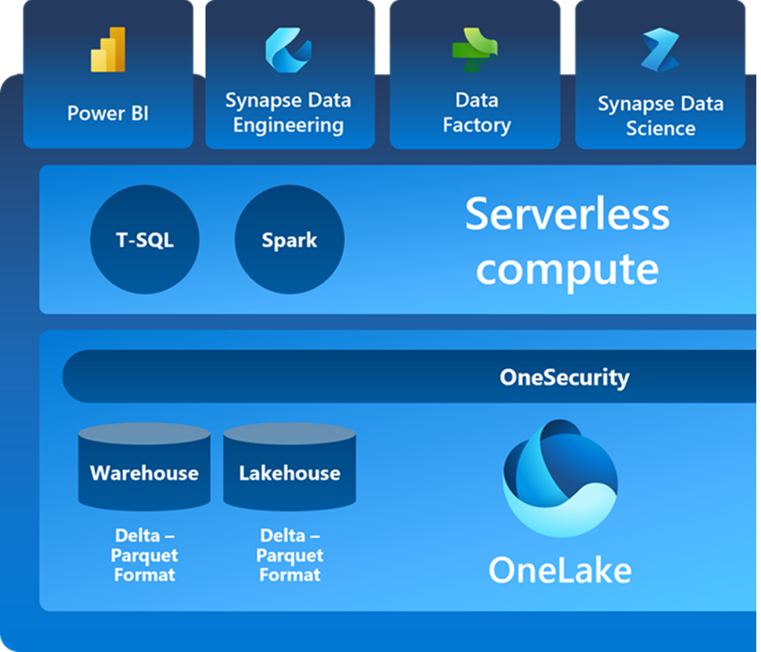





Train ML Model in Fabric
Prepare data: Cleans, Filter + Add/remove columns
Train model:
  Split data into Test + Train data
  Define Algorithm
  Train Algorithm with Train data
Evaluate performance
  Predict values on Test data
  Calculate Score
Deploy model
  Register Model
Apply model to real data
  Load real data
  Predict values on real data

Slide 37
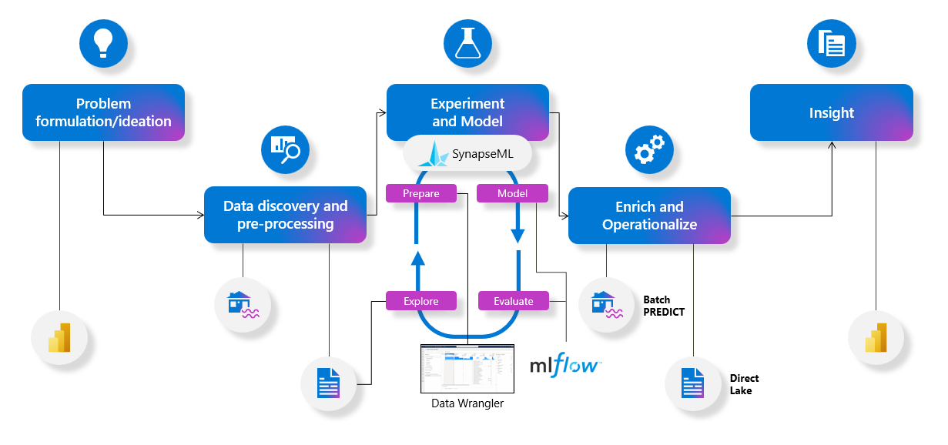
Synapse Data Science

Slide 38

LightGBM (Light Gradient Boosting Machine)
Microsoft Research:
Developed and released in January 2017
High Efficiency:
Optimized for speed and performance
Low Memory Usage:
Minimizes memory footprint during model training.
Parallel and GPU Learning:
Supports multi-core processing and GPU acceleration.
Versatile Application:
Applicable to a wide range of ML tasks: regression and classification
Ease of Use:
Easy integration with major programming languages and platforms.
LightGBM’s documentation

Slide 39
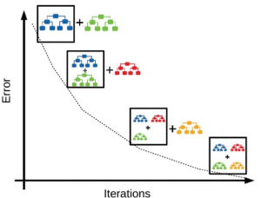
Gradient Boosting
Improves prediction accuracy by combining multiple weak decision tree models sequentially:

Slide 40
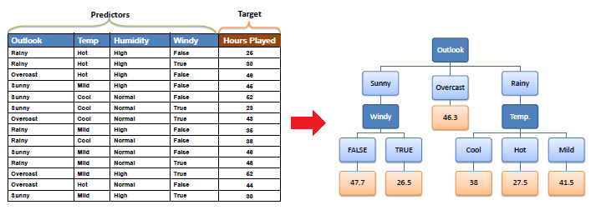
Decision Trees
Hierarchical model for decision-making through binary questions.
Can be used for Regression and Classification

Slide 41
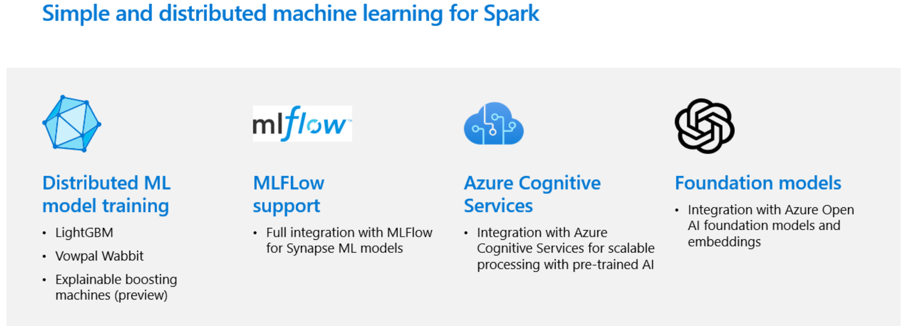
SynapseML

Slide 42
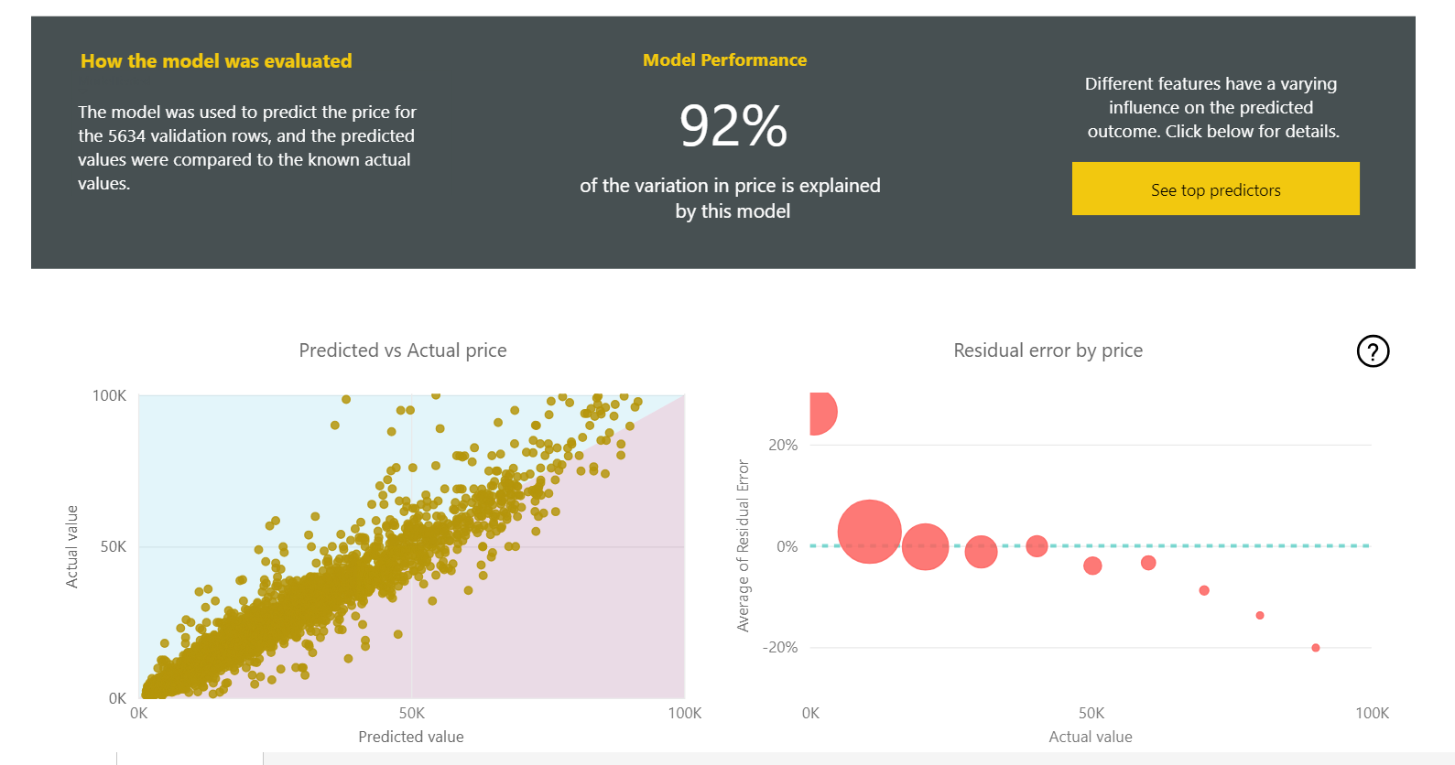
Performance Regression Model Car Prices
Input: Country, Make, Bodytype, Weight, Age, Mileage + Power
R²
MAPE
(Mean Absolute Percentage Error)

Slide 43
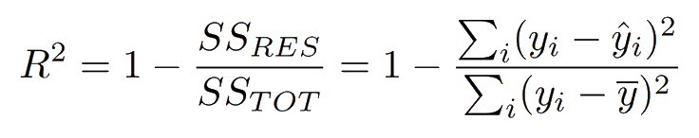
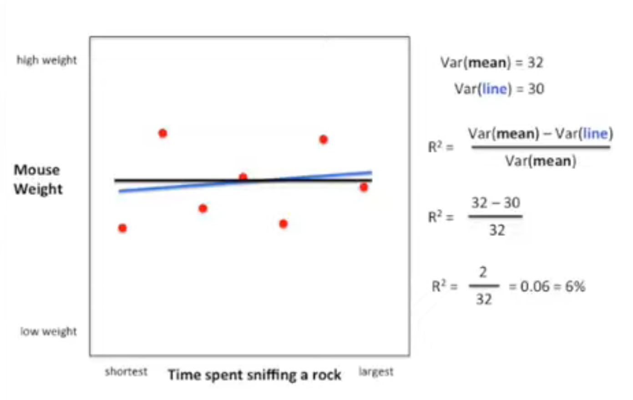
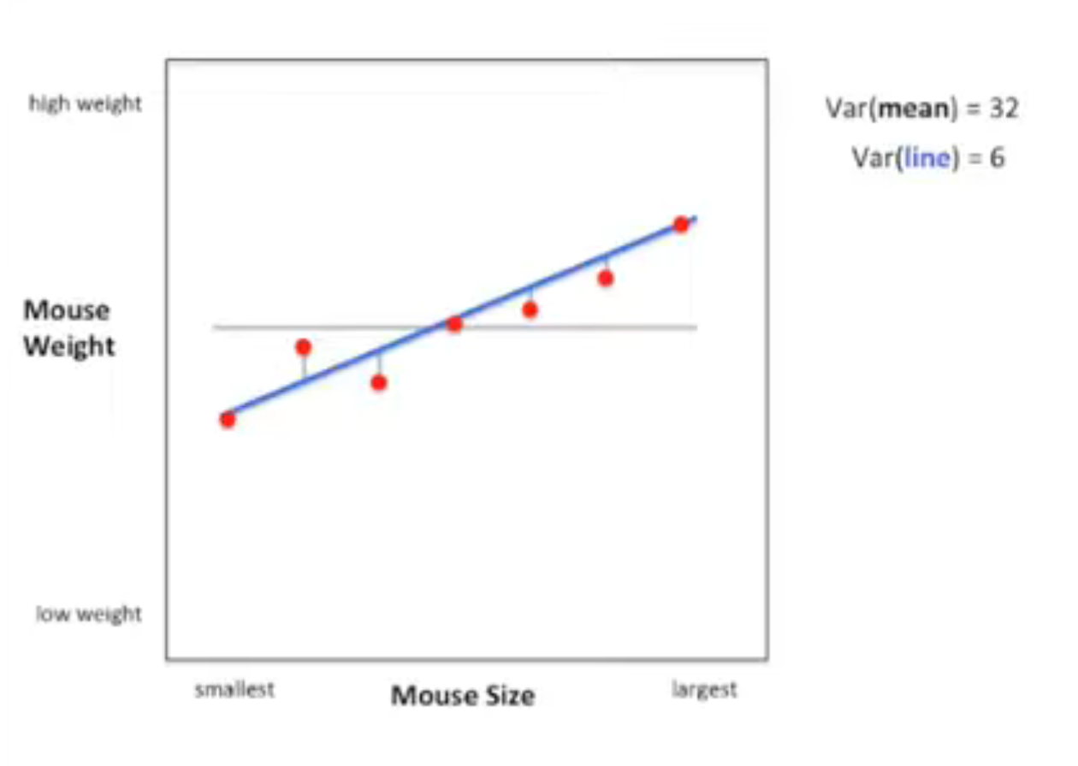
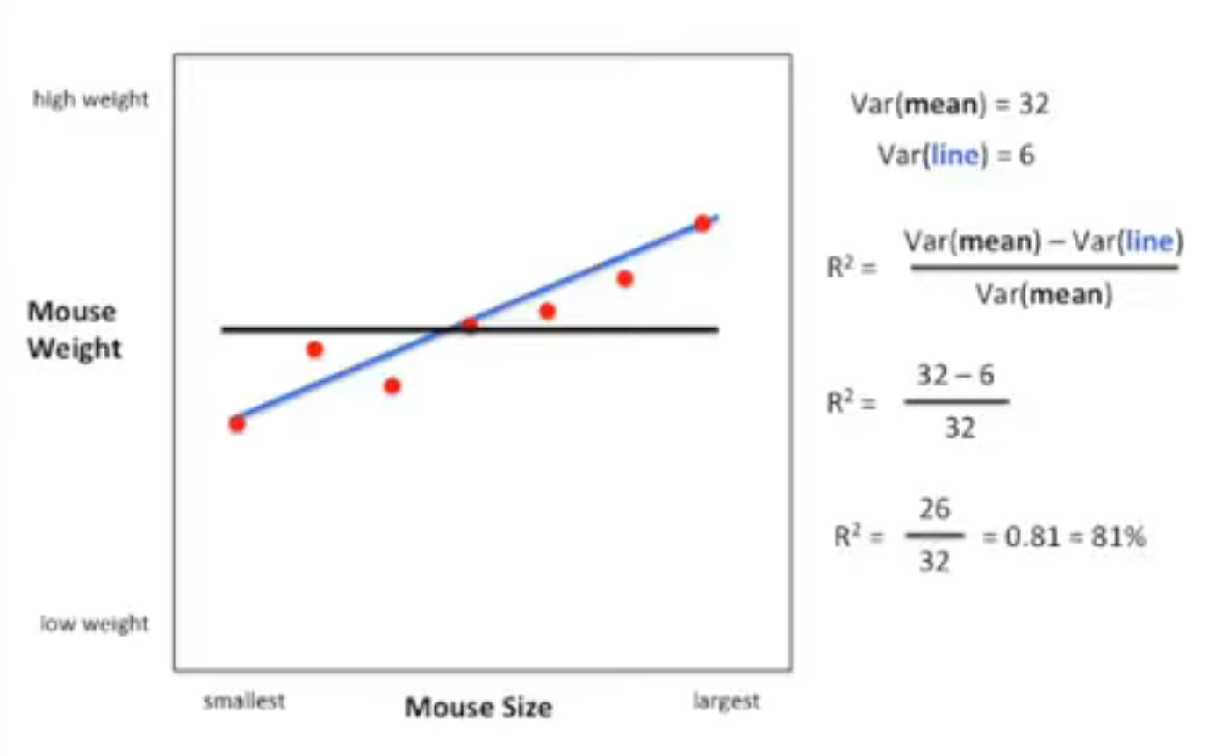
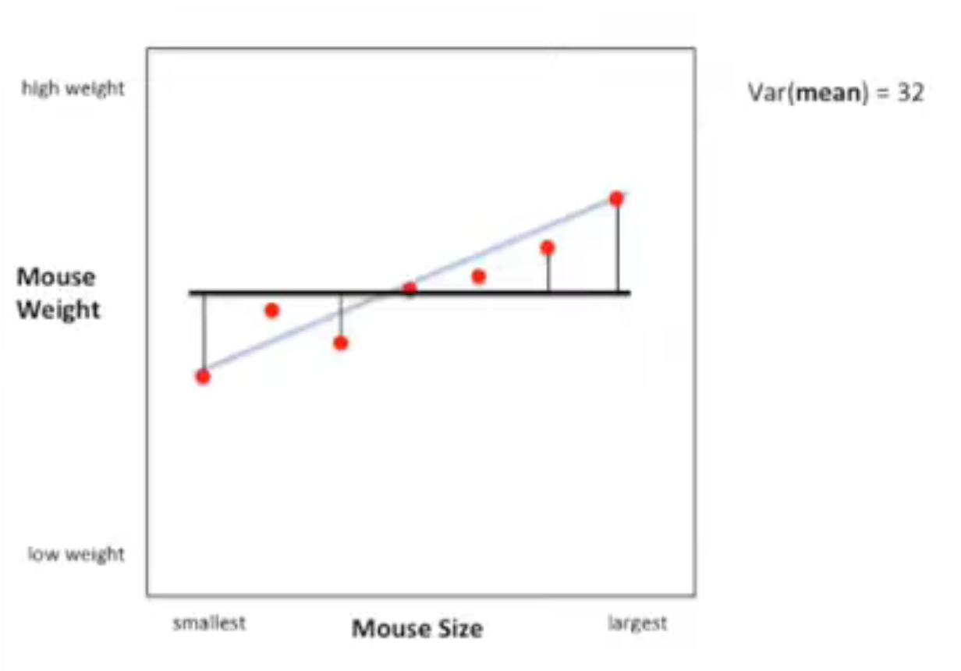
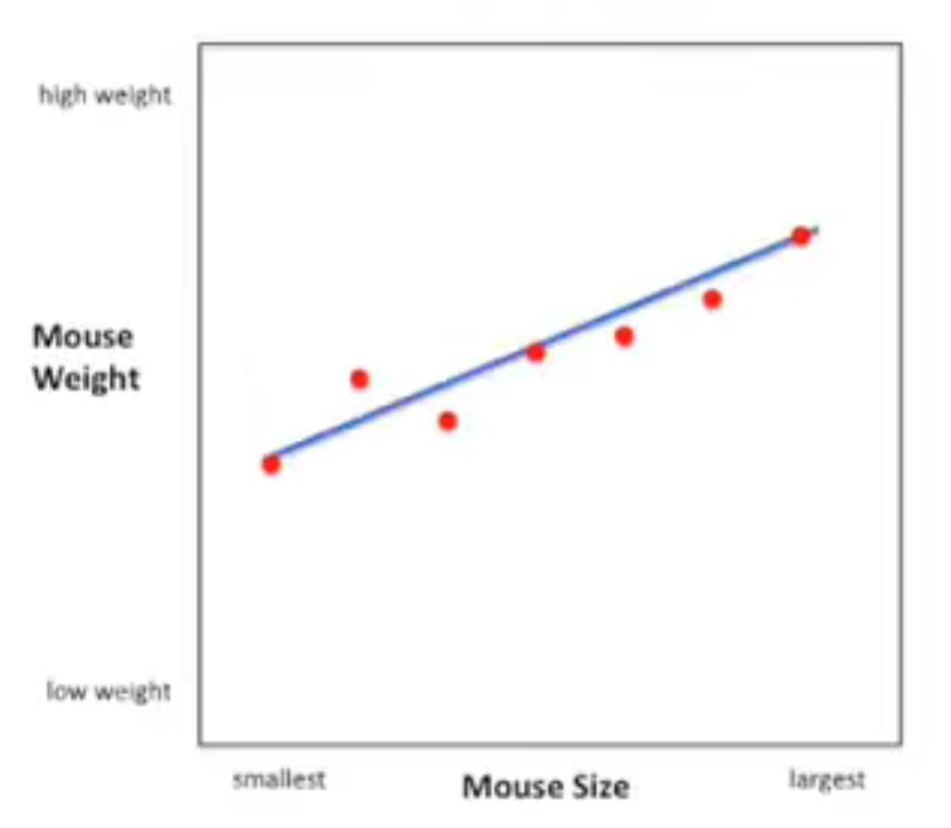
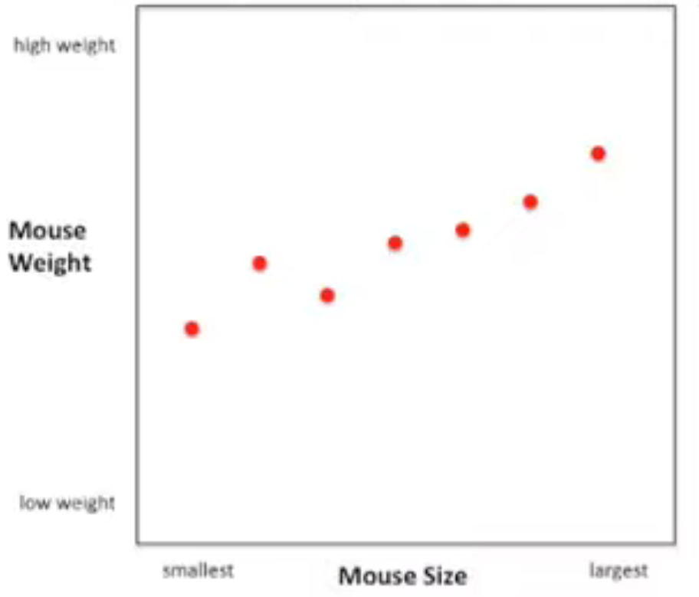
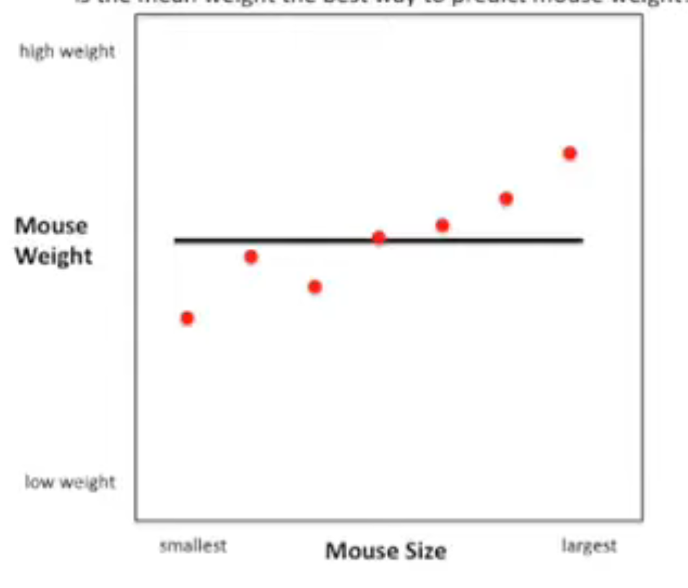
Performance of a Regression Model 1/2
R² (R Squared) is the proportion of the variance in the dependent variable explained by the independent variables in a regression model:
Regression model
Base model (mean)
R-squared, Clearly Explained - YouTube

Slide 44


Performance of a Regression Model 2/2
Mean Absolute Percentage Error (MAPE) measures the average percentage error between actual and predicted values:
A_{t} = Actual, F_{t} =Predicted value

Slide 45


Custom Performance Report
Create your own Performance Report by importing the Train and Test Dataflows:

Slide 46


Training Details Regression Model Car Prices
Ensemble Machine Learning Models:

Slide 47


Apply ML Regression Model in Dataflows
Click on "Apply ML Model"
Select input Dataflow:

Slide 48

Apply ML Model Autoscout24
Import customer data from:
  SQL Server: uaptdderwp.database.windows.net
  Database: Xtreme2022
  Login: poweruser, Password: P@ssw0rd
  Table: Data.ML_CustomerCars
Change Column names to match Input Features ML Model
Apply ML Model to add the prediction column

Slide 49

Visualize predictions in Power BI
Import the Predictions and visualize the data:

Slide 50

Exercise - EDA Bodyfat - Statistics
Which filters to apply?
Which Calculated Columns to add?
Which Columns to remove?

Slide 51

Exercise - EDA Bodyfat – Statistics - Solution
Added Columns:
[BMI] =
[#"Weight (kg)"]/ Number.Power(
[#"Height (cm)"]/100,2 )
Applied Filters:
[#"Height"] >= 140
[#"BodyFat %"] >= 0.1
Removed Columns:
[Density]
[Heighth (inch)]

Slide 52

Exercise - EDA Bodyfat – Feature Selection
Which columns are Feature candidates based on the Correlation Matrix and / or on domain knowledge?

Slide 53
Exercise - EDA Bodyfat – Feature Selection - Solution
Which columns are Feature candidates based on the Correlation Matrix and / or on domain knowledge?

Slide 54

Regression Model Performance Body Fat%
Input: Density

Slide 55

Regression Model Performance Body Fat%
Input: Weight + Height

Slide 56

Regression Model Performance Body Fat%
Input: Abdomen, Weight, Height + BMI

Slide 57

Regression Model Performance Body Fat%
Input: Abdomen, Weight, Height, Hip + Thigh

Slide 58
Bodyfat Classification Model
Add an extra column to the Bodyfat Dataflow:
  IsOverweight:
  if [#"Bodyfat %"] >= 0.25 then 1 else 0
Train a ML Binary Classification Model with output IsOverweight
Evaluate the Performance

Slide 59

Bin. Classification Model Performance Overweight
Input: Abdomen, Weight, Height, Hip, Thigh + Age
Area under (ROC) Curve
Precision
Recall
Confusion Matrix
Probability threshold

Slide 60



Performance Classification Model
Confusion Matrix is a table that summarizes the actual versus predicted classifications of a classification model.
Precision: "Out of all the instances predicted as positive, how many were actually positive?"
Recall/Sensitivity: "Out of all the actual positive instances, how many were correctly predicted as positive?"

Slide 61

Custom Performance Report: Classification
Create your own Performance Report by importing the Train and Test Dataflows:

Slide 62

Performance Classification Model Advanced
ROC (Receiver Operating Characteristic) curve is a graphical representation of a classifier's performance across different probability threshold values.

Slide 63
Lessons learned ML in Power BI + Fabric
Power BI is very usable for EDA with some Python + DAX magic
ML + Light-GBM in Fabric can produce good models if:
  data correctly cleaned
  input features carefully selected
  enough good quality training data
2024Q1 Auto-ML for Fabric will be released:
  Hyperparameter tuning and FAML
For more advanced scenario's:
  call a Data Scientist…

Slide 64

Questions

Slide 65




Thank you!
Session evaluation
Download slides, code samples + video:
http://tinyurl.com/ml-powerbi
Usefull links:
How to train models with SynapseML - Fabric
Data science tutorial - get started – Fabric
Welcome to LightGBM’s documentation!
Questions, reach out to me:
info@arthurgraus.nl
https://www.linkedin.com/in/arthurgraus

