Slide 1


Embedding Power BI reports in your own portal
Joël Vangrunderbeeck
Eager to learn, happy to share...
BI Consultant @Bmatix
Joel.vangrunderbeeck@bmatix.be
https://www.linkedin.com/in/joël-vangrunderbeeck/

Slide 2




Slide 3







Bmatix Belgium and Luxembourg
Belgium ±60
Founded
Headcount
Luxemburg ±14
2010
>74
Kontich
Genk
Heusden
Belgium
Luxemburg
Offices
4
>8 yrs
Average experience
Financials
Active Customers
Belgium
Luxemburg
The Netherlands
Switzerland
>7.5M €
>70

Slide 4
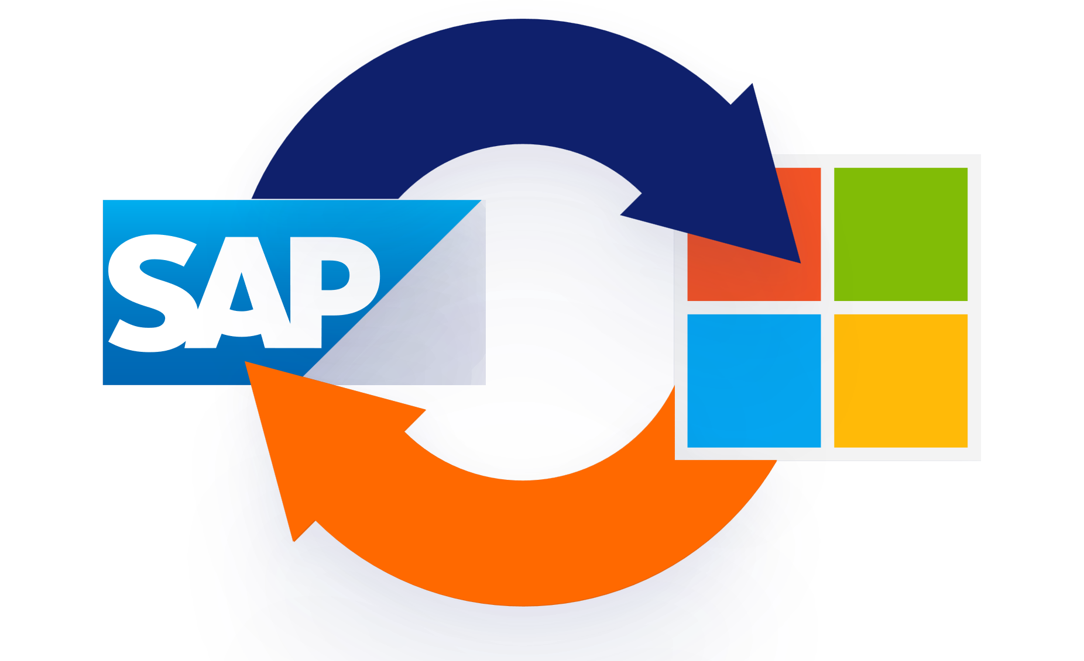







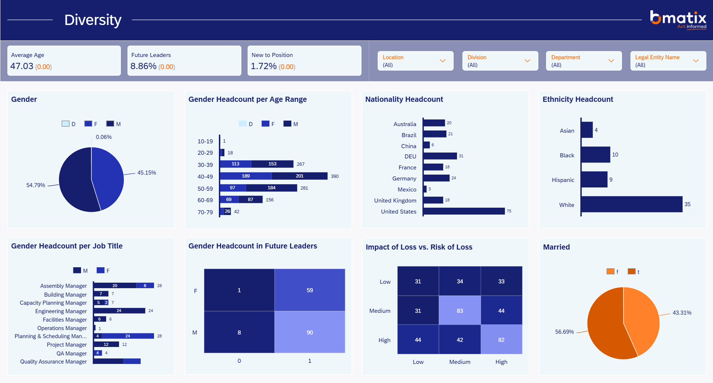




What we do
Consultancy
BI Study
Solutions
SAP to Microsoft Extractor
Staffing
Working Capital
Go Beyond Analytics
Demand Planning

Slide 6
Table of Contents: Power BI Embedded Analytics
What is Power BI Embedded Analytics
Different kinds of embedding
Pricing
Embedding Setup Power BI
API Calls
Reports without security
Reports with security
New features
Questions

Slide 7
What is Power BI Embedded Analytics: Use case
Retail chain
Internal users have no or minimal communication with corporate
  Need to view sales reports
  Need to view stock reports
External users/Customers have no communication with corporate
  Need to view stock reports

Slide 8
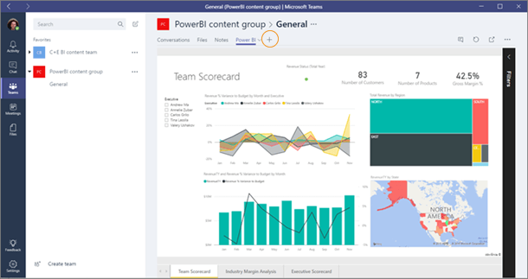
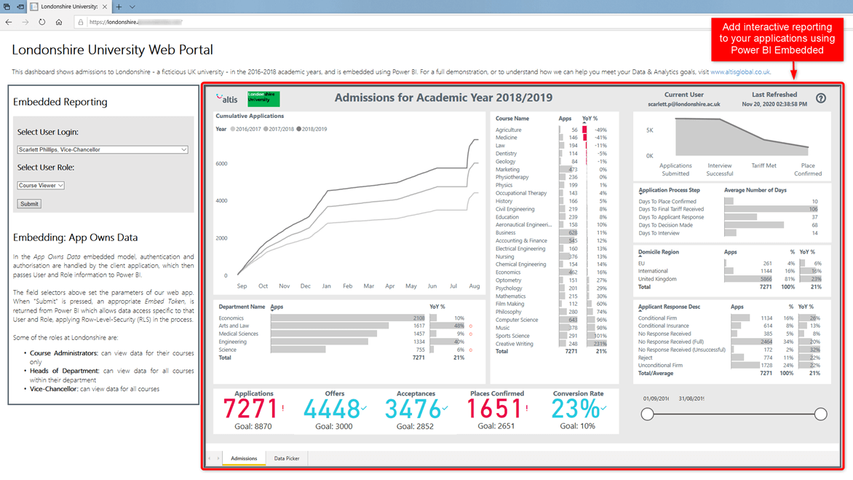
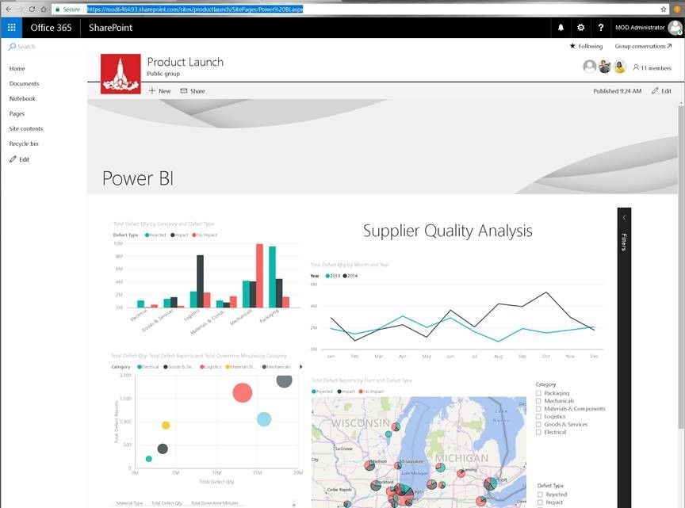
What is Power BI Embedded Analytics
Embedding a report outside of Power BI portal

Slide 9
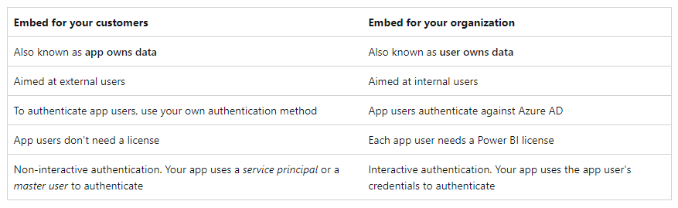
Different kinds of embedding
Embedding in your organization
Embedding in a custom application
          Custom client portal: Power BI in Your Apps | Microsoft Power BI

Slide 10
Embedding Setup Power BI: What do you need
Power BI pro account
Premium/Fabric capacity workspace
Published report
App registration rights on Azure Active Directory + Admin to consent
The ability to add code to your application

Slide 11
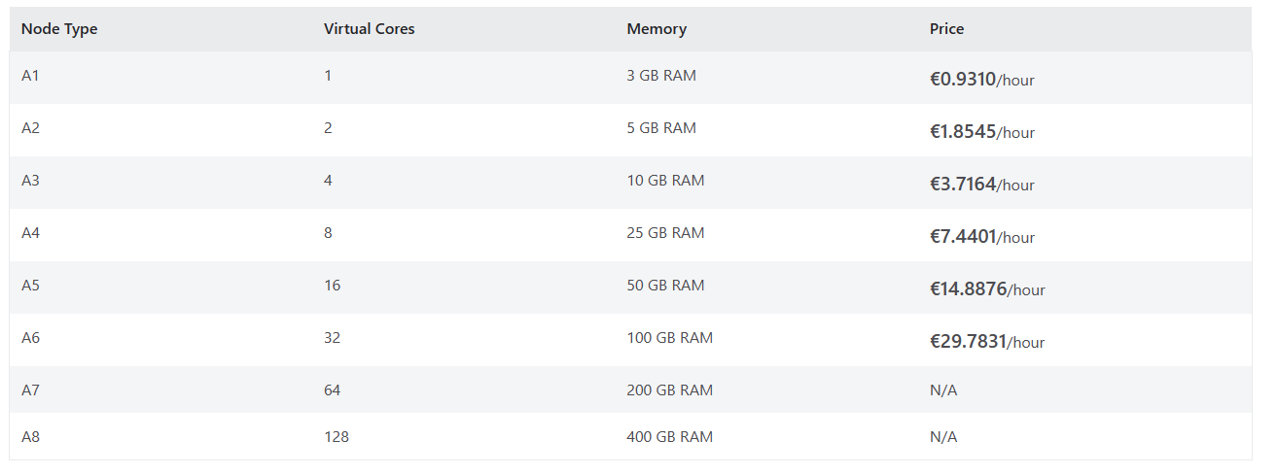
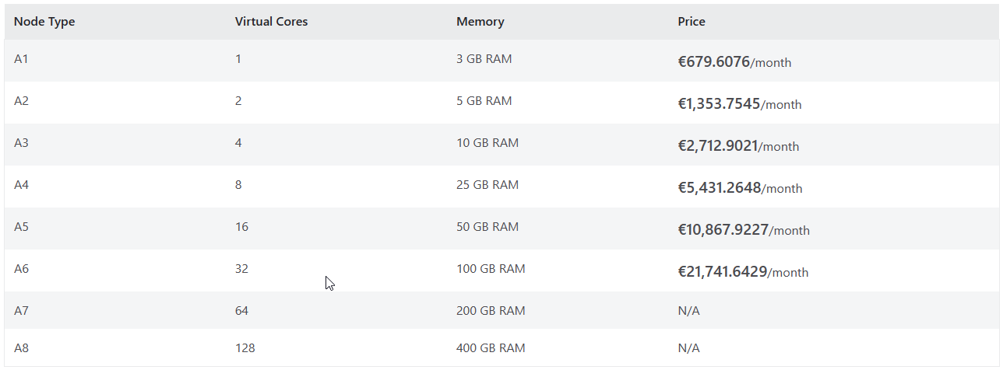
Pricing
Power BI Premium P
Power BI Embedded A
Fabric F

Slide 12
Different kinds of embedding: Embedding for your organisation
Sharepoint
Teams
Dynamics
Salesforce
…

Slide 13
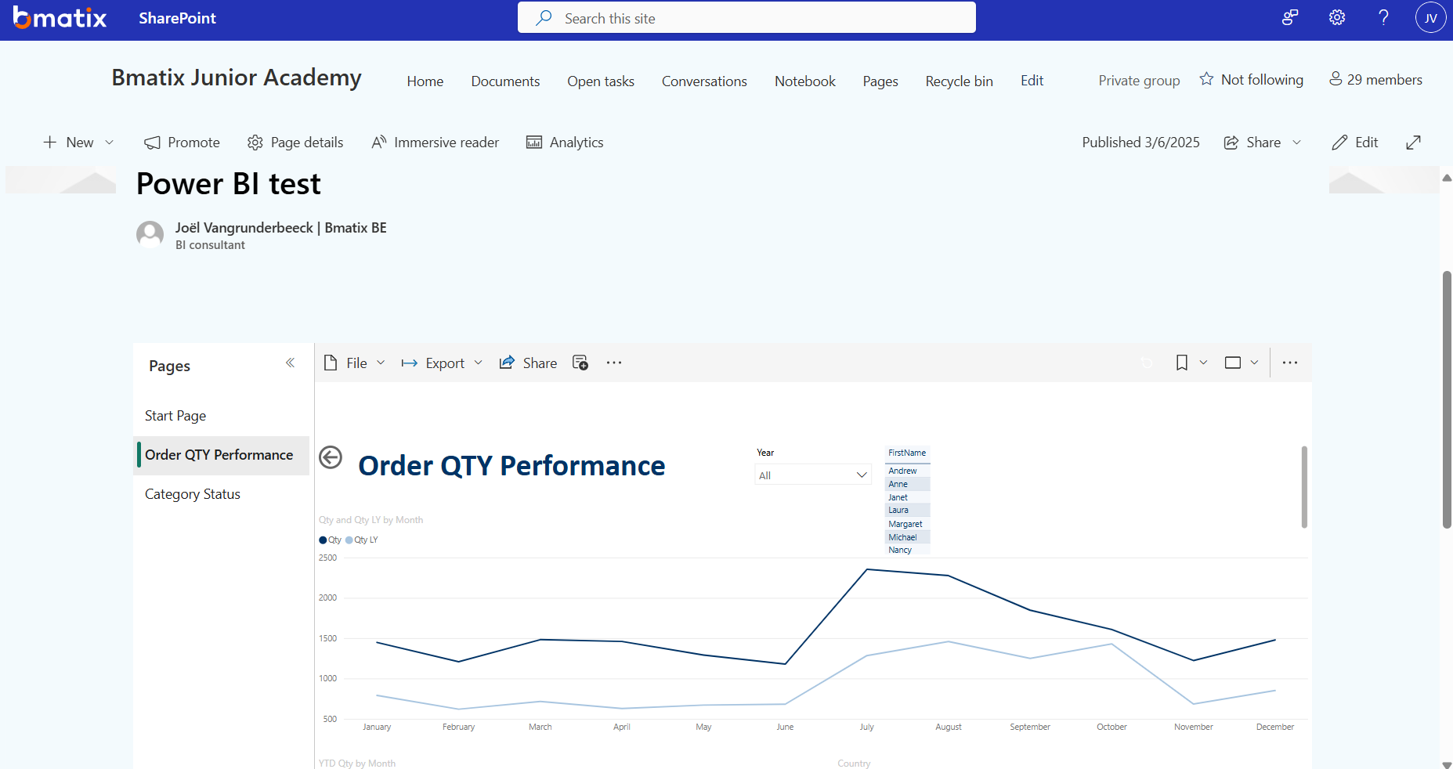
Different kinds of embedding: Embedding in sharepoint
Power BI test

Slide 14
Different kinds of embedding: Embedding in a custom application
Pro’s
        User only needs to login in custom application
        Application manages security and can be used in Power BI
        No Power BI license needed for report viewers
        No knowledge of Power BI needed by users
Cons
  A bit of development needed
  API knowledge needed
  Not for enterprise wide use (not a replacement for Power BI premium)

Slide 15
Embedding Setup Power BI
Create Power BI embedded capacity
Allow service principals to use Power BI APIs
App registration
Set up Premium workspace
Publish report
  Give member access to workspace in Power BI

Slide 16
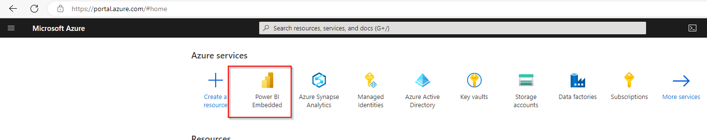
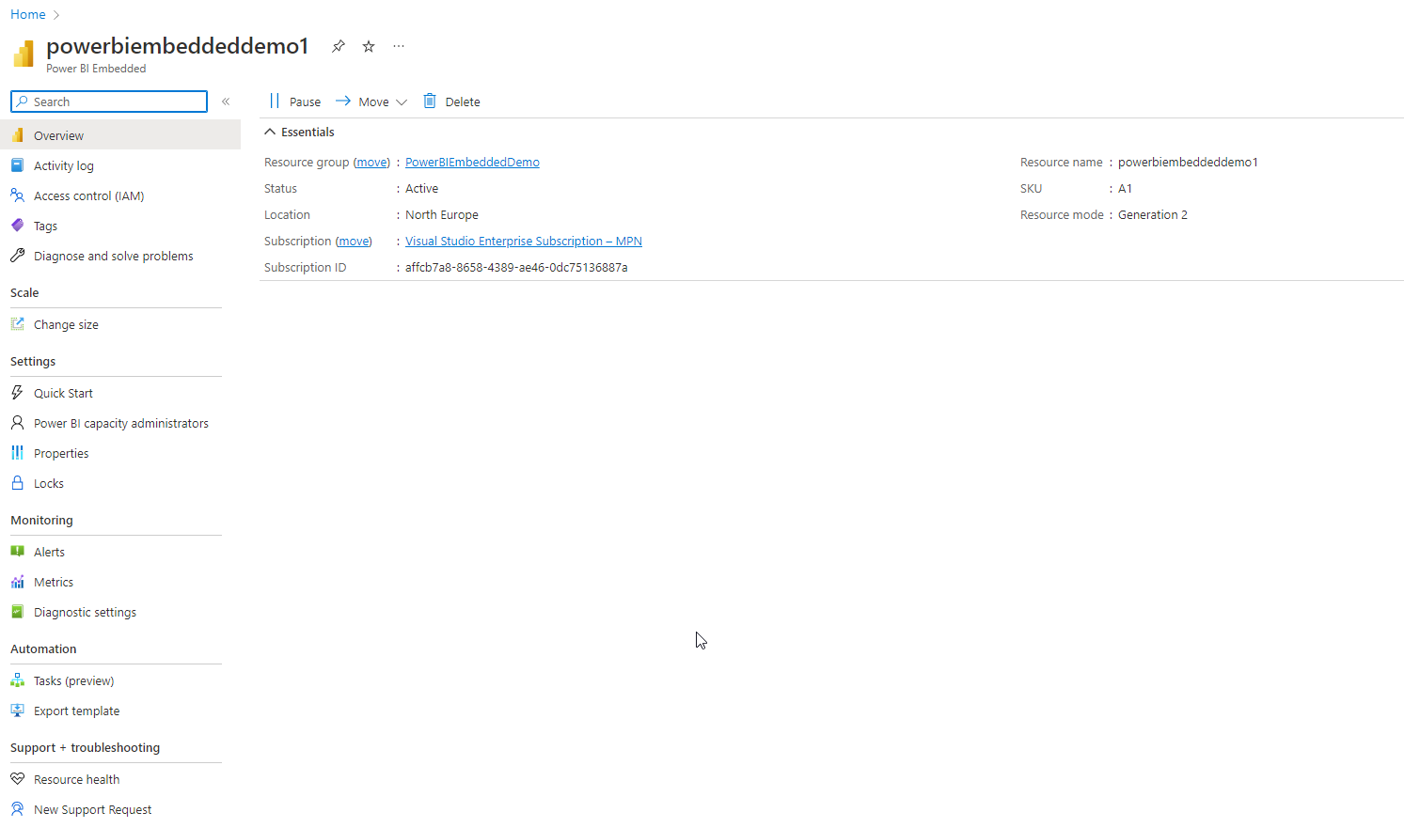
Create Power BI embedded capacity

Slide 17
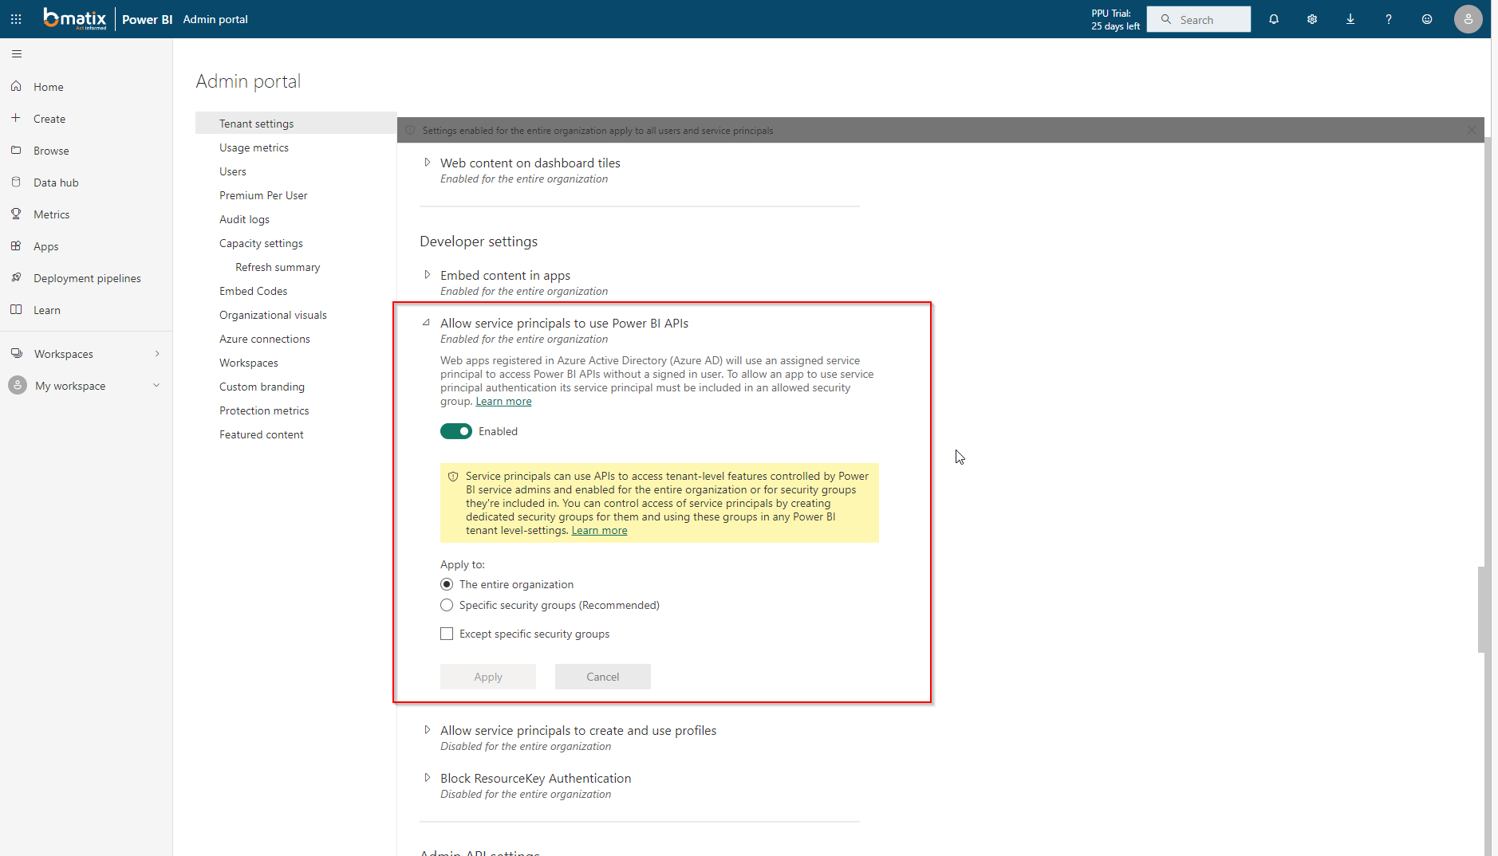
Allow service principals to use Power BI APIs

Slide 18
App registration
Create app
Create secret
Grant API permision to read reports

Slide 19
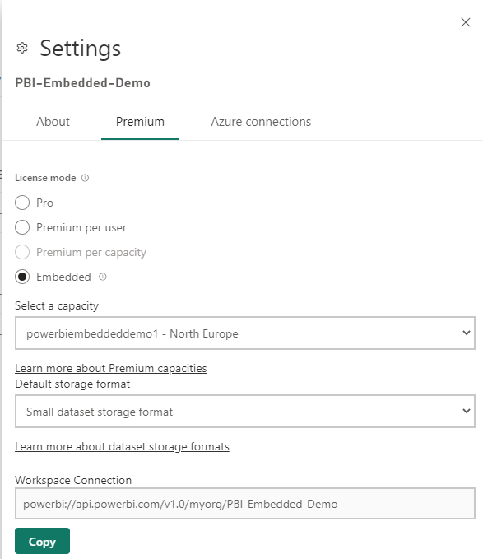
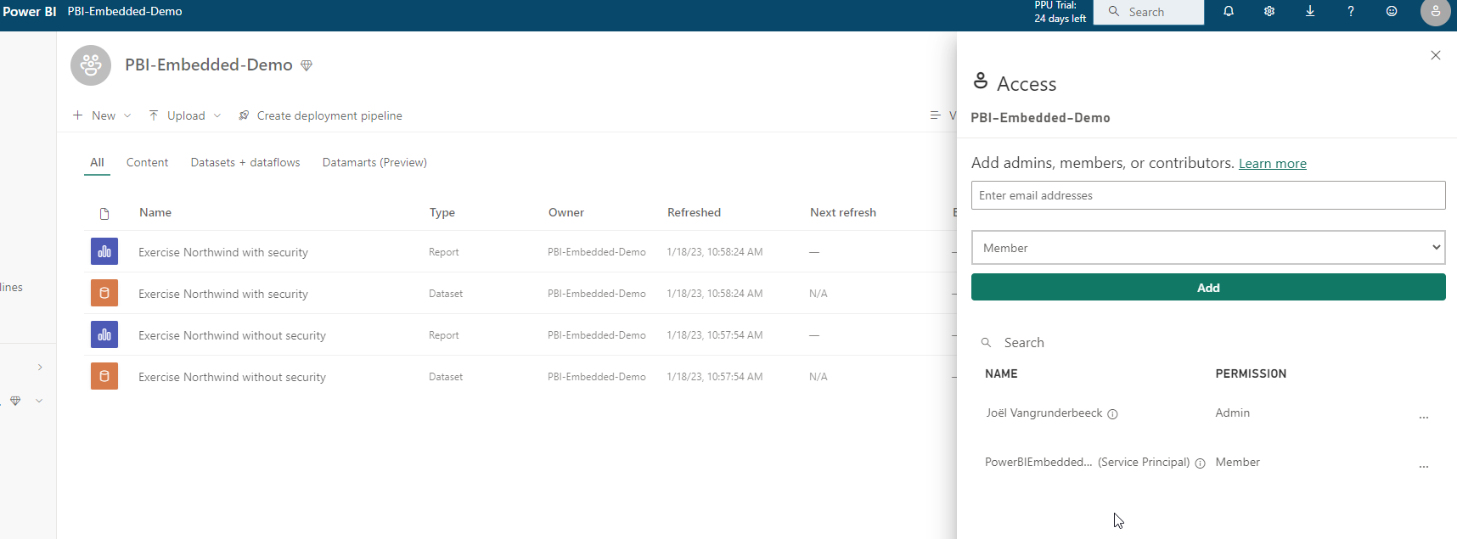
Create premium workspace
Create premium workspace with embedded capacity
Add App as member to workspace

Slide 20
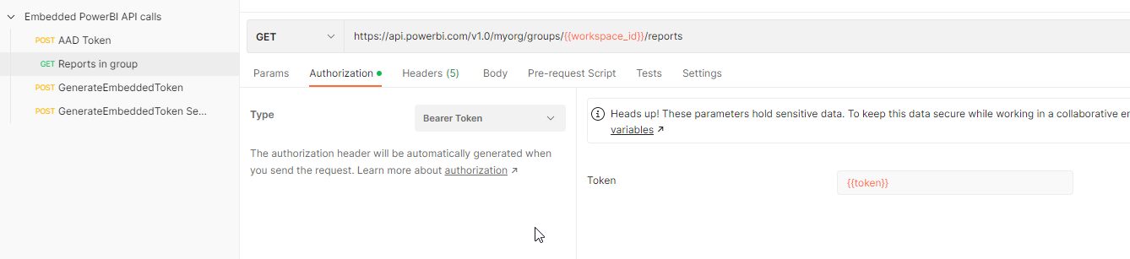
API Calls: Report without security
GET Reports in group

Slide 21
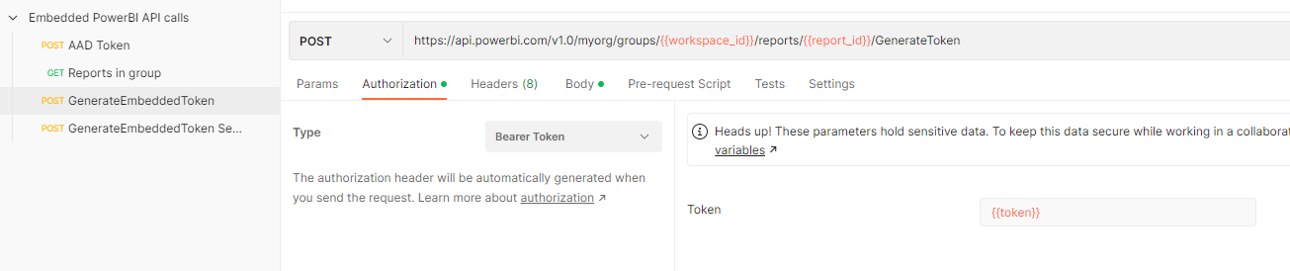
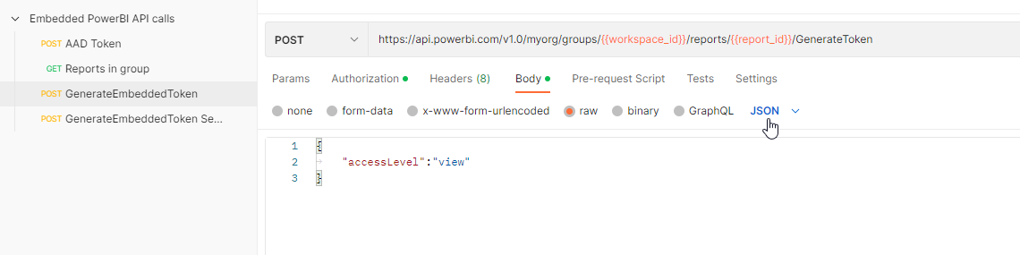
API Calls: Report without security
POST GenerateEmbeddedToken

Slide 22
API Calls: Power BI playground
https://playground.powerbi.com/en-us/
Generate code for application

Slide 23
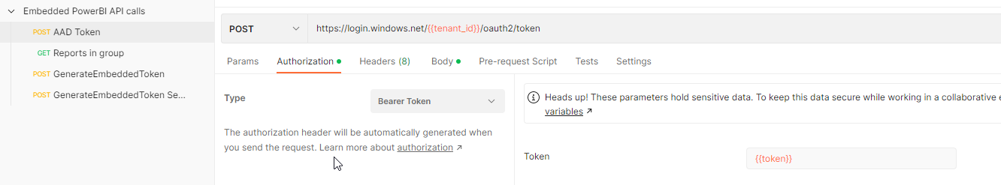
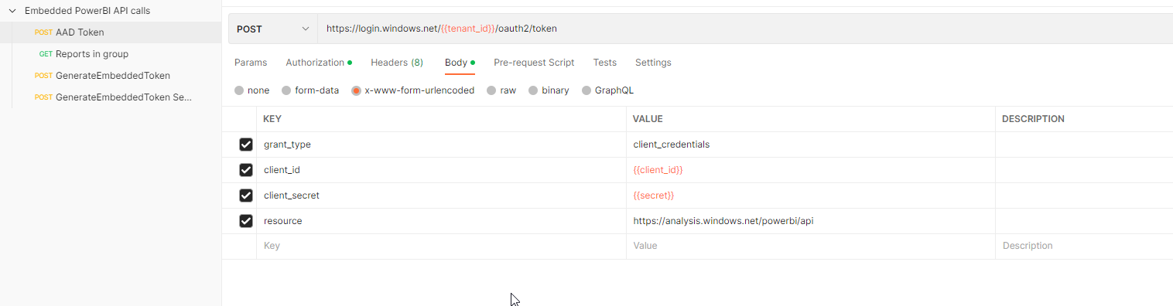
API Calls: Report with security
POST AAD Token

Slide 24
API Calls: Report with security
GET Reports in group

Slide 25
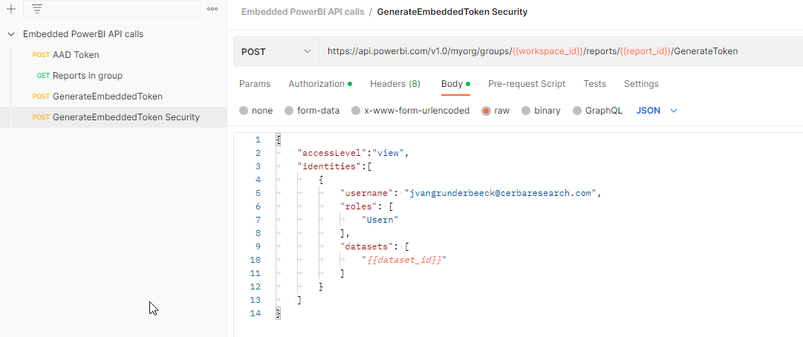
API Calls: Report with security
POST GenerateEmbeddedToken

Slide 26
Power BI embedded playground
Power BI Playground - Showcases

Slide 27
Power BI Embedded new features
Released
Using Microsoft fabric capacity
Private preview
Power BI embedded with Direct lake semantic model

Slide 28
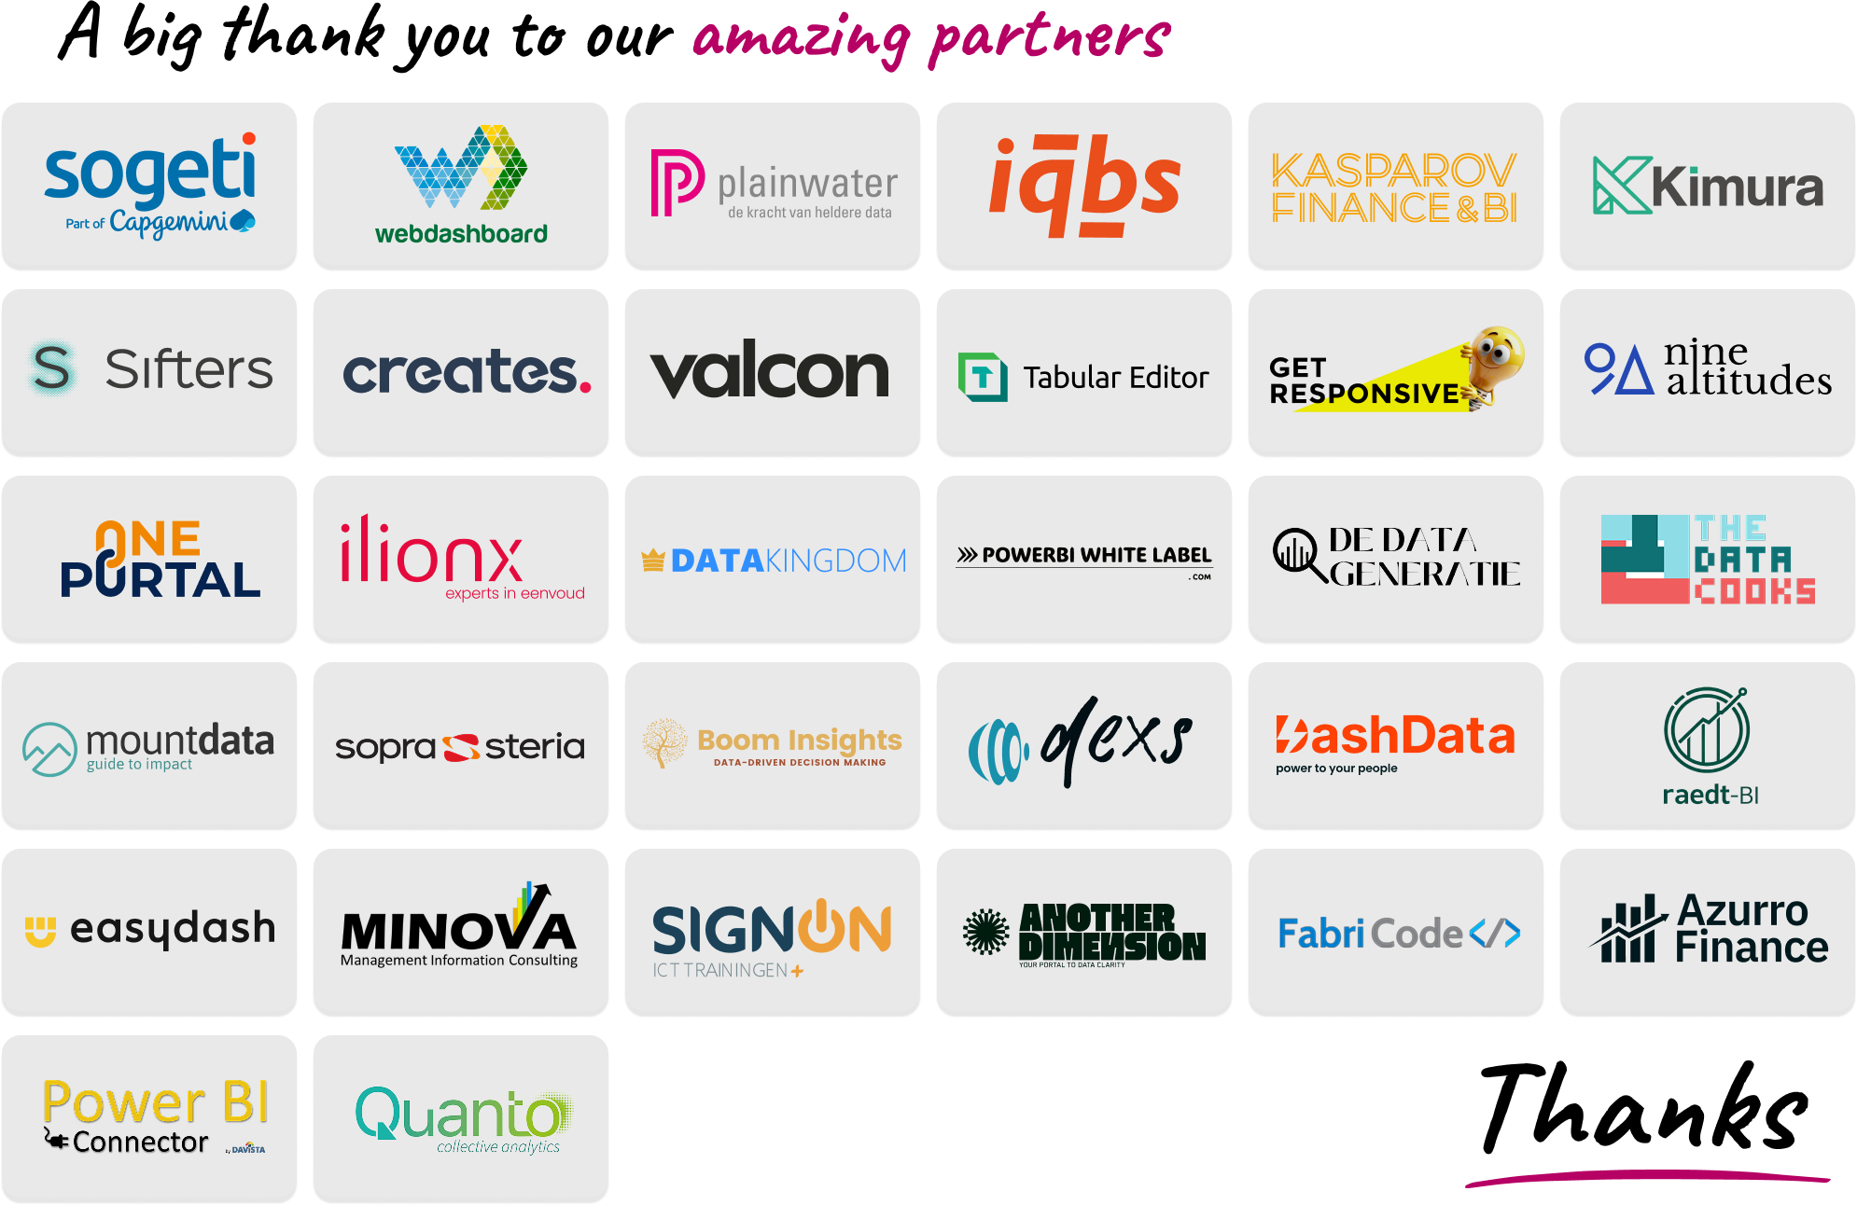

Slide 29


Bmatix BE
Satenrozen 10
2550 Kontich
Belgium
+32 3 844 26 05
Charlotte Pavic
Business development
+32 488 185 201
Charlotte.pavic@bmatix.be
Jan Vautmans
Managing partner
+32 498 511 803
Jan.vautmans@bmatix.be
Bmatix LU
Zone Industrielle, 22
L-8287 Kehlen
Luxembourg
+352 24 84 12 01

Slide 30


